Slide 1
Introduction to Authority Control
Rosemary Groenwald, Mount Prospect Public Library
Laura Murff, Lisle Library District
Shelly Sandstrom, Naperville Public Library
Notes:
Thank you for coming to our Authority Control Intro session today.
Paul Frank has presented an introduction to the concepts of authority control, why it’s important now and in the future, and an overview of how authority records are created using content standards and also using MARC format for authority records.
We now would like to use the rest of the session today to elaborate more specifically on each type of Heading record found within MARC 21 format.
I’d like to introduce today’s presenters.
I’m Shelly Sandstrom, I’m the Cataloging Librarian at Naperville Public Library.
Also presenting today will be Rosemary Groendwald, Head of Technical Services at Mt. Prospect Public Library,
and Laura Murff, Head of Technical Services at Lisle Public Library District.
We’ll be presenting the basics of Authority Records formatted using MARC21 records today, it’s not a comprehensive deep dive, but rather an overview of what information is represented in MARC authority records, and how to use this information when creating or editing MARC bibliographic records. While we won’t be covering every detail of every part of each Heading record, we hope to provide a good basis for understanding Authority Control within MARC 21 and how it can be used in a cataloging process.

Slide 2
Authority Records using MARC 21
Authority Records provide information for use of Name, Subject, Series, Genre and Uniform Title headings and subdivisions in Bib. Records
Today we are covering authority records constructed using MARC 21 format for Authority Data
Library of Congress Controlled Vocabularies - LCSH, LC/NAF and LCGFT
Other Controlled Vocabularies covered today - GSAFD and OLACVGGT
Notes:
Authority Records provide information for the use of Name, Subject, Series, Genre and Uniform Title Headings and varying types of subdivisions in Biibliographic Records.
We’ll be covering Authority Records constructed using MARC 21 format for Authority Data that correspond to Bibliographic Records creating using MARC21 format for Bibliographic Data.
Some of the Authority Records will contain Established Heading 1XX fields that have an established heading or Access Point derived from a controlled vocabulary, or thesaurus.
We’ll be covering 3 controlled vocabularies maintained by the Library of Congress, LCSH, NAF, and LCGFT terms
Library of Congress Subject Headings, Library of Congress/NACO Authority File and Library of Congress Genre/Form terms
Rosemary will also cover headings from 2 other controlled vocabularies ; GSAFD (Guidelines on Subject Access to Individual Works of Fiction, Drama) and OLACVGGT (OLAC Video Game Genre Terms)
The Library of Congress maintains an Authority file which includes controlled vocabularies created by them or as part of the NACO or SACO process (more on that later) - lcsh, lc/naf and lcgft
Today we want to show you how to interpret the basics of Authority Records constructed using theMARC 21 Authority format, includingr fields, indicators, subfields and codes.
By being able to interpret these authority records, you can then determine which headings and subdivisions can be used, and how to represent them as name, subject, series, genre and uniform title headings in bibliographic records within your online catalog.
.

Slide 3
MARC Authority Record Basic Structure
Leader | Numbers or Coded Values
00X | Control Fields
01X-09X | Numbers or Code Fields
1XX | Headings Information
2XX/3XX | Complex References
4XX | See From Tracing Fields
5XX | See Also Tracing Fields
6XX | Series Treatment/Complex References/Notes
7XX | Heading Linking Fields
8XX | General Information
Notes:
Similar to MARC21 bibliographic records, MARC21 authority records contain field tags, indicators and data elements.
Rather than describing something like a book or a movie or any of the types of things that are described in Bibliographic Records ...
Authority Records hold information on headings and subdivisions that can be used in Subject, Name, Title, Gennre or Series Headings within a bibliographic record.
This table shows the basic breakdown of fixed fields and variable fields within the MARC21 authority record structure.
The 1XX field in an authority record contains information on headings. This field is the starting point for all other information found in an authority record.
For instance a 100 field in an Authority Record provides information about a Personal Name Heading.
A 150 field in an authority record provides information on a topical subject heading, a 155 provides information on genre headings.
Do you see a relationship between these Authority Record tags and Bibliographic Record tags?
There is a correlation between field tags in authority and bibliographic records ;
Tthe last 2 digits in the Authority Tags correspond to the last 2 digits in Bibliographic Records
A 150 field in an Authority Record indicates that there is information in that Authority Record that corresponds to a 650 field in a Bibliographic Record
The other fields in an Authority Record contain coded information concerning the Heading found in the 1XX field.
For the rest of the session today, we’ll define and elaborate on relevant fields and the information they supply within each type of Authority Record, and how that information can be used by you to provide established headings in the bibliographic records you create or edit, thereby providing consistent access for your staff and customers.

Slide 4
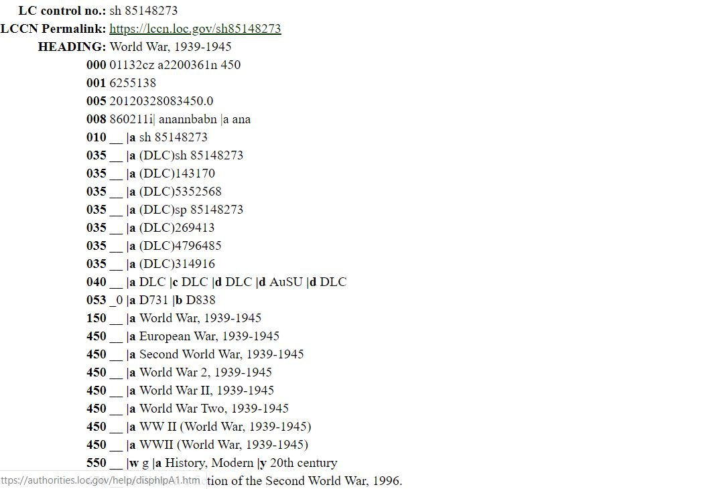
Library of Congress Authority Record
Leader
Fixed Field
authorities.loc.gov
Notes:
Before beginning to describe the individual field tags and their contents, I want to point out something that can be confusing about Authority Record display..
Depending on what system you are searching, the Authority Records may not appear identical. This isn’t unique to Authority Records, Bibliographic Records can differ from system to system.
This is particularly true when looking at the Leader and the 008 field in Authority Records.
These fields contain a defined number of character codes, and interpreting those codes is dependent on knowing what information is provided.
So, to start, I thought I’d show the difference between an authority record found in the Library of Congress Authority file on the Library of Congress site, and the same authority record in OCLC.
The Library of Congress site can be found at authorities.loc.gov = Library of Congress Authorities
This is an authority record for the established heading for World War II, the authorized heading is found in the 150 field here - World War, 1939-1945.
I’ve indicated where the Leader and the 008 fields are in this record with arrows. We’ll define those fields in a while, for now just notice how they display here in the LC record, and now...

Slide 5
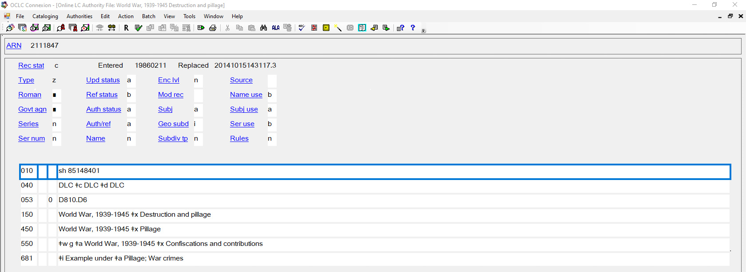
OCLC Authority Record
Leader and Fixed Field
Notes:
… how they display in the OCLC record.
In the OCLC record, the Leader and 008 field are combined and each of these fields has an abbrerviated description label - for instance the Red Box outlines the term Subj use on this record
but in the LC Authority record there is just a string of letters and numbers (go back to previous slide)
The Variable fields in the records look more or less the same with some exceptions - the subfield a in each tag is shown in the LC record, but only implied in the OCLC record.
My point here is that depending on where you are viewing the LC authority record, you may be looking at somewhat different displays. Your catalog authority records may look slightly different as well.
We’ll be using records mostly from OCLC and SkyRiver Authority Files today, which display similarly. We will define The Leader and 008 field elements by a numbered position, which is universal among all systems. The variable fields are defined by their field tags and subfields.
Something to be aware of as you are looking at and interpreting MARC authority records.

Slide 6
Leader
• Provides information for the processing of a record
•Contains Numbers or coded values – mainly for computer use
•Identified by character position – 24 character positions long
Notes:
I’m beginning by providing an introductory overall description of the Leader, the Control Fields and the Fixed Field elements as found generally in a MARC21 authority record.
As each of us describes different types of Heading Authority Records, we’ll point out things to look for in these introductory fields as applies to that type of heading.
The Leader is the first field in a MARC 21 authority record
It provides information required for the processing of a record.
The data elements contain numbers or coded values and are identified by relative character positions.
The Leader is 24 character positions long and the meaning of the codes or numbers is identified by their numbered position within that string.
Much of the information in the Leader is for computer use in reading and processing the record and is computer generated.
For the most part you don’t need to know the meaning of each character for your use of authority records.

Slide 7
Leader Display
OCLC
LC
Notes:
Here are leaders from the Authority File as it displays in OCLC (on the top) and the Library of Congress authorities site on the bottom.
You can see once again that the display is very different between these 2 systems.
Here I indicated with the arrow the 17th character position in the leader. The code “n” indicates the encoding level. That shows that this is a complete record. If the value were “o”, that would indicate an incomplete record.
Some other elements within the leader, as shown more explicitly on the OCLC record ; Rec stat (Record Status) is coded “c” = corrected ; The “z” is Type of record=Authority data ; The “a” is Character Coding Scheme,
As I said, this information is meant for machine use, you generally will not use this it for providing access points in a bibliographic record, but I wanted to show you this in case you see it and wonder - what the heck is that?

Slide 8
0XX Control numbers, call numbers, coded data
010 LC Control number - Indicates Controlled Vocab being used
beginning with “n” = LC Name Headings
Beginning with “no” = LC Name heading created in OCLC
beginning with “sj” = LC Children’s Subject Headings
Beginning with “sh” = LC Subject Headings
Beginning with “gf” = LC Genre/Form Headings
040 Cataloging Source
053 LC Classification Number
082 Dewey Classification Number
loc.gov/marc/authority
Notes:
The 0XX fields in authority records contain a variety of different types of information.
The Library of Congress Control number is in the 010 field
The first 3 positions in the LC Control # indicate which type of LC Heading the record is
-beginning with “n” indicates LC Name Headings,
-beginning with “no” indicates LC Name Headings created in OCLC
-beginning with “sj are LC Children’s Subject Headings,
-beginning with “sh” are LC Subject Headings
-beginning with “gf” are LC genre form terms
The 040 field indicates the Cataloging Source institution
The 053 is LC Classification Number or
The 082 field has the Dewey Decimal Number associated with the record.
There are more 0XX fields and their definitions can be found at the LC MARC 21 formats site seen in red here loc.gov/marc/authority
- this is also included on the “Sources” slides at the end of the presentation

Slide 9
008 Fixed Field
Character Position | Value
09 | Kind of record - (Established, Reference)
11 | Subject Heading system - (LCSH or other))
12 | Type of series
14 | Heading Use – main or added entry
15 | Heading use – subject added entry
16 | Heading use – series added entry
Highlighted Character Positions indicate how the 1XX field in the Authority Record can be used as a heading in a Bibliographic Record : Main or Added Entry (1XX or 7XX), Subject Added Entry (6XX) or Series Added Entry (8XX)-
Notes:
The 008 field is referred to as Fixed-Length Data Elements, or Fixed Field Codes.
It’s presented in 40 character positions which contain information in an abbreviated form.
Like the Leader, many of the codes are for machine usage, but there are some elements that provide information to catalogers.
As we discuss each type of Heading Record ; Subject, Series, Name, Genre or Title, we’ll highlight codes within the 008 field that apply more specifically to each type of Authority Record.
Here are some of the element codes that are found in the 008 Fixed Field that we will elaborate on later in the presentation:
Character position 9 indicates the kind of Authority Record you’re viewing, either Established or Reference Record
Character position 11 indicates the Subject Heading system being used to create the 1XX Heading
Character position 12 indicates the the type of series heading represented in the 1XX
Character position 14 indicates whether the 1XX field contains an established heading that can be used as a main (1XX) or added entry (7XX) - or in other words a name entry in a Bibliographic Record
Character position 15 indicates whether the 1XX field contains an established heading that can be used as a subject in a Bibliographic Record
Character position 16 indicates whether the 1XX field contains an established heading that can be used as a series in an 8XX field in a Bibliographic Record

Slide 10
008 Fixed Field Display
loc.gov/marc/authority
SkyRiver
Sierra
Notes:
Like the Leader, the 008 Fixed Field Elements can display differently in different systems
Here, the top display is the 008 Fixed Field in a SkyRiver Authority Record
The Bottom display is the 008 Fixed Field in a Sierra Authority Record
The red outlines show where the element in each record is that indicates the heading can be used as a Subject Main Heading ; character position 14 ; the value a means that it can be used as a Subject Main Heading
The nice thing about OCLC and SkyRiver records is they supply an abbreviated label to each element, rather than just relying on counting out the positions ; Subj use, Ser use, Auth/ref.
The 008 in Sierra can be expanded to display all the individual elements with choices for each.
Just as in the Leader this demonstrates 008 field display differences in different databases.
To find the value of each element, consult loc.gov/marc/authority
.

Slide 11
Established Heading or Reference Record?
008/09 a - Established Heading b = Reference d=Subdivision
Established Heading 100 -15X in the AR can be used in Access Point lead elements in a Bib Record (1XX, 6XX, 7XX, 8XX)
Reference Records contain unestablished headings which refers to an established heading or provides instruction on use of subject subdivisions
Notes:
The 9th Character Position in the 008 Field indicates the purpose of the Authority Record
Code a indicates that the 100 through the 15X field in these Authority Record can be used as the lead element in constructing Access points in Bibliographic Records (1XX, 6XX, 7XX and 8XX fields)
You can copy these headings as they appear in the Authority Record into the corresponding eading in a Bibliographic Record.
Code b indicates a Reference Authority Record which may contain an unestablished heading that refers the user to an established heading ; or may contain a subdivision with instructions on using that subdivision with an established heading in Access points in Bibliographic Records.
The 1XX field in these records may not be used as the subfield a in a corresponding Bibliographic Record Heading. The record will provide instruction or point to a Heading that may be used.

Slide 12
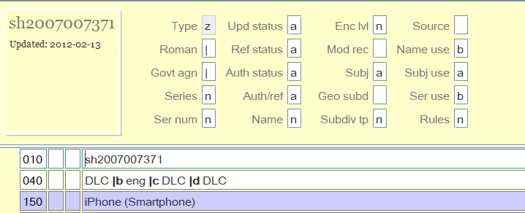
Established Heading Record
1XX Field - OK for use Lead Element in 1XX, 6XX, 7XX or 8XX in Bib Record
Notes:
This is an example of an Established Heading Record.
Here the 008/09 position outlined in red is coded “a” indicating this is an Established Heading Record.
In this example, the 150 Field in this Authority Record - iPhone (Smartphone) can be used as a lead element subfield a in the 650 field in a Bibliographic Record. It can be transcribed exactly as is.

Slide 13
Reference Record
1XX Field - not for use Lead Element in 1XX, 6XX, 7XX or 8XX in Bib Record
260 or 644 Field provide usage instruction
Notes:
This is an example of a Reference Record.
Here the 008/09 position highlighted in the red box is “b” indicating this is a Reference Record.
This record is intended to provide instruction
The 150 Field is not to be used as a lead element in 1XX, 6XX, 7XX or 8XX fields in a Bibliographic Record, but rather as a subdivision
In Reference records there will be either a 260 or a 644 field to provide usage instructions
Here he 260 Field gives instruction to use the phrase “Religious life and customs” as a subdivision under names of countries, cities, etc. for description of the religious practices and customs of those places.
MARC 21 Authority File Records are intended to provide consistently constructed terms and phrases from a controlled vocabulary, using fields tags, indicators and codes.
They also provide instruction on appropriate usage and subdivision of these Headings.
Keep in mind this basic introduction to information and display as we describe in detail Authority Records for different types of Access Point Headings that can be used in Bibliographic Records.

Slide 14
LC Subject Headings
Notes:
Myself, Laura and Rosemary will each be detailing different Headings Authority Records..
I’ll start by describing Library of Congress Subject Heading Authority Records.

Slide 15
Library of Congress Subject Headings
Library of Congress Subject Headings- terms that capture the essence of a topic
List of subject headings maintained by the Library of Congress for use as Subject Access Points in Bibliographic Records
Subject Authority File/LCSH ; Topical, Name Uniform Title and Geographic Subjects
Created by PCC/SACO - using LC Subject Cataloging Manual
loc.gov/aba/pcc/saco
Notes:
Library of Congress Subject Headings (LCSH) are terms that capture the essence of a topic.
The terms within LCSH make up a controlled vocabulary which are then used as subject access points in bibliographic records.
These subject headings are found in the subject authority file maintained by the Library of Congress.
It is popularly known by its abbreviation as LCSH and is sometimes used interchangeably with the phrase subject authority file.
The Library of Congress Subject Authority File includes subject access points for topical, name, uniform title and geographic subjects.
Library of Congress Subject Headings are created using instruction provided in the Library of Congress Subject Cataloging Manual.
Today’s focus is not on how the subject headings are constructed using the rules in the Library of Congress Subject Cataloging Manual, but rather how to interpret and use the information in subject authority records to verify or assign headings in bibliographic records.
LC Subject Headings are created as part of the Project for Cooperative Cataloging/Subject Authority Cooperative Program - PCC/SACO
This program (SACO) enables member institutions to submit proposals for additions to Library of Congress Subject Headings (LCSH)
If interested in becoming a SACO participant, find more information on requirements and training at https://www.loc.gov/aba/pcc/saco

Slide 16
Types of Subject Heading Authority Records
Type of Authority Record | 1XX Field in Authority Record
Name Headings | 100, 110, 111
Geographic Name Headings | 151
Topical Subject Headings | 150
Reference | 150
Notes:
There are different types of subject authority records, just as there are different type of subject headings used in bibliographic records.
The types of subject authority records are:
Subject name established headings which are found in the 100, 110 and 111 fields in their authority records.
Geographic name established headings which are found in the 151 field in their authority records.
Topical subject headings which are found in the 150 field in their authority records.
Reference - The 150 field is not an established heading - The phrase can be used as a subdivision or other element of a heading, there is instruction included
I will break down topical subject heading authority records for you. I’ll mention a few things about the name/geographic subject headings as well, but most of the information about those authority records will be covered in the name authority record portion of the presentation. Those name heading records serve double duty as name and subject records.

Slide 17
150 - Established Topical Subject Heading
Topical Subject Heading :
A heading consisting of a topical subject term.
A record in which the 150 contains an established subject heading·
008/09 contains “a” = established
heading·
008/15 contains “a”= subject heading
Used only as a subject added entry (650) in Bib Record
Topical term headings may be used only as subject added entries -- in 650 field in Bib Reord
Notes:
We’ll start with Established Topical Subject Headings records which contain a 150 field containing an established subject heading
A Topical Subject Heading is a heading consisting of a topical term
9th character in the 008 field is coded “a” - established
15th character in the 008 field is coded “a” = Ok to use as a subject heading
Topical term headings are used only as subject added entries in 650 fields in a Bibliographic Record

Slide 18
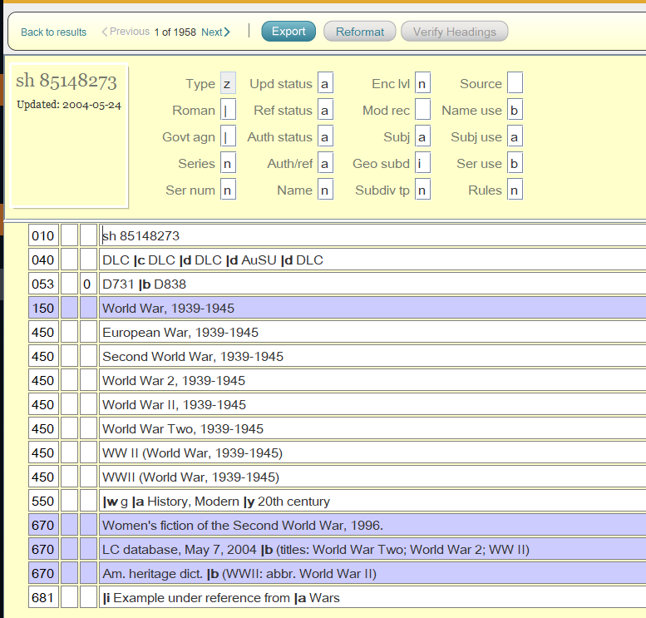
Notes:
Here is a Library of Congress Topical Subject Heading Authority Record
It looks like a bibliographic record in that it has fields, indicators and subfields.
It differs from a Bibliographic Record in that each of these data elements don’t represent a piece being cataloged, but rather represent information about the Heading in the 150 field
The 150 Field contains the phrase World War, 1939-1940 ; in other words World War II
The Fixed Field elements, and field tags indicate that this phrase is the Established Heading for World War II, that this heading can be used in a 650 field in a Bibliographic Record, that this heading cannot be used as a Name or Series Heading in a Bibliographic Record, that this heading can be subdivided geographically, that there are alternate terms for this War that should not be used in a 650 field in a Bibliographic Record, and that there is a broader term for this period - History modern -- 20th century, that could be also be used in a 650 field in a Bibliographic Record.
We’ll start delineating where this information can be found in a Topical Subject Heading Authority Record.

Slide 19
008 - Topical Subject Heading Authority Records
Character Position | Value
06 | Geographic subdivision - Not subdivided geographically (#) or subdivided geographically (a)
09 | Kind of record - Established Heading (a) or Reference (b)
11 | Subject Heading System - LCSH (a)
15 | Heading Use - Subject Added Entry - Appropriate (a) ; Not appropriate (b)
Notes:
The 008 Field in a Topical Subject Heading Authority Record contains coded information in 40 character positions.
As noted, the display can vary from system to system, so the codes are universally defined by their position in the field.
I’ve noted here some of the elements in the 008 field which are relevant and can be useful to know as relates to a subject authority record.
The 6th position indicates if the subject heading can be divided geographically
# = Not subdivided geographically
a = subdivided geographically
The 9th position indicates the kind of record which is represented
a = established heading
b = Reference record
d=Subdivision record
The 11th position indicates what Subject Heading System is used to establish this heading
a = LCSH
b = Library of Congress Children’s Subject Headings
The 15th position indicates if the record is appropriate to be used as a Subject Added Entry in a Bib Record
a= appropriate
b = not appropriate
The next slides will illustrate these codes in use in authority records

Slide 20
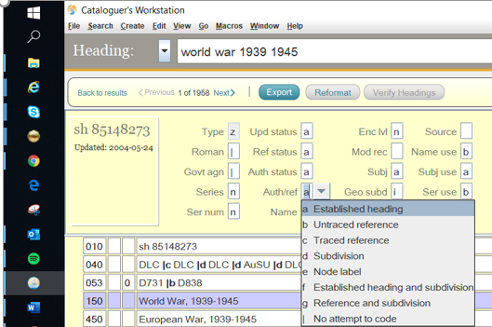
008/09
a = established heading
b = reference record
Notes:
The 09 position in the 008 field indicates whether the authority record represents an established, Or unestablished heading.
Note : This is an authority record from SkyRiver. In SkyRiver there are handy pop down boxes with codes and their meaning - will not find this in OCLC. In OCLC you’ll have to refer to either OCLC or MARC Authority Formats and Standards. You’ll find those links on the Sources slide at the end of the presentation
When determining if you can use a heading from an authority record in a 650 field in a bibliographic record, the code “a” in this position tells you that this is an established heading, and it can be used.
The code “b” means that this heading is only used as a reference - we’ll discuss reference records later in the presentation.

Slide 21
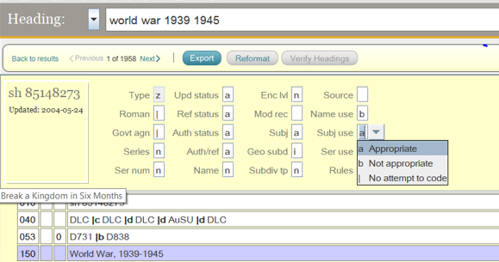
008/15
a = used as a subject heading
Notes:
The 15th position in the 008 field indicates whether the heading in the 150 field of the authority record is appropriate to use as a 650 subject field in a bibliographic record
If it’s coded “a” it is appropriate for use as a subject field in a bibliographic record ; coded “b” it’s not appropriate for use as a subject field in a bibliographic record

Slide 22
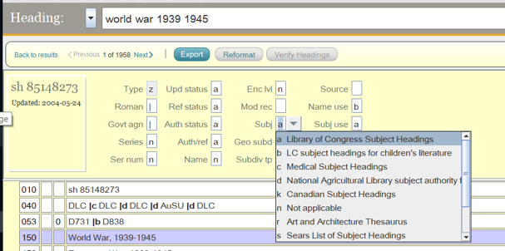
008/11
a = LC heading
b = LC children’s
Notes:
Shelly
The 11th position in the 008 field identifies the subject heading system/thesaurus used to formulate the 150 heading.
You can see here different subject heading lists. If you see an “a” in this element - that indicates this is a Library of Congress Subject Heading.
If you use Library of Congress subject headings for children’s literature in your catalog, that’s indicated by a “b” in this element.
And you can see other subject heading systems in the choices in the pop down box.

Slide 23
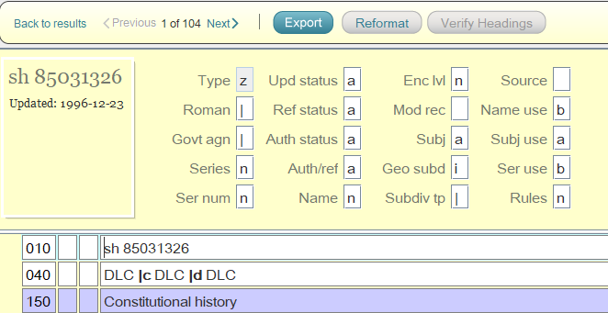
008/06 Geographic subdivision
Blank = no
i = yes
Notes:
The 6th character in the 008 field indicates whether the subject heading provides for subdividing the heading by the name of a country or other jurisdiction, region, or geographic feature.
Blank = not subdivided geographically
i= subdivided geographically
This instruction allows you to use geographic headings as subdivisions in 650 fields in a bibliographic record.
All geographic subdivision is indirect
In this example the Established Topical Subject Heading in the 150 field, Constitutional history can be subdivided geographically.
650 field is from a Bibliographic Record that subdivided it with |z United States.

Slide 24
010 LC Control Number
beginning with “sh” = LC Subject Heading
Notes:
I mentioned before that the first 3 positions in the LC Control # in field 010 iindicates which type of LC Heading the record is
In this case the 010 begins with “sh” identifies this as a Library of Congress Subject Heading Authority Record

Slide 25
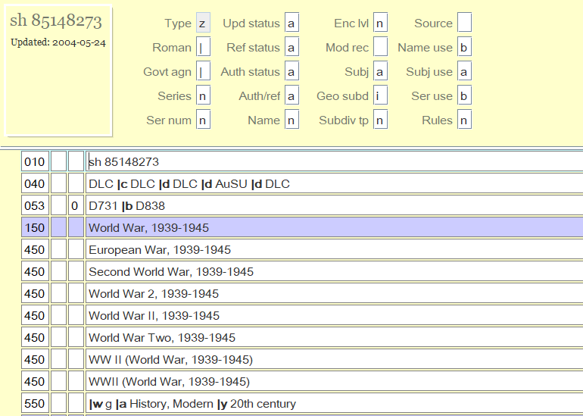
150 - Topical Subject Established Heading Record
11
15
9
6
Established Heading
Notes:
So, given all that information, let’s look at the Topical Established Heading Record for World War 2 again -
The 11th Character Position in the 008 field is coded “a” indicating that this is a term from the Library of Congress Subject Heading Controlled Vocabulary/Thesaurus.
The 9th Character Position in the 008 field is coded “a” indicating that this is an Established Heading Record rather than a Reference Record
The 15th Character Position in the 008 field is coded “a” indicating that the 150 field can be used as a Subject Added Entry in a 650 field of a Bibliographic Record
The 6th Character Position in the 008 field is coded “i” indicating that the Established Heading in the 150 field can be subdivided geographically.
The first 2 characters in the 010 field are “sh” indicating that this is a Library of Congress Subject Heading
… and The 150 field subfield a contains the Established Heading “World War 1939-1945”

Slide 26
150 Topical Subject Established Heading - Subdivisions
|a established heading
|x topical subdivision
|y chronological subdivision
|v form subdivision
|z geographic subdivision
|g Miscellaneous information
Notes:
There may be subdivisions included in a150 Established Heading
You may see:
Subfield a = Established Heading
subfield x = General subject subdivision (Added to established headings to further subdivide the topic)
subfield y = chronological subdivision (dates or phrases that qualify a subject in terms of time)
subfield v = form subdivision (added to established headings to indicate what the item being cataloged is ; for example |v Periodicals)
subfield z = geographic subdivision (names of places used as subdivisions.)
These same subdivisions, along with others, are also used in a 650 field in a Bibliographic Record

Slide 27
150 Established Topical Subject Heading
|a topical subject heading
|x topical subdivision
Can use the entire string found in field 150 of AR in 650 field in Bibliographic Record.
|z geographic subdivision
|y chronological subdivision
|v form subdivision
Notes:
Established Headings in a 150 field may include subdivisions. If they do, you can use the entire string of the topical subject heading and subdivisions in the 650 field of a bibliographic record.
This is true for all types of Established Heading authority records. The 1XX field with the lead element in the subfield a and any subdivisions in following subfields can be used in an access point field in a bibliographic record.

Slide 28
Topical Subject Headings in AR - BR
Established Heading in Authority Record | Subject Heading in Bibliographic Record
Notes:
This slide illustrates how Estblished Topical Subject Headings in Authority records can be used as a subject access point in a Bibliographic Record.
Here the 150 field from topical authority records are on the left, and on the right are 650 topical subject headings from bibliographic records using that established heading
Notice the second indicator on the 650 fields - the value is 0, indicating that this is a Library of Congress subject heading.
In the 008 field position 11 of this subject authority record, value a indicated that this is an LC subject heading.
If you’re using a LC Children’s subject heading, then the second indicator in the 650 field is a value of 1
And there are other values in the 2nd indicator of the 650 field in a bibliographic record that indicate the heading is from another controlled vocabulary or list.

Slide 29
450 See from Reference
Leads from unestablished heading to established heading
Guide to find established headings to use in 650 field in Bib record
Generate a “See From” reference in the catalog
Esbablished Heading
See From / Unestablished Headings
Notes:
Field 450 in a subject authority record is referred to as a “See from Reference” or also sometimes known as a tracing field.
The purpose of this field in a subject authority record is to :
Provide direction from a topical term that is not an established heading (450) to an established subject heading (150)
Help catalogers find established headings to use in a 650 field in a bibliographic record ; When a cataloger searches a topic in the authority file and it’s in a 450 field, know to use the established heading found in the 150 field in a bibliographic record 650 field.
Generate a see from reference in your public catalog, that will direct users to records with an authorized subject heading, which then leads to a list of all materials on that subject together in a search display.

Slide 30
450 subfields
a unestablished heading
|x topical subdivision
|y chronological subdivision
|v form subdivision
|z geographic subdivision
|i Relationship information
|g Miscellaneous information
|w Control subfield
Notes:
The 450 field may contain subfields as the 150 field does. Many of the subfields are the same with a few additional ones
subfield x = General subject subdivision (Added to established headings to further subdivide the topic)
subfield y = chronological subdivision (dates or phrases that qualify a subject in terms of time)
subfield v = form subdivision (added to established headings to indicate what the item being cataloged is ; for example |v Periodicals)
subfield z = geographic subdivision (names of places used as subdivisions.)
Subfield g - miscellaneous information
Additionally there are
Subfield w - Control subfield
Subfield i - relationship information
Details for values in subfields w, and i are the same in 450 and 550 fields and -will be covered in the 550 slide

Slide 31
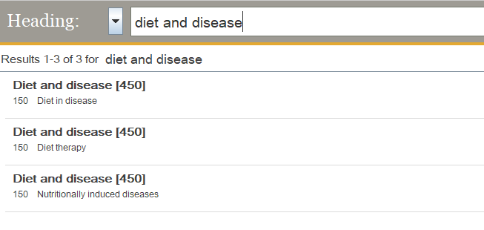
Authority File Search Result - Unestablished Heading
Notes:
This slide shows an example of a how a 450 “See from” field affects a cataloger’s search in an authority file (LC, OCLC, Skyriver, etc.).
The phrase “diet and disease” was searched and resulted in 3 hits.
In the first result, highlighted by the red box, ”Diet and disease” is in a 450 field - signifying an unestablished heading
Under this unestablished heading, the cataloger is referred to the established heading, “Diet in Disease” found in a 150 field in an Authority Record.
There are two more Results with “Diet and Disease” found in a 450 field in Authority Records. Each of those refer the cataloger to an established heading in a 150 field ; Diet therapy and Nutritionally induced diseases.
From this information a cataloger knows to use the 150 established headings iin the 650 field in a bibliographic record.

Slide 32
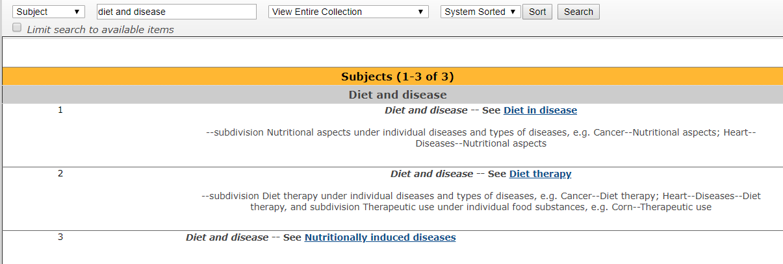
Public Catalog Display of See Reference
Notes:
This slide demonstrates the same search for the phrase “diet and disease” In the public catalog.
Here the the 450 field in 3 different Topical Established Heading Authority Records generates a “See” reference, as shown iin the red boxes here.
If the user clicks on the link for the established headings, Diet in disease, Diet therapy or Nutritionally induced diseases, the result will be materials cataloged with those established headings in the 650 field in a Bibliographic Record.

Slide 33
550 See Also from Reference
Leads from established heading to a related established heading
Guide to find established headings to use in 650 field in Bib record
Generate a “See Also From” reference in the catalog
Esbablished Heading
Broader Term Established Heading
Notes:
Field 550 in a subject authority record is referred to as a “See Also from Reference” or also sometimes known as a tracing field.
The purpose of this field in a subject authority record is to :
Provide direction from an established heading to another established heading (550)
Help catalogers find alternate established headings that may be used in a 650 field in a bibliographic record**
They are used to generate a see from reference in your public catalog, that will direct users to records with an authorized subject heading, which then lead to a list of all materials on that subject together in a search display.
*Some types of alternate established headings may be an a later heading, a broader term, a narrower term, or an acronym
.

Slide 34
550 See Also from Reference - subdivisions
|a established heading
|x topical subdivision
|y chronological subdivision
|v form subdivision
|z geographic subdivision
|i Relationship information
|g Miscellaneous information
|w Control subfield
Notes:
Match many of the 150 subfields are the same in the 550 field
subfield x = General subject subdivision (Added to established headings to further subdivide the topic)
subfield y = chronological subdivision (dates or phrases that qualify a subject in terms of time)
subfield v = form subdivision (added to established headings to indicate what the item being cataloged is ; for example |v Periodicals)
subfield z = geographic subdivision (names of places used as subdivisions.)
Additionally there are
Subfield i - relationship information
Subfield w = control subfield
Details for values in subfields w, i and are the same in 450 and 550 - covered in the next slide

Slide 35
Subfield w in a 4XX or 5XX
Subfield w is a control subfield used in 4XX and 5XX Fields
The character position determines the meaning
4 character positions after the |w
|w/0 - Special relationship
|w/1 - Tracing use restriction
|w/2 - Earlier form of heading
|w/3 - Reference display
Notes:
Subfield “w”is a control subfield that is found in 4XX and 5XX fields in Authority Records. The position codes and meanings apply to all Authority Record Headings, not just topical subject headings.
They indicate specific information or instructions for the headings when needed
There are 4 character positions 0-3 after the delimiter and the letter w
Each character position can contain a letter that carries meaning or instruction about the 4XX or 5XX field
First position |w/0 indicates a special relationship
Second position |w/1 Tracing use
Third position |w/2 Earlier form of heading
Fourth position |w/3 - Reference display

Slide 36
Subfield w in a 4XX or 5XX field
|w/0 - Special relationship |w/1 -Tracing Use |w/3 - Earlier form of Hdg
g= Broader Heading n= Not applicable e= Earlier form
h= Narrower Heading
n= Not applicable
Notes:
This slide demonstrates how the control subfield w provides information for the cataloger
In this example the |w in the 450 field is highlighted blue -
1st character position in the 450 field is “n” - not applicable ;
The 2nd character position is also n = not applicable
The 3rd character position in the 450 is e= a earlier established heading that is no longer valid
In both 550 fields the 1st character position indicating a special relationship iis “g” - which means these are broader established name headings than the heading in the 150 field “Selling, and they can be used in a 650 field in a bib record.
The control subfield w contains these values in all 4XX and 5XX fields in all Authority Records.

Slide 37
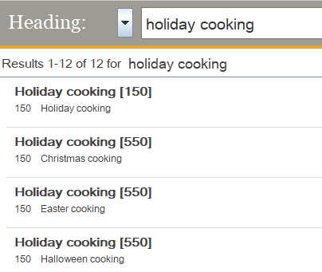
AF Search Result Alternate Established Heading(s)
Notes:
This slide shows an example of a how a 550 “See Also” field affects a cataloger’s search in an authority file (LC, OCLC, Skyriver, etc.).
The phrase “holiday cooking ” was searched and resulted in 4 hits.
In the first result, the term “Holiday Cooking” is found in a 150 field, signifying that this is an established heading that can be used as a 650 subject field in a Bib Record.
The second through fourth results show “Holiday Cooking” found in a 550 field in these Authority Records. Each of those refer the cataloger to another established heading in a 150 field ; Christmas Cooking, Easter Cooking and Halloween Cooking.
From this information a cataloger knows to that any of these 150 established headings can be used in the 650 field in a bibliographic record.
When searching the term “holiday cooking” the result shows the other established headings that are found in the 550 field of the authority record. The terms Christmas cooking, Easter cooking and Halloween cooking, are all narrower terms for holiday cooking,.
They’re generated in the search because there is a 550 fo Holiday Cooking in each of those Authority Records.
Any of these headings could be used in the 650 field in a bibliographic record.

Slide 38
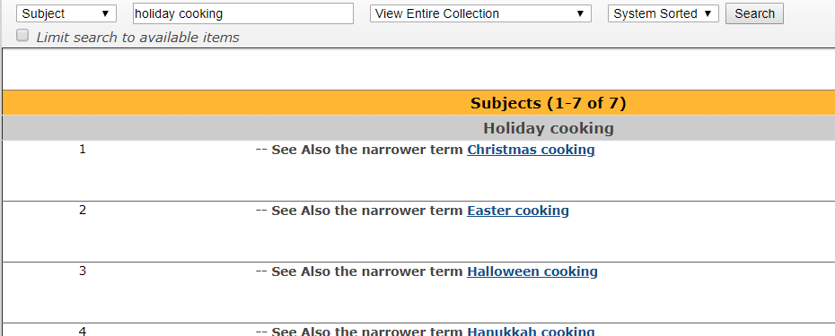
Public Catalog Display of See Also Reference
Notes:
In the public catalog, the 550 field generates a “See Also” reference, in the red box here
This guides the user to the other established headings, Christmas cooking, Easter cooking, and Halloween Cooking.

Slide 39
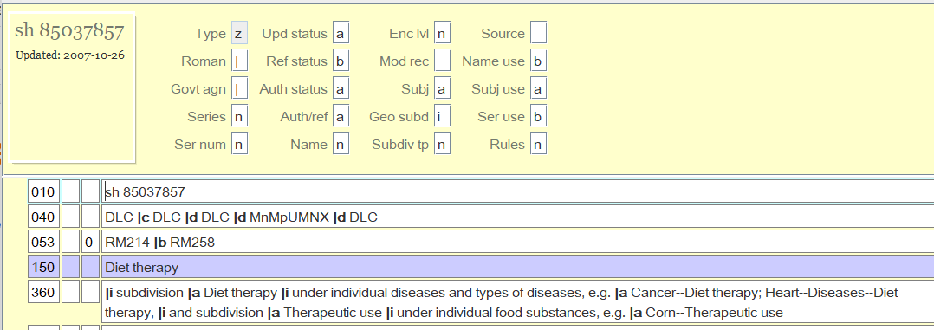
360 - Reference Field
established
Appropriate for use as a subject heading
|i = explanatory information
|a = heading being referred to
Notes:
Field 360 in a subject authority record gives a note explaining that the 150 field in this subject authority record which CAN be used as an established subject heading, and can also be used as a subdivision under a different subject heading.
The 150 field is a phrase that can be used as a subdivision under an established subject heading, but it also can be an established heading in the subfield a of a bibiographic record
In this example the phrase “Diet therapy” is in the 150 field
The 360 field gives instruction of how to use this phrase as a subdivision with established subject headings
In this case it states that Diet therapy can be used as a subdivision under individual diseases and types of diseases and then gives examples in |a Cancer -- Diet therapy
It also gives an alternative subdivision “Therapeutic use” which can be used under individual food substances, and then give an example |a Corn -- Therapeutic use
Subfield i = explanatory text
Subfield a = heading referred to
360 fields are in authority record for established headings ; the 360 field gives instruction on how to also use the heading as a subdivision.
Established heading records that can also be used as a subdivision can be identified in this case by the 360 field, but can also be identified by 2 elements in the fixed field.
Fixed Field 009 = a (established heading)
Fixed Field 15= a (appropriate for use as a subject heading)

Slide 40
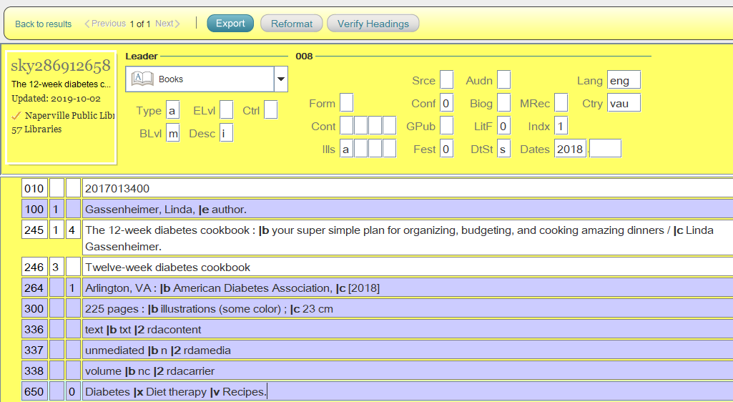
Notes:
Here the red box indicates the established subject heading “Diet therapy” being used as a subdivision with another topical subject heading, Diabetes, in a bibliographic record.
The cataloger who created this record followed the instruction in the Established Heading Authority Record for this phrase and used it according to the instruction in the 360 field as a subdivision under individual diseases and types of diseases.
This is a book about using diet to help control diabetes - so the instruction applies.

Slide 41
150 Topical Subject Heading Reference Record
A record in which the 150 contains an unestablished subject heading
008/09 contains “b” = not an established heading
008/15 contains “b”= not subject heading
Contains a 260 Complex See From field which guides the user
Notes:
A 150 Topical Subject Heading Reference Record field can NOT be used as an established subject heading.
It is meant as a reference giving instruction on how to use the phrase in the 150 field
Reference Records will contain the value “b” in the 008/09 field
Reference Records will also contain the value “b” in the 008/15 field = not appropriate as a subject heading
Contain a 260 Complex See From field which provides information for the user

Slide 42
260 - Reference Field
b=not appropriate for use as a subject heading
b=reference
|i Explanatory note
|a = heading being referred to
|i = explanatory information
Notes:
Field 260 in a subject authority record gives an explanatory note explaining that the 150 field in this subject authority record can NOT be used as an established subject heading.
The 9th character position in the 008 field has a value “b” which indicates this is not an established heading record .
The 15th character position in the 008 field is also coded “b” which indicates this is not a subject heading.
The 150 field is a phrase that can be used as a subdivision under an established subject heading
In this example the phrase “Religious life and customs” is in the 150 field
This cannot be used in a 650 subfield a in a bibliographic record because it is not an established heading
The 260 field gives instruction of how to use this phrase as a subdivision with established subject headings
In this case it states that Religious life and customs can be used as a subdivision under names of countries, cities, etc., for descriptions of the religious practices and customs of those places.
Subfield i = explanatory text
Subfield a = heading referred to

Slide 43
260 Reference Instruction used in a Bib Record
Notes:
Here the red box indicates the topical subject heading “Religious life and customs” being used with a geographic subject heading, United States in a bibliographic record.
The cataloger who created this record followed the instruction in the Reference Authority Record for this phrase and used it as a subdivision under names of countries, cities, etc., for descriptions of the religious practices and customs of those places.
This is a book about the muslim faith in the United States - so the instruction applies.

Slide 44
Free Floating Subdivisions
Free-floating subdivisions are form or topical subdivisions used under designated subjects without an authority record being created for each main heading/subdivision combination that might be needed.
Use with Caution - List is found in the Subject Headings Manual published by the Library of Congress
Notes:
A note :
There isn’t always a topical heading authority record for all Subdivisions or Subject heading/Subdivision combinations .
Free Floating Subdivisions are form or topical subdivisions that can be used with designated subjects to form a 650 heading Topical Subject Heading in a Bibliographic Record.
The List is found in section H 1095 in the Subject Headings Manual published by the Library of Congress .
These subdivisions should be used cautiously - Catalogers should search the Subject Authority File first for subdivision strings in the 150 field, or 260 or 360 fields in Reference or Established Heading Records for instruction on assigning subdivisions to Subject heading.
If the cataloger can’t find an appropriate subdivision, then the Free Floating Subdivision list can be consulted.

Slide 45
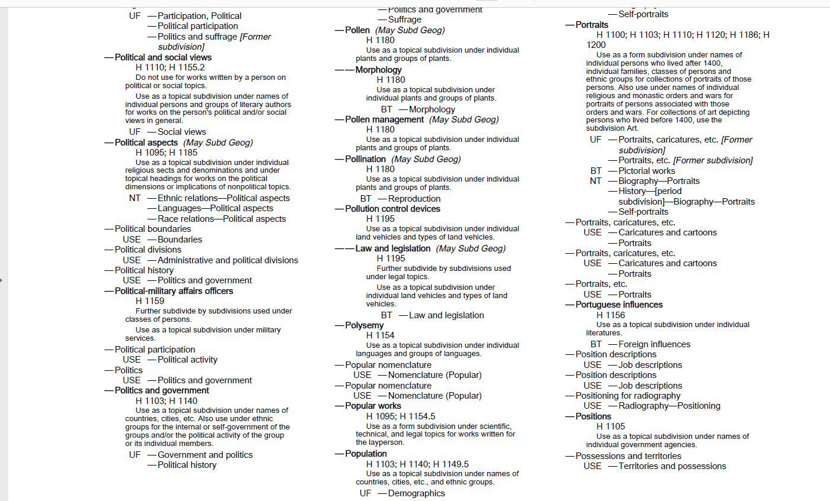
Notes:
This is a page out of The Free Floating Subdivision List.
Note the instructions under the subdivision headings
For example under --Poltical aspects “Use as a topical subdivision under individual religious sects and denominations and under topical headings for works on the poltical or implications of nonpolitical topics.
It’s also noted that this subject heading - subdivision combination may be further divided geographically.
Also Narrower subject heading - subdivision examples are provided

Slide 46
6XX Fields Notes
667 = General non public note
670 = Source note contains a citation for consulted source
680 = General information can be used in pubic display
681 = How 150 can be used in a reference field of another authority record
Notes:
The 6XX notes in Authority Records are for notes
667 = General non public note contains a note that provides general information about a 1XX heading
670 = Source note contains a citation for a consulted source in which information is found related in some manner to the entity represented by the authority record or related entities. The field may also include the information found in the source.
680 = contains a note that provides general information about a 1XX heading that can be adequate to be used as a public display.
681 = a note that documents the use of a 1XX established subject or authorized subdivision heading as an example or reference in a 260, 360 Complex See Also Reference, or 680 Public General Note field of another authority record.
These are mostly information for the cataloger’s use, with the exception of the 680
These 6XX fields can be found in any Authority Record

Slide 47
7XX Heading Linking Entry fields
Provide a machine link within a system between headings
e.g. 781 Subdivision Linking Entry - Geographic Subdivision
Authority Record
Bibliographic Record
Notes:
7XX Fields provide a machine link between headings
An example is a 781 field which contains a geographic subdivision name that is equivalent to a 151 geographic name heading.
In this example the 781 field the note indicates that “Illinois” can be used as a geographic subdivision in a subject heading in a bibliographic record.
These 7XX fields are valid in any type of Authority Record

Slide 48
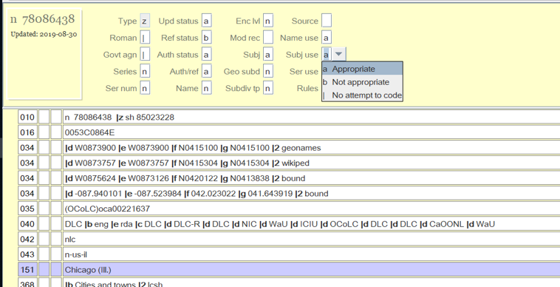
100, 111, 110, 151
008/15
Notes:
Subject headings can also be name headings which are found in Authority Record fields 100, 111, 110 and 151
They do double duty, because they can all be used as a subject headings as well as a name headings in a bibliographic record - e.g. in a 1XX or a 6XX field
The 008 fixed field element that in is character position 15 indicates when a heading is appropriate or not appropriate to be used as a subject heading - you can check that when trying to determine if you can use a name established heading in a subject field in a bibliographic record.
I will cover information about name headings and their uses next.

Slide 49
LC Name Headings
Notes:
Library of Congress Name Headings

Slide 50
Library of Congress Name Headings
LC Name Authority File (NAF)
Contains Name Authority Records (NAR)
NAR for person, corporate body, meeting or geographic name headings used as a 1XX, 6XX or 7XX in a Bibliographic Record
Created by NACO
https://www.loc.gov/aba/pcc/naco
Notes:
The Library of Congress Name Authority File includes Name Authority Records
Generally, a name authority record is made for any person, corporate, meeting, or geographic name heading that may be used as a main or added entry heading (including subject added entries) or in some cross-references in a Bibliographic Record.
The established headings in Name Authority Records can be used in 1XX, 6XX or 7XX fields in Bibliographic Records.
Who creates LC Name Authority Records?
PCC/NACO
The Name Authority Cooperative Program (NACO) enables member institutions to create and contribute Name Authority Records to the NAF
If you’d like to join NACO, you can find more information at the LC website, or you can ask me.

Slide 51
008 - Name Heading Authority Records
Character Position | Value
09 | Kind of record - Established Heading (a) or Reference (b)
14 | Heading use - 1XX or 7XX entry - Appropriate (a) ; Not appropriate (b)
15 | Heading Use - Subject Added Entry - Appropriate (a) ; Not appropriate (b)
Notes:
The 008 Field contains coded information in 40 character positions.
As noted, the display can vary from system to system, so the codes are universally defined by their position in the field.
I’ve noted here some of the elements in the 008 field which are relevant and can be useful to know as relates to a name authority record.
9th position - Kind of record
Established heading = a
Reference record = b
14th position - Can be used as a Main 1XX or Added 7XX (Name) entry in a Bibliographic Record
Appropriate = a
Not appropriate = b
15th position - Subject Added Entry in a Bib Record a= appropriate b = not appropriate
The next slides will illustrate these codes in use in name authority records

Slide 52
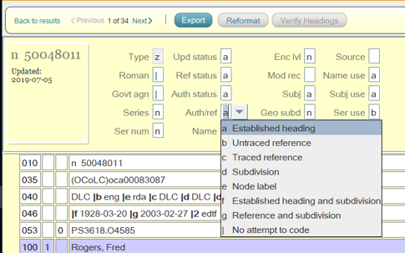
008/09 Kind of record
a = established heading
Notes:
The 09 position in the 008 field indicates whether the authority record represents an established or unestablished 1XX Heading.
When determining if you can use a heading from an authority record in 1XX, or 7XX field in a bibliographic record, the code “a” in this position tells you that this is an established heading, and it can be used.
The code “b” means that this heading is only used as a reference.
In this SkyRiver record, and in OCLC records there is a descriptive label for this field that says “Auth/ref”

Slide 53
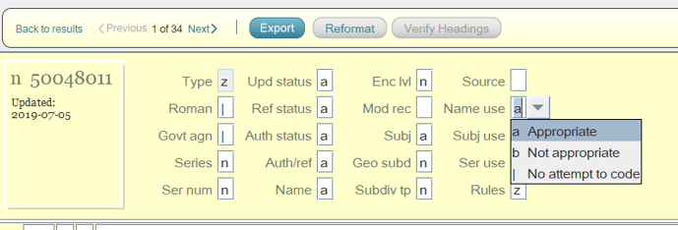
008/14 Heading use - main or added entry
a = appropriate
b = not appropriate
Notes:
The 14th position in the 008 field indicates whether the 1XX field in an Authority Record is an established name heading that can be used in a 1XX or 7XX field in a bibliographic record.
Code a = appropriate to be used as a name established heading
Code b = Not appropriate to be used as a name established heading
In other words, the 1XX field in this Name Authority Record is an established name heading.
In this SkyRiver record, and in OCLC records there is a descriptive label for this field that says “Name use”.

Slide 54
008/15 Heading Use Subject Added Entry
a = used as a subject heading
Notes:
Shelly
The 15th position in the 008 field indicates whether the heading in the 1XX field of the authority record is appropriate to use as a 6XX subject field in a bibliographic record
If it’s coded “a” it is appropriate for use as a subject field in a bibliographic record.
If it’s coded “b” it is not appropriate for use a subject field in a bibliographic record.
We saw this code used with topical subject headings, and this code is relevant to Name Authority Records as well.
In this SkyRiver record, and in OCLC records there is a descriptive label for this field that says “Subj use”.

Slide 55
010 LC Control Number
beginning with “n” = LC Name Headings
Or with “no” LC Name Headings created in OCLC
Notes:
I mentioned before that the first 3 positions in the LC Control # in field 010 iindicates which type of LC Heading the record is
In this case the 010 begins with “n” identifies this as a Library of Congress Name Authority Record
Or
The 010 begins with “no” it is an LC Name Authority Record created in OCLC

Slide 56
046 - Special Coded Dates
Contains dates associated with entity described in the NAR
Person - date of birth, death and date (s) of period of activity
Corporate body - dates of conferences, dates of establishment, period of activity
|f Birth date
|g Death date
|k Beginning or single date created
|l Ending date created
|q Establishment date
|r Termination date
|s Start period
|t End period
Notes:
Field 046 contains dates that are associated with the entity described in the record. These include:
For a person: a person's date of birth, date of death, and the date or date range of the person's period of activity.
For a corporate body: a date or range of dates on which a conference, etc., is held, or a date with which the corporate body is otherwise associated (e.g., date of establishment, date of termination, period of activity).
Can be helpful when trying to determine if the person/corporation in the Name Authority Record is the same as the person/corporation on the piece you are cataloging.
Subfields on the slide with meaning
Formatting of date yyyy-mm-dd

Slide 57
Types of Name Heading Authority Records
Type of Authority Record | 1XX Field in Authority Record
Personal Name | 100
Corporate Name | 110
Conference/Meeting Name | 111
Jurisdictional Geographic Name | 151
Non-Jurisdictional Geographic Name | 151
Reference Record | 100, 110, 111, 151
Notes:
There are different types of name authority records, just as there are different types of subject headings used in bibliographic records.
The types of name authority records are:
Personal name headings which are found in the 100 field in the Authority Record
Corporate name headings which are found in the 110 field in their authority records.
Conference/Meeting Name headings which are found in the 111 field in their authority records.
Jurisdictional and Non-Jurisdictional geographic Name Headings in the 151 field in their authority records.
Reference - The 1XX field is not an established heading - The phrase can be used as a subdivision or other element of a heading, there is instruction included
I will break down Name heading authority records for you.

Slide 58
100 Personal Name Heading Authority Record
Definition of “Person” :
An individual or an identity established by an individual (either alone or in collaboration with one or more other individuals) (RDA 8.1.2)
Most personal names are coded in 100 in MARC Authority and in 100, 600 or 700 in MARC Bib Records
Notes:
Field 100 in a Name Authority Record contains a personal name heading.
RDA Definition of a person - “An individual or an identity established by an individual (either alone or in collaboation with one or more other individual)
Personal name headings are coded in 100 field in the MARC Authority Record and in 100, 600 or 700 in MARC Bibliographic Records.

Slide 59
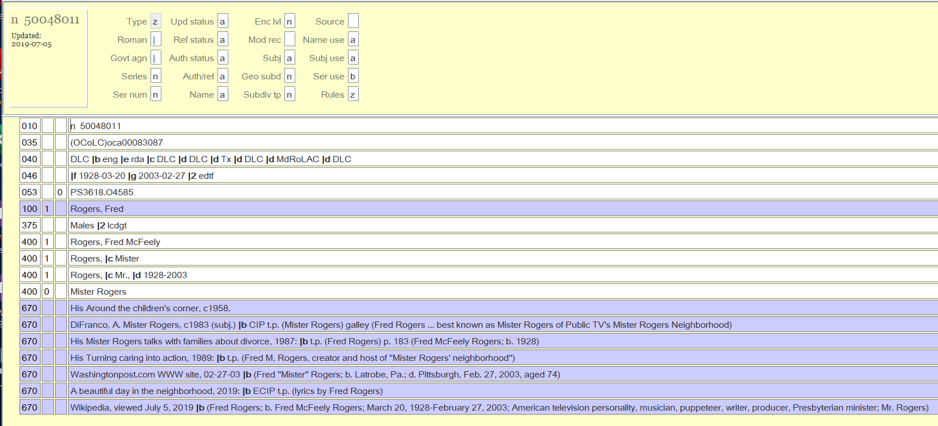
Example of 100 Personal Name Authority Record
14
15
9
Established Personal Name Heading
Notes:
So, given all that information, let’s look at the Personal Name Established Heading Record for Fred Rogers
The 9th Character Position in the 008 field is coded “a” indicating that this is an Established Heading Record rather than a Reference Record
The 14th Character Position in the 008 field is coded “a” indicating that the 100 field can be used as a Personal Name Heading in a 100 or 700 field of a Bibliographic Record.
The 15th Character Position in the 008 field is coded “a” indicating that the 100 field can be used as a Personal Name Heading Entry in a 600 field of a Bibliographic Record
The first character in the 010 field is “n” indicating that this is a record from the LC Name Authority File
The 046 subfield f tells us that this Fred Rogers was born on March 20th, 1928, and the subfield g tells us that he died on February 2nd, 2003.
… and The 100 subfield a contains the Established Heading “Rogers, Fred”

Slide 60
100 Indicators
First Indicator:
0 = Forename
1 = Surname
3 = Family name
Second indicator: Blank
Notes:
Indicators in the 100 field of a Name Authority Record: .
The first indicator notes what type of personal name is contained in the field
0=Forename
1=Surname
3=Family name

Slide 61
100 subfields
|a Personal Name
|b Roman Numeral or Part of Forename
|c Titles or other words associated with a name
|d Dates of birth, death or flourishing or any other date used with a name
|q Fuller form of name
|t Title of a work
Notes:
These are some of the more common subfields found in the 100 field of a Personal Name Authority Record
Sufield a = contains a personal name. The name may be a surname and/or forename; letters, initials, abbreviations, phrases, or numbers used in place of a name
Subfield b = contains a roman numeral or a roman numeral and a subsequent part of a forename. It is used only when the entry element is a forename.
Subfield c = contains titles and other words associated with a name. Including titles like “Sir”, terms of address like Mrs., or other words associated with a name like Saint, or an occupation like clockmaker.
Subfield d = contains dates of birth, death, or flourishing or any other date used with a name
Subfield q = contains a more complete form of the name than the form in subfield $a.
So on this example of King Gustav the Fifth of Sweden, subfields a through d are shown in the first example
The second example shows the use of the subfield q with a fuller form of the name for Claudius - Claudius Ceccon
in a Personal Name Established Heading
The third example shows a name/title heading. This is a personal name combined with the title of a work by that person. These are used with musical compositions, works of literature and other works combined with the creator of that work.
There are other subdivisions found in the 100 field that can be found in MARC 21 Format for Authority Data

Slide 62
Personal Name Headings in AR -BR
Established Heading in a NAR | Bibliographic Record
Notes:
Here the 100 fields from name authority records are on the left, and on the right are corresponding main or added entry headings that could be found in bibliographic records.
The first row shows the Personal Name Heading for Fred Rogers. In this example his name is the main entry in a bibliographic record.
It’s represented exactly the same - the first indicator in the Authority and Bibliographic record in the 100 field shows that this is a surname. The 2nd indicator is blank in both.
The second row shows the Name Authority Record for King George the third if Great Britain on the left, and in the Bibliographic Record on the right, this name heading is being used as a subject in a 600 field.
Here the first indicator in both the Authority Record and the Bibliographic Record indicates that this is a forename.
The second indicator is blank in the Authority Record, but there is a 0 in the Bibliographic Record. It indicates what subject heading system is being used - 0 for LCSH
The third row shows a 100 Personal Name Heading in the Authority record on the left and a corresponding 700 Added Entry Personal Name Heading in the bibliographic record on the right.
The first indicator is the same, indicating that this is a personal name that includes a surname - Vassallo
The second indicator is blank in the authority and bibliographic record
Blank in the 700 field in the Authority Record = Undefined
Blank in the 700 in the Bibliographic Record = No information provided regarding if this is an analytic heading (including a work title as well as a name)
The 4th row shows a 100 Personal name/Title heading in the Authority Record on the left and a corresponding 700 Added Entry Personal Name/Title Heading in the bibliographic record on the right.
The 1st indicator is 1 in both records for having a surname
The 2nd indicator is blank on the Name Authority Record on the left ; and is 2 in the Bib Record on the right. - this indicates that this is an analytic heading. It has listed a specific title that is included in the piece being cataloged in the Name/Title Heading.

Slide 63
3XX Other Information
368 Other attributes of person
370 A place associated with person
372 A field of endeavor, area of expertise
373 A group, institution, association person is associated with
374 Profession or occupation
377 Associated languages
378 Fuller form of name (Can also be found in 100 |q)
Notes:
3XX fields in a Personal Name Authority Record gives you additional information about the person represented in the 100 field.
There are often more than 1 person who has the same name. The subfields with dates, titles and numeration can help distinguish one person from another, but if you’re still trying to find the right name heading for the person on the piece that you’re cataloging, the 3XX fields can be helpful.
368 contains Other Attributes of Person
370 contains a place associated with a person's birth, death, residence, and/or identity
372 A field of endeavor or expertise
373 Group Associated with person
374 Occupation
377 Language
378 Sometimes this field includes fuller form of the name, which can also be found in |q of the 100 field

Slide 64
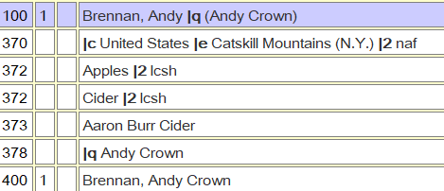
Example of 3XX Fields in Name Authority Record
Notes:
Here’s an example of a name authority record with some of the 3XX fields with additional information about Andy Brennan
370 He lives in the Catskill Mountains of NY in the US
372 His Field of endeavor is apples
373 He is associated with Aaron Burr Cider - associated group
378 A fuller form of his name is Andy Crown Brennan - which is also seen in |q of 100 field

Slide 65
400 See from Reference - subdivisions
|a Personal Name
|b Roman Numeral or Part of Forename
|c Titles or other words associated with a name
|d Dates of birth, death or flourishing or any other date used with a name
|g Miscellaneous information
|i Relationship information
|w Control field - applies the same as with Topical Subject Headings
Notes:
Subdivisions in a 400 match the subdivision in a 100 field in a name authority record except :
Subfield i - relationship information
Subfield w is a control field - works the same for any 4XX or 5XX field. I covered in the Topical Subject Heading Section of the Presentation, and these subfields and codes work the same here as they did with Topical Subject Headings.

Slide 66
400
Leads from unestablished heading to established heading
Guide to find established headings to use in 100, 600 or 700 field in Bib record
Generates a “See From” reference in the catalog
Notes:
Like the 450 in a subject authority record, there can be a “See from Reference” in a Name Authority Record in a 400 field.
It serves the same purpose in a name authority record :
Provides direction a form of a personal name that is not an established heading (400) to an established personal name heading (100)
Helps catalogers find established name headings to use in a 100, 600 or 700 field in a bibliographic record * and
Can generate a see from reference in your public catalog, that will direct users to records with an authorized name heading, which then lead to a list of all materials by or about that person..
This Name Authority Record shows the established name heading for William Shakespeare in the 100 field
And shows some variant forms of his name in the 400 fields
These fields show his last name spelled without an “e” at the end in the first 400 field, without an “e” in the middle in the second 400 field, and in a different language in the third 400 field.

Slide 67
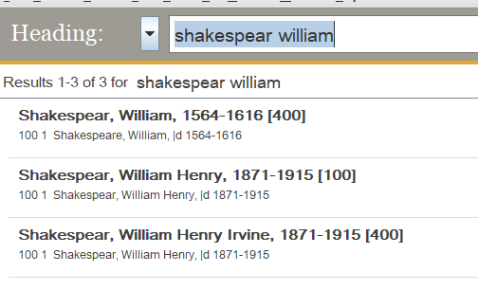
NAF Search Result - Unestablished Name Heading
Notes:
This slide demonstrates how a cataloger can use the information in a 400 field to find an established name heading to use.
It shows the result in the SkyRiver Authority File when I attempted to search William Shakespeare without an “e” at the end of his name.
Since that is an unestablished heading in a 400 field, I am directed to the 100 field with the established heading for his name.

Slide 68
Public Catalog Display of See Reference
Notes:
In our public catalog at Naperville, the 400 field generates a “See” reference that says “Try a search for”, in the red box here, that guides the user to the established name headings, Shakespeare with an “e” at the

Slide 69
500 See Also from Reference
Leads from established name heading to a related established name heading
Guide to find established headings to use in 100, 600 or 700 field in Bib record
Generate a “See Also From” reference in the catalog
Notes:
Shelly
Field 500 in a personal name authority record is referred to as a “See Also from Reference” or also sometimes known as a tracing field.
The purpose of this field in a subject authority record is to :
Provide direction from an established name heading to another established name heading (500)
Help catalogers find alternate established name headings that may be used in a 100, 600 or 700 field in a bibliographic record**
They are used to generate a see from reference in your public catalog, that will direct users to records with an authorized name heading, which then lead to a list of all materials by or about that person together in a search display.
Here the established name heading in the 100 field of this authority record is Twain, Mark 1835-1910.
There are three 500 headings in this record that are also established name headings for this same person
.

Slide 70
500 See Also from Reference - subdivisions
|a Personal Name
|b Roman Numeral or Part of Forename
|c Titles or other words associated with a name
|d Dates of birth, death or flourishing or any other date used with a name
|g Miscellaneous information
|i Relationship information
|w Control field - applies the same as with Topical Subject Headings
Notes:
Subdivisions in a 500 match the subdivision in a 100 field in a name authority record except :
Subfield i - relationship information
Subfield w is a control field - works the same for any 4XX or 5XX field, covered in the Topical Subject Heading Section of the Presentation

Slide 71
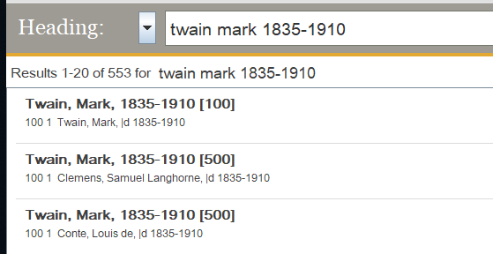
NAF Search Result Alternate Established Heading(s)
Notes:
This slide demonstrates how a cataloger can use the information in a 500 field to find an alternate established name heading to use.
It shows the result in the SkyRiver Authority File when I searched using Mark Twain’s established heading.
I get an authority record with that form in a 100 field on the first result, but am also directed to 2 other name authority records with other 100 field headings that are also established forms of his name
and have the form I searched in a 500 field.

Slide 72
6XX - Notes
663/664 Complex Name References
666 General Note for Reference Headings
667/680 General Notes - Non-public and Public
670 Source Data
678 Biographical or Historical Data
Notes:
There are other 6XX fields contain notes that apply to name headings.
I’ve listed some of the more commonly used 6XX field here
Will elaborate on 663/664 and 670
666 - Reference note, the 100 field is not an established heading and the note contains explanatory information
667/680 are General Notes - Public and Non-public
678 Give Biographical or Historical Data which can help to decide if the 100 field is the person that your piece is by or about

Slide 73
663 Complex See Also Reference - Name
100, 110, 111, 151
Sometimes used when there is a 500 in the NAR - Any
Provides information/instruction on alternate established name headings
Notes:
Field 663 is a Complex See Also Reference that applies to all types of Name Authority Records.
It’s sometimes used when there are 400 or 500 fields that refer to another name heading for the same person.
They provide information and/or instruction concerning the relationship between the 2 established headings ; the 1XX and the 400 or 500
In the first NAR example the 663 field instructs the user to search under other names used by this author.
The second NAR example is for one of the alternate name headings used by this author - it’s 663 field provides instruction to search under Japp, Alexander H. for other names that he uses - refers the user back to the 1st record.
This note can also provide a cross reference in the public display of the catalog.

Slide 74
100/110/111/151 Name Heading Reference Record
A record in which the 1xx contains an unestablished name heading
008/09 contains “b” = not an established heading
008/14 contains “b”= not name heading
Contains a 664 Complex See From field which guides the user
Notes:
A 100/110/111 or 151 Name Heading Reference Record field can NOT be used as an established name heading.
It is meant as a reference giving instruction on how to use the phrase in the 1XX field
Reference Records will contain the value “b” in the 008/09 field
Reference Records will also contain the value “b” in the 008/14 field = not appropriate as a name heading
Contain a 664 Complex See From field which provides information for the user

Slide 75
664 Complex See From Reference - Name
100, 110, 111, 151
Sometimes used when there is a 400 in the NAR - Any
Provides information/instruction on alternate established name headings
Notes:
Field 664 is a Complex See From Reference that applies to all types of Name Authority Records.
It’s sometimes used when there are 400 fields that refer to an established name heading for the same person/corporation/conference
They provide information and/or instruction concerning the relationship between the established headings in the 1XX field and the “See From Reference” in the 4XX field.
The 664 in this record instructs the user to search under or use Reger, Max, 1873-1916. Requiem (Mass) rather than the name/title Heading in the 100 field.
.This note can also provide a cross reference in the public display of the catalog.

Slide 76
670 Source Note
Information on sources consulted when when the NAR was created
Separate 670 field for each source
Helpful when determining if this is the correct 100 field to use.
Notes:
Field 670 contains a citation for a consulted source in which information is found related in some manner to name entity you’re working with
There are separate 670 fields for each source consulted
Helpful when trying to determine if the is the correct heading to use - is this the person/corporation/meeting your piece is by or about?

Slide 77
7XX Heading Linking Entry fields
Same as used in Topical Subject Headings (150)
Provide a machine link within a system between headings
Not generally needed to provide information for catalogers
Notes:
7XX Fields provide a machine link between headings
The same as used in Topical Subject Heading Authority Records

Slide 78
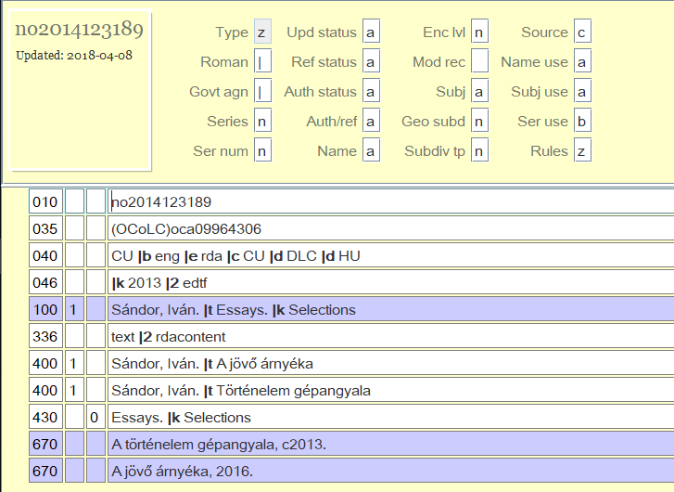
Name/title Heading
Heading with both name and title portions
Title may be uniform title, conventional title or series title.
May be used as name, subject or series entries in Bib Records as shown in 008 field elements
Notes:
Name/title heading:
A heading consisting of both name and title portions.
The name portion contains a personal, corporate, meeting, or jurisdiction name.
The title portion contains the title by which an item or a series is identified for cataloging purposes and may be a uniform title, a conventional title, or a title page title of a work, or a series title.
The 14th, 15th and 16th position in the 008 field will show if the heading may be appropriately used as a name, subject or series entry in a Bibliographic Record .
In this Name/Title Authority Record the Headingg Sandor, Ivan Essays Selections is appropriate for name or subject use in a bib record, but not for series use

Slide 79
Examples of Name/Title Headings in Bib Records
Notes:
Here are examples of NameTitle Headings being used in Bib Records
The first example has the name portion of the Authority Record (subfield a) in a 100 field, and the title portion (subfield t and subfield k) in a 240 field i a bibliographic record
The second example is a Name/Title used as a subject heading in a 600 field of a bibliographic record
The third example is a Name/Title Heading from an Authority Record used as an added author/title field
The fourth example is a Name/Title heading from a Series Authority Record used in an 800 field in a bibliographic record.

Slide 80
110 Corporate Name Heading Authority Records
Definition of a Corporate Body :
The term corporate body refers to an organization and/or organizations that is identified by a particular name and that acts, or may act, as a unit. (RDA 8.1.2)
Corporate bodies are coded in 110 in MARC Authority and in 110, 610 and 710 in MARC Bib Records
Notes:
Field 110 in a Name Authority Record contains a corporate name heading.
RDA Definition of a corporate body - The term corporate body refers to an organization and/or organizations that is identified by a particular name and that acts, or may act, as a unit.
Corporate name headings are coded in 110 field in the MARC Authority Record and in 110, 610 or 710 in MARC Bibliographic Records.

Slide 81
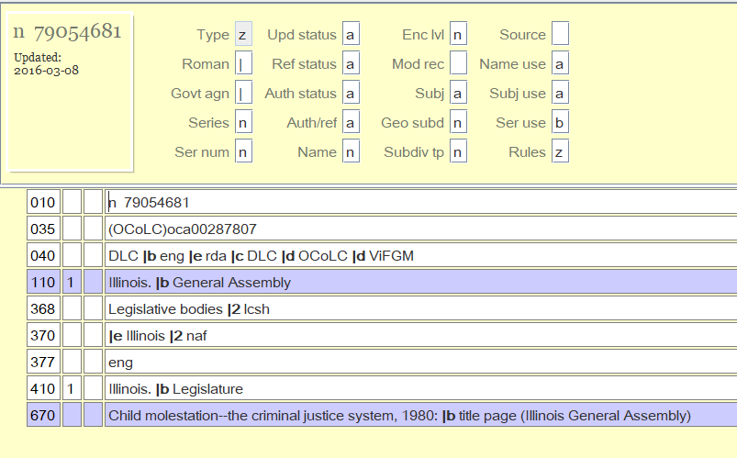
Example of a Corporate Name Heading Authority Record
14
15
9
Notes:
let’s look at the Corporate Name Established Heading Record for the Illinois General Assembly
The 9th Character Position in the 008 field is coded “a” indicating that this is an Established Heading Record rather than a Reference Record
The 14th Character Position in the 008 field is coded “a” indicating that the 110 field can be used as a Corporate Name Heading in a 110 or 710 field of a Bibliographic Record.
The 15th Character Position in the 008 field is coded “a” indicating that the 110 field can be used as a Personal Name Heading Entry in a 610 field of a Bibliographic Record
The first character in the 010 field is “n” indicating that this is a record from the LC Name Authority File
… and The 110 subfield a contains the Established Heading subfield a Illinois. Subfield b General Assembly

Slide 82
110 Indicators
First Indicator:
0 = Inverted name
1 = Jurisdiction name
2 = Name in direct order
Second indicator: Blank
Notes:
The first indicator notes what type of personal name is contained in the field
0=Inverted name
1=Jurisdiction name
3=Name in direct order

Slide 83
110 subfields
|a Corporate Name or a Jurisdiction Name
|b Subordinate Unit
|c Location of a Meeting
|d Dates of a Meeting or Treaty Signing
|e Relator Term
|f Date of a work
|g Miscellaneous information
|k Form subheading
|l Language of a work
|n Number of part/section/meeting
|t Title of a work
|u Affiliation
Notes:
These are the subfields in the 110 field of a Corporate Name Authority Record
Sufield a = contains a corporate name or a jurisdiction name.
The other subfields supply additional information

Slide 84
Corporate Name Headings in AR -BR
Established Heading in a NAR | Bibliographic Record
Notes:
Here the 110 fields from corporate name authority records are on the left, and on the right are corresponding main or added entry headings that could be found in bibliographic records.
Note that the indicators in all 3 examples are the same in the Corporate Name Authority 110 field as in the 710 field in the bibliographic record.

Slide 85
3XX Other Information
368 Other attributes of Corporate Body
370 A place associated with person
372 A field of endeavor, area of expertise
373 A group, institution, association group is associated with
374 Profession or occupation
377 Associated languages
Notes:
3XX fields in a Corporate Name Authority Record give you additional information about the corporate body represented in the 110 field. -
These fields help distinguish among corporate bodies to help determine which name heading matches the subject or responsibility statement on the piece you’re cataloging..
368 contains Other Attributes of Corporate Body e.g. Type of Corporate Body, Type of Jurisdiction ; Start Period ; End Period and other designation.
370 contains a place associated with a corporate body e.g. Place of headquarters
372 A field of endeavor or expertise - e.g. for a musical group it might be Jazz or Rap Music.
373 Group Associated with
374 Occupation ; e.g. for a publishing company - Publication
377 Language

Slide 86
Example of 3XX Fields in Corporate Name Authority Record
Notes:
Here’s an example of a corporate name authority record with some of the 3XX fields with additional information about the rock group The Rolling Stones
368 Other attributes of Corporate Body - They are a rock group and a musical group
370 Associated place - London England is the place they are headquartered
372 The group’s fields of endeavor is Rock music, Blues music, Blues rock music and Rhythm and blues music

Slide 87
410 See from Reference
Leads from unestablished heading to established heading
Guide to find established headings to use in 110, 610 or 710 field in Bib record
Generates a “See From” reference in the catalog
Notes:
Like the 400 in a personal name authority record, there can be a “See from Reference” in a Corporate Name Authority Record in a 400 field.
It serves the same purpose in a name authority record :
Provides direction a form of a personal name that is not an established heading (410) to an established personal name heading (110)
Helps catalogers find established name headings to use in a 110, 610 or 710 field in a bibliographic record * and
Can generate a see from reference in your public catalog, that will direct users to records with an authorized name heading, which then lead to a list of all materials by or about that person..
This Name Authority Record shows the established name heading for The Rolling Stones in the 110 field
And shows some variant forms of his name in the 410 fields
.

Slide 88
410 See from Reference - subdivisions
a Corporate Name or a Jurisdiction Name
|b Subordinate Unit
|c Location of a Meeting
|d Dates of a Meeting or Treaty Signing
|e Relator Term
|f Date of a work
|g Miscellaneous information
|k Form subheading
|l Language of a work
|n Number of part/section/meeting
|t Title of a work
|u Affiliation
|w Control subfield
|i Relationship information
Notes:
Subdivisions in a 410 match the subdivision in a 100 field in a name authority record except :
Subfield i - relationship information
Subfield w is a control field - works the same for any 4XX or 5XX field, covered in the Topical Subject Heading Section of the Presentation

Slide 89
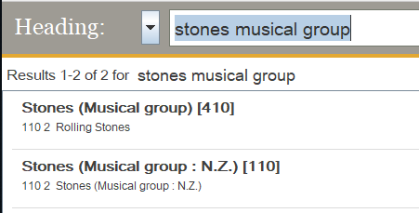
NAF Search Result - Unestablished Corporate Name Heading
Leads to 110 established heading NAR
Notes:
This slide demonstrates how a cataloger can use the information in a 410 field to find an established name heading to use.
It shows this result in the SkyRiver Authority File when I attempted to search Stones musical group.
Since that is an unestablished heading in a 410 field, I am directed to the 110 field with the established heading for his name.
In the red box there’s a result for an unrelated musical group called the Stones in New Zealand.

Slide 90
Public Catalog Display of See Reference
Notes:
Just as with the personal name 400 field, the 410 field generates a “See” reference. In this case See Rolling Stones.

Slide 91
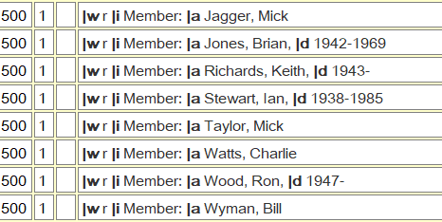
500 See Also from Reference
Connects personal name headings to corporate body headings
Provides information about the relationship between them
Generate a “See Also From” reference in the catalog
|w/01 Relationship designation in subfield i
|i Relationship information
Notes:
Shelly
There can be a Field 500 in a corporate name authority record.
It connects personal name headings to corporate bodies.
The purpose of this field in a subject authority record is to provide information about the relationship between persons and corporate bodies with which they have some involvement
In this example “Rolling Stones” is the established corporate name heading and the 500 fields lead to Personal Name Headings for all the members.
As I noted in Personal name headings |w in 4XX or 5XX headings is a control field ; in this record it provides relationship information along with |i in the 500 fields between the headings for each member and the musical group.
.

Slide 92
510 See Also from Reference
Leads from established name heading to a related established name heading
Guide to find established headings to use in 110, 610 or 710 field in Bib record
Generate a “See Also From” reference in the catalog
Notes:
Shelly
Field 510 in a corporate name authority record is referred to as a “See Also from Reference” or also sometimes known as a tracing field.
The purposes are the same as in a personal name authority record
Provide direction from an established name heading to another established name heading (510)
Help catalogers find alternate established name headings that may be used in a 110, 610 or 710 field in a bibliographic record**
They are used to generate a see from reference in your public catalog, that will direct users to records with an authorized name heading, which then lead to a list of all materials by or about that person together in a search display.
Here the 110 and the 510 are both esblished corporate name headings for the ALA Annual Conference.
.

Slide 93
510 See from Reference - subdivisions
a Corporate Name or a Jurisdiction Name
|b Subordinate Unit
|c Location of a Meeting
|d Dates of a Meeting or Treaty Signing
|e Relator Term
|f Date of a work
|g Miscellaneous information
|k Form subheading
|l Language of a work
|n Number of part/section/meeting
|t Title of a work
|u Affiliation
|w Control subfield
|i Relationship information
Notes:
Subdivisions in a 410 match the subdivision in a 100 field in a name authority record except :
Subfield i - relationship information
Subfield w is a control field - works the same for any 4XX or 5XX field, covered in the Topical Subject Heading Section of the Presentation

Slide 94
NAF Search Result Alternate Established Heading(s)
Notes:
This slide demonstrates how a cataloger can use the information in a 510 field to find an alternate established name heading to use.
It shows the searc result in the SkyRiver Authority File for the term American Library Association Annual Conference
Result is an authority record with that form in a 110 field on the first result, but am also directed to 1 other name authority records with a different 110 heading
Alternative established heading is American Library Association Meeting in the red box.
As with topical subject and personal name 5XX fields, this also leads to a reference in the public catalog

Slide 95
6XX - Notes
663/664 Complex Name References - same in al NARs
666 General Note for Reference Headings
667/680 General Notes - Non-public and Public
670 Source Data
678 Biographical or Historical Data
Notes:
The 6XX notes fields contain the same tags and information as in a Personal Name Authority Record
Some of the more commonly used 6XX fields are:
Will elaborate on 643/644 and 670 operate the same way in Corporate Name ARs as covered in Personal NAR
666 - Reference note, the 100 field is not an established heading and the note contains explanatory information
667/680 are General Notes - Public and Non-public
378 Give Biographical or Historical Data which can help to decide if the 100 field is the person that your piece is by or about

Slide 96
7XX Heading Linking Entry fields
Same as used in Topical Subject Headings (150)
Provide a machine link within a system between headings
Not generally needed to provide information for catalogers
Notes:
7XX Fields provide a machine link between headings

Slide 97
111 Conference/Meeting Name Heading Authority Record
Conferences are considered a Corporate Body
Contains a meeting name used in a name or name/title heading in Name Heading records
Conference names are coded in 111 in MARC Authority and in 111, 611 or 711 in MARC Bib Records
Notes:
Field 111 in a Name Authority Record contains a conference or meeting name heading.
Conference Headings are constructed using the rules for Corporate Body Name Authority Record
Conference headings contain a meeting name used in name or name/title heading in a Name Heading Record
Conference Names are coded in 111 in an Authority Record and in 111, 611, or 711 in a MARC Bibliographic Record

Slide 98
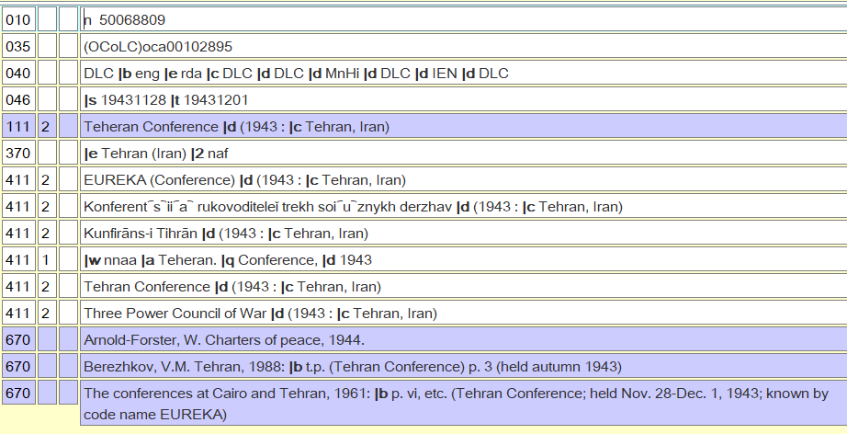
Notes:
Example of a 111 Conference/Meeting Name Authority Record

Slide 99
111 Indicators
First Indicator:
0 = Inverted name
1 = Jurisdiction name
2 = Name in direct order
Second indicator: Blank
Notes:
Field 111 in a Name Authority Record contains a conference or meeting name established heading.
The indicators are the same as a in a 110 Corporate Name Heading
The first indicator notes what type of conference name is contained in the field
0=Inverted name
Entry element of the meeting name is a personal name that is formatted in inverted order
1=Jurisdiction name
Entry element is a jurisdiction name under which the name is entered
3=Name in direct order
The meeting name is formatted in direct order.
The second indicator is blank

Slide 100
111 subfields
|a Meeting Name or a Jurisdiction Name
|c Location of a Meeting
|d Dates of a Meeting or Treaty Signing
|e Subordinate Unit
|f Date of a work
|g Miscellaneous information
|k Form subheading
|l Language of a work
|n Number of part/section/meeting
|t Title of a work
Notes:
These are the subfields in the 111 field of a Conference Name Authority Record
Sufield a = contains a Meeting or Jurisdiction Name
The other subfields supply additional information

Slide 101
Conference Name Headings in AR -BR
Established Heading in a NAR | Bibliographic Record
Notes:
Here the 111 fields from corporate name authority records are on the left, and on the right is a corresponding field in a bibliographic record
The first indicator in Authority and Bibliographic records
2 = Name in Direct Order
The second indicator in both is blank
Authority Record = Always blank (no information)
Bibliographic Record
111
Blank = Undefined
611
0 = LCSH Heading
Bibliographic Record = 711 field 2 = analytic entry

Slide 102
3XX Other Information
368 Other attributes of Corporate Body
370 A place associated with Conference
372 A field of endeavor, area of expertise
373 A group, institution, association conference is associated
377 Associated languages
Notes:
The 3XX fields in a Conference Name Authority Record provides the same information that they do in a Corporate Name Authority Record.
These fields help distinguish among corporate bodies to help determine which name heading matches the subject or responsibility statement on the piece you’re cataloging..
368 contains Other Attributes of Corporate Body e.g. Type of Corporate Body, Type of Jurisdiction ; Start Period ; End Period and other designation.
370 contains a place associated with a corporate body e.g. Place of headquarters
372 A field of endeavor or expertise - e.g. for a musical group it might be Jazz or Rap Music.
373 Group Associated with
377 Language

Slide 103
Example of 3XX fields in a 111 AR
Notes:
Here the 3XX fields provide the additional details that the 10th Olympic Winter Games were a Sporting Event (368) and a Sports Tournament (368) were held in Grenoble France (370) and involved Winter Sports and Winter Olympics as activities (372)

Slide 104
411 See from Reference
Leads from unestablished heading to established heading
Guide to find established headings to use in 111, 611 or 711 field in Bib record
Generates a “See From” reference in the catalog
Notes:
Like the 410 in a corporatel name authority record, there can be a “See from Reference” in a Conference Name Authority Record in a 411 field.
It serves the same purpose in a name authority record :
Provides direction a form of a personal name that is not an established heading (411) to an established personal name heading (111)
Helps catalogers find established name headings to use in a 110, 610 or 710 field in a bibliographic record * and
Can generate a see from reference in your public catalog, that will direct users to records with an authorized name heading, which then lead to a list of all materials by or about that person..
This Name Authority Record shows the established name heading for the 3rd Olympic Winter Games in Lake Placid, N.Y.and shows some variant forms of his name in the 411 fields
.

Slide 105
411 See from Reference - subdivisions
a Corporate Name or a Jurisdiction Name
|b Subordinate Unit
|c Location of a Meeting
|d Dates of a Meeting or Treaty Signing
|e Relator Term
|f Date of a work
|g Miscellaneous information
|k Form subheading
|l Language of a work
|n Number of part/section/meeting
|t Title of a work
|u Affiliation
|w Control subfield
|i Relationship information
Notes:
Subdivisions in a 411 match the subdivision in a 100 field in a name authority record except :
Subfield i - relationship information
Subfield w is a control field - works the same for any 4XX or 5XX field, covered in the Topical Subject Heading Section of the Presentation

Slide 106
Public Catalog Display of See Reference
Notes:
In the public catalog, the 411 field generates a reference, in the red boxes here, that guides the user to the established heading
The Subject Search ws for lake placid Olympic
“Try a search for Olympic Winter Games (3rd : 1932 : Lake Placid, N.Y.)

Slide 107
511 See Also from Reference
Leads from established name heading to a related established name heading
Guide to find established headings to use in 111, 611 or 711 field in Bib record
Generate a “See Also From” reference in the catalog
Notes:
Field 511 in a conference name authority record is referred to as a “See Also from Reference” or also sometimes known as a tracing field.
The purposes are the same as in a corporate name authority record
Provide direction from an established name heading to another established name heading (511)
Help catalogers find alternate established name headings that may be used in a 111, 611 or 711 field in a bibliographic record**
They are used to generate a see from reference in your public catalog, that will direct users to records with an authorized name heading, which then lead to a list of all materials by or about that person together in a search display.
Here the 111 and the 511 are both established Conference/Meeting Headings for The Oregon Shakespearen Festival
The 511 is an earlier heading - the |w code “b” provides that information
.

Slide 108
Public Catalog Display of See Also Reference
Notes:
In the public catalog, the 511 field generates a “See Also” reference
The subject search was Oregon Shakespeare Festival
The 511 field generated “See Also” references to an earlier heading “Oregon Shakespearean Festival” and also the established heading “Oregon Shakespearean Festival”

Slide 109
6XX - Notes
663/664 Complex Name References - same for all NAR
666 General Note for Reference Headings
667/680 General Notes - Non-public and Public
670 Source Data
678 Biographical or Historical Data
Notes:
The 6XX notes fields contain the same tags and information as in a Personal Name Authority Record or Corporate Name
Some of the more commonly used 6XX fields are:
643/644 and 670 operate the same way in Corporate Name ARs as covered in Personal NAR
666 - Reference note, the 1xx field is not an established heading (Reference) and the note contains explanatory information
667/680 are General Notes - Public and Non-public
678 Give Biographical or Historical Data which can help to decide if the 1XX field is the correct heading that your piece is by or about

Slide 110
7XX Heading Linking Entry fields
Same as used in Topical Subject Headings (150)
Provide a machine link within a system between headings
Not generally needed to provide information for catalogers
Notes:
7XX Fields provide a machine link between headings

Slide 111
151/110 Geographic Name Heading Authority Records
Geographic Name Headings can be :
Jurisdictional Headings - Cities, Countries, etc. and their departments that could author or issue works.
Non Jurisdictional Headings - Geographic areas or features without political identity that could only be used as a subject.
Notes:
Geographic headings for place names may appear in
Geographic Name Headings may broken down into 2 broad categories:
Political jurisdictions: Places that have or had jurisdictional status on some level: Such politically defined places -- e.g., countries, cities, and provinces -- could have governments that issue works and function as corporate authors.
Or
Non-jurisdictional headings: Geographic features or areas without jurisdictional status: Such places do not have any political identity and could only relate to a work as subjects.

Slide 112
151 Geographic Name Indicators
First Indicator: Blank
Second indicator: Blank
Notes:
Both indicators in 151 Geographic Name Headings are blank

Slide 113
151 Geographic Name subfields
|a Geographic Name
|g Miscellaneous information
|v Form subdivision
|x General subdivision
|y Chronological subdivision
|z Geographic subdivision
Notes:
These are the subfields in the 151 field of a Geographi Name Authority Record
Sufield a = contains a geographic name
The other subfields supply additional information

Slide 114
Jurisdictional Geographic Name Headings
Can possibly serve 2 purposes :
A geographic area found in a 651 in Bib Record
or
The government of that area in a 110 or 710 field in Bib Record
Notes:
A jurisdictional heading potentially serves a dual function; it may represent:
The geographic area (651 field)
The government of that area (110 or 710 field) - in these cases the heading is a corporate body heading

Slide 115
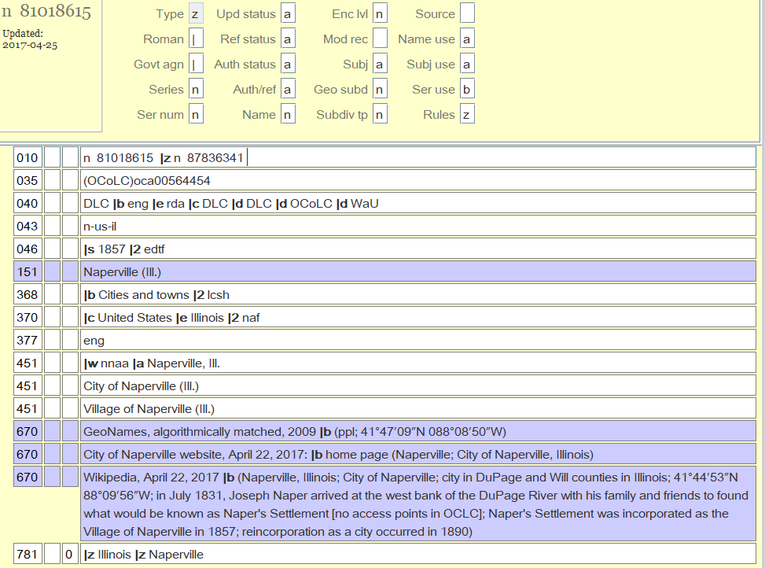
14 Name
15 Subj
Notes:
Here’s an Example of Jurisdictional Geographic Name Heading
In the 008 Fixed Field Elements - Positions 14 and 15 are coded “a” tells us that this heading can be used as a name or as a subject in a Bib Record
In the 010 LC Control number field the prefix is “n” = Name Authority Record
The Established heading for this Jurisdictional Geographic Name is found in the 151 field - Naperville (Ill.)

Slide 116
Jurisdictional Geographic Name Headings in AR- BR
Established Heading in a NAR | Bibliographic Record
Notes:
151 fields from name authority record for Naperville on the left
Used as a 110 Corporate Name Heading in a Bibliographic Record on the right in the first row
And
Used as a 651 Geographic Name Subject heading in a Bibliographic Record on the right in the second row

Slide 117
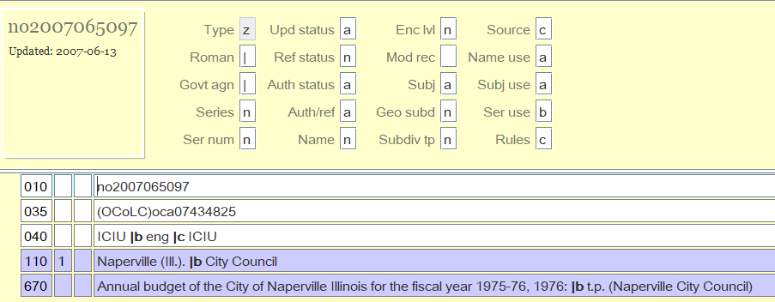
Jurisdictional Geographic Heading as 1st Element of a Govt. Body
Notes:
As a government, a jurisdictional heading may also appear as the first element of a government body heading here it’s being treated as a corporate Name Heading
In these headings the Established Heading is in a 110 Field in the Name Authority Record
These headings can also be used as either a name or subject heading in a Bibliographic Record

Slide 118
Jurisdictional 1st Element of Govt. Body
Established Heading in a NAR | Bibliographic Record
Notes:
Here the 110 field from the Authority Record for is on the left
Used as a Jurisdictional 1st Element of a Govt. Body in the 110 of a Bib Record on the right.
This Heading could also be used in a 610 field as a subject in a Bib Record

Slide 119
Non-Jurisdictional Geographic Name Heading
Can only serve as a subject heading
A geographic feature or area without jurisdictional status
Found in a 651 in Bib Record
Notes:
A Non- jurisdictional heading can only serve as a subject heading in (651 field)
Geographic features or areas without jurisdictional status

Slide 120
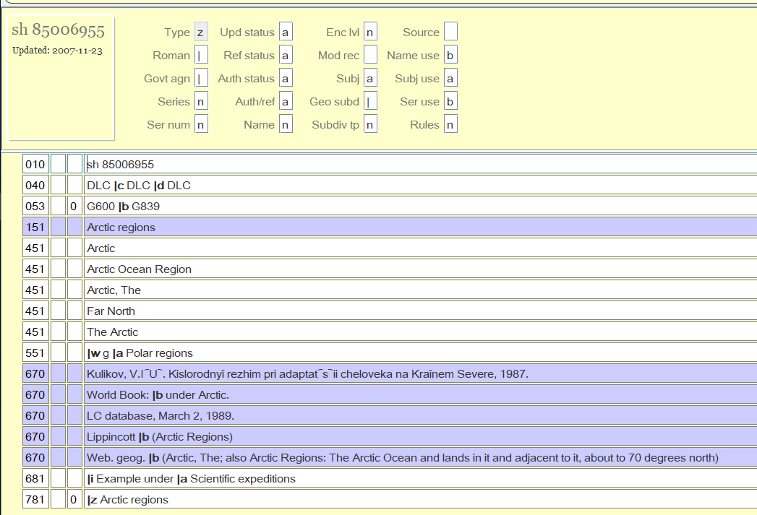
14 Name
15 Subj
Notes:
Here’s an Example of a Non-Jurisdictional Geographic Name Heading
In the 008 Fixed Field Elements - Positions 14 is coded “b” - cannot be used as a Name Heading in a Bib Record
Position 15 is coded a tell us that this heading can be used a Subject Heading in a Bib Record
In the 010 LC Control number field the prefix is “sh” = Library of Congress Subject Heading, not a name heading
The Established heading for this Non- Jurisdictional Geographic Name is found in the 151 field - Arctic regions

Slide 121
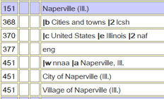
451 See from Reference
Leads from unestablished heading to established heading
Guide to find established headings to use in 151, 651 or 751 field in Bib record
Generates a “See From” reference in the catalog
Notes:
Like the 4XX in other name authority records, there can be a “See from Reference” in a Geographic Name Authority Record in a 451 if it’s a Heading that is a jurisdictional or non-jurisdictional Geographic Name that is NOT the 1st element of a Govt. Body
It serves the same purpose in other name authority record :
Provides direction a form of a geographic name that is not an established heading (451) to an established geographic name heading (151)
Helps catalogers find established name headings to use in a 151, 651 or 751 field in a bibliographic record Can generate a see from reference in your public catalog, that will direct users to records with an authorized name heading, which then lead to a list of all materials by or about that person..
.

Slide 122
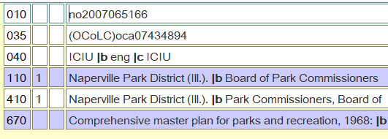
410 See from Reference
Leads from unestablished heading to established heading
Guide to find established headings to use in 110, 610 or 710 field in Bib record
Generates a “See From” reference in the catalog
Notes:
Like the 4XX in other name authority records, there can be a “See from Reference” in a Geographic Name Authority Record in a 410 if it’s a Heading that is a jurisdictional 1st element of a Govt. Body
It serves the same purpose in other name authority record :
Provides direction a form of a geographic name that is not an established heading (410) to an established geographic name heading (110)
Helps catalogers find established name headings to use in a 110, 610 or 710 field in a bibliographic record Can generate a see from reference in your public catalog, that will direct users to records with an authorized name heading, which then lead to a list of all materials by or about that person..
.

Slide 123
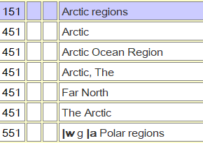
551 See Also from Reference
Leads from established name heading to a related established name heading
Guide to find established headings to use in 151, 651 or 751 field in Bib record - this example is non-jurisdictional so only a 651 or 751
Generate a “See Also From” reference in the catalog
Notes:
Field 551 in a geographic name authority record is referred to as a “See Also from Reference” if it’s a Heading that is a jurisdictional or non-jurisdictional Geographic Name that is NOT the 1st element of a Govt. Body
The purposes are the same as in a other name authority records
Provide direction from an established name heading to another established name heading (551)
Help catalogers find alternate established name headings that may be used in a 151, 651 or 751 field in a bibliographic record
In this example this is a non-jurisdictional geographic name, so the 151 “Arctic regions” can only be used in a subject field in a bib recor
They are used to generate a see from reference in your public catalog, that will direct users to records with an authorized name heading, which then lead to a list of all materials by or about that person together in a search display.
Here the 551 - Polar Regions- is a broader subject heading - the subfield w coded “g” indicates that.

Slide 124
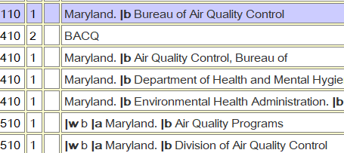
510 See Also from Reference
Leads from established name heading to a related established name heading
Guide to find established headings to use in 151, 651 or 751 field in Bib record
Generate a “See Also From” reference in the catalog
Notes:
Like the 511 in other name authority records, there can be a “See from Reference” in a Geographic Name Authority Record in a 510 if it’s a Heading that is a jurisdictional 1st element of a Govt. Body
The purposes are the same as in a other name authority records
Provide direction from an established name heading to another established name heading (510)
Help catalogers find alternate established name headings that may be used in a 110, 610 or 710 field in a bibliographic record
They are used to generate a see from reference in your public catalog, that will direct users to records with an authorized name heading, which then lead to a list of all materials by or about that person together in a search display.
Here the 510 fields are later names for the heading in the 110 field. The code “b” in the subfield w indicates that

Slide 125
6XX - Notes
663/664 Complex Name References - same for all NAR
666 General Note for Reference Headings
667/680 General Notes - Non-public and Public
670 Source Data
678 Biographical or Historical Data
Notes:
The 6XX notes fields contain the same tags and information as in a Personal Name Authority Record or Corporate Name
Some of the more commonly used 6XX fields are:
663/664 and 670 operate the same way in Corporate Name ARs as covered in Personal NAR
666 - Reference note, the 1xx field is not an established heading (Reference) and the note contains explanatory information
667/680 are General Notes - Public and Non-public
678 Give Biographical or Historical Data which can help to decide if the 1XX field is the correct heading that your piece is by or about

Slide 126
7XX Heading Linking Entry fields
Same as used in Topical Subject Headings (150)
Provide a machine link within a system between headings
Not generally needed to provide information for catalogers
Notes:
7XX Fields provide a machine link between headings

Slide 127
Series Headings

Slide 128
What is a series?
“A group of separate resources related to one another by the fact that each resource bears, in addition to its own title proper, a collective title applying to the group as a whole. Numbering is not a requirement for a series” – RDA definition

Slide 129
Notes:
Monographic series include continuing resources like serials, periodicals, and newspapers.
A Monographic series and serials have three main characteristics:
--it is issued in a succession of discrete parts;
--it usually bears numbering; and
--it has no pre-determined conclusion.
***Additional characteristic of Monographic series, outside of serials, they have a collective title and a distinct title
Multipart monographs, were also called multipart items
-Issued in seperate parts and finite (a predetermined end point - even if the end point is the death of the author)
-May or may not have numbering and individual titles.
Series like phrase

Slide 130
Series Authority Records include...
Authorized heading form
Cross references from unused forms of headings
Cross references to related forms of headings
Numbering pattern
Decisions on how items in the series should be handled (Analysis, treatment, and classification)
Series Authority Record function
Validate access point
Identify series from other similar series
Document decisions regarding analysis, series access and classification

Slide 131
Primary Fields in Series Authority Records
008 | Fixed length data elements
1XX | Established series heading
4XX | See from reference from non-established form
5XX | See also from reference from related established heading
64X | Series treatment fields
667, 670, 675 | Notes

Slide 132
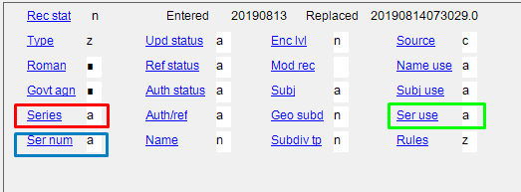
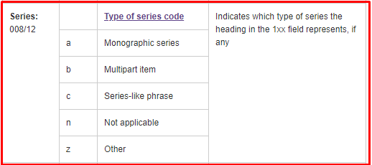
008 Fixed Length Data Elements

Slide 133
Types of Series (008/12)
a - Monographic series
Group of separate items issued in a specific order and as individual items
May be numbered or unnumbered
No planned end
Collective title and individual title
b - Multipart items
Issues in separate parts
May be numbered or numbered
Finite
May or may not have individual titles
c - Series–like phrase
Statement used to group items but will not be used as a series in bibliographic record

Slide 134
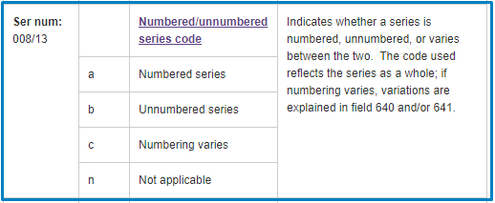
008 Fixed Length Data Elements

Slide 135
1XX Established Series Headings
130 – Uniform title series heading
May have qualifier
May have subseries
100 – Personal name-title proper series heading
May also be a collective uniform title series

Slide 136
4XX See From reference from non-established form of heading
Any non-established version of the 1XX
Could be
Variant forms of series title found on individual items
Common variants users may search under
Alternative spellings of words in established series
Active cross-references used locally
1XX in various languages

Slide 137
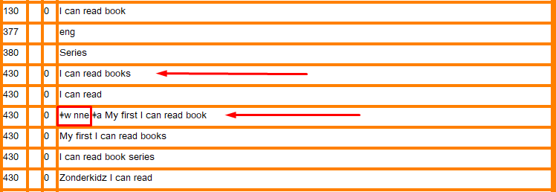
Notes:
Subfield w will establish relationship with 1XX.
Special relationship to heading (Earlier/later/broader term, etc) / tracing use restriction / Earlier form of heading(pre-AACR or not /Reference display (when to display a cross reference from tracing)

Slide 139
5XX See Also reference from related established heading
Used when there are two or more established forms of a heading
Series name change
Part of more than one series

Slide 140
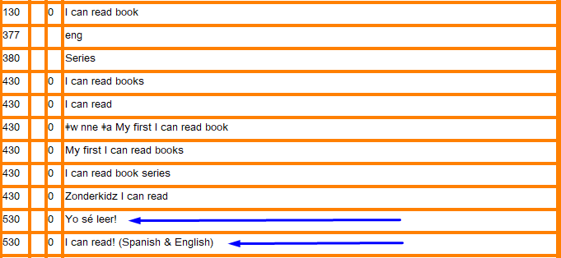

Slide 142
640-642 Series numbering
640 Series dates of Publication and/or sequential designation
641 Series numbering peculiarities
642 Series numbering example
Documents how numbering is handled in a standardized and consistent way
Provides catalogers with an example of how to record series numbering in the series access point in the bibliographic record.

Slide 144
643 Series Publisher
643 Series place and publisher/issuing body
Subfield codes
$a Place of publication
$b Publisher/Issuing body
$d Volumes/dates to which place and publisher apply
643 is a repeatable field when needed
If there is both a publisher and an issuing body, the issuing body recorded in a 410 name-title reference.

Slide 145
Issusing body for Criterion collection
Multiply publishers, 643 repeated. Issuing body in 410.

Slide 146
644-646 Series treatment
Series treatment statements are optional fields, not all SARs will have them.
Can be used to document local decisions for the analysis, tracing and classification of series (the local series treatment)
Fields used to document series treatment
644 – Analysis decisions
645 – Tracing decisions
646 – Classification decision
Notes:
Contain information concerning the treatment of the series represented by the 1XX heading

Slide 147
644-646 Series treatment : Subfield $a
644 |  | Indicates the series analysis practice
 | $a | f (Analyzed in full) p (Analyzed in part) n (Not analyzed)
645 |  | Indicates the series tracing practice
 | $a | t (Traced as series added entry) n (Not traced as series added entry)
646 |  | Indicates the series classification practice
 | $a | c (Classified as a collection) m (Classified with main or other series) s (Classified separately)

Slide 148
Notes:
Analyized in Full - Traced as a series - classified seperately

Slide 149
667 670 675 Notes
667 - Nonpublic general note - permanent or temporary note ; not for general public
670 - Source data found - Where and when information was found ; including material in hand source
675 - Source data not found - List sources consulted but information not found

Slide 152
3XX RDA Series AR MARC Tags
336 - Content Type
370 - Associate Place
373 - Associated Group
377 - Language
380 - Form of Work - A class or genre to which a work belongs.

Slide 154
Local practice options
Local headings
Patron access
Multiple authors
Dead authors still writing
Award headings

Slide 155
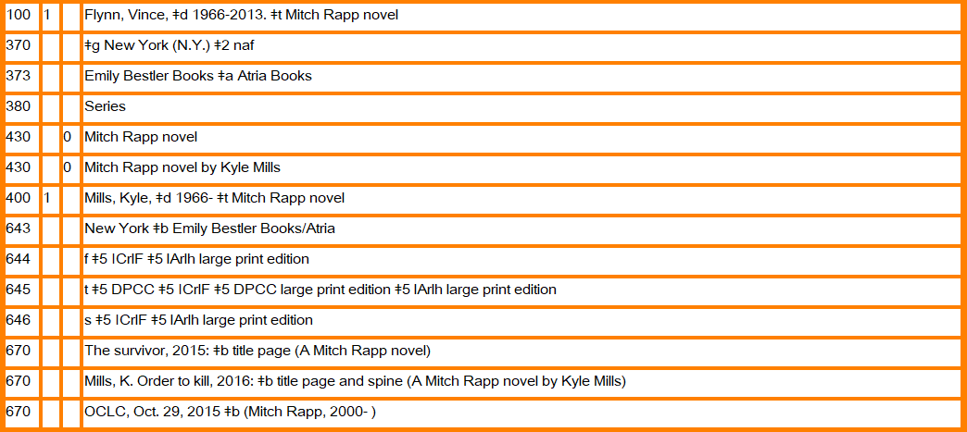

Slide 156
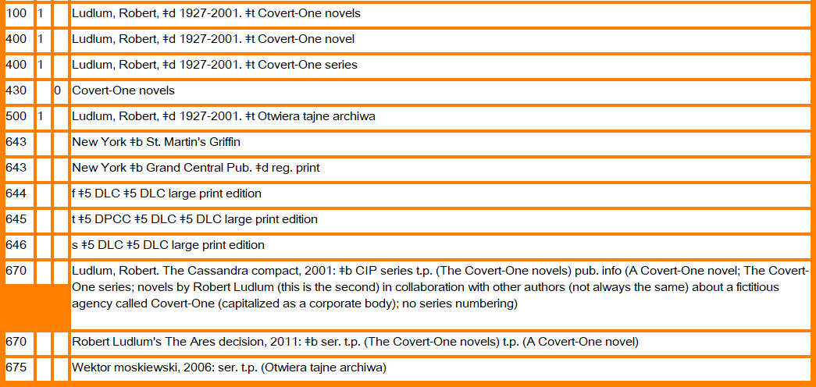

Slide 158
Uniform Titles
Notes:
Shelly

Slide 159
130 Heading - Uniform Titles (Preferred Title for Work - RDA)
Heading consisting of the title by which an item or series is identified when
Title is not entered under a personal, corporate, meeting or jurisdiction name in a name/title heading
May be used as a main or added entry (name), subject or series heading (130, 630, 730 or 830) in a Bibliographic Record
Notes:
A uniform title is A heading consisting of the title by which an item or a series is identified for cataloging purposes when the title is not entered under a personal, corporate, meeting, or jurisdiction name in a name/title heading construction.
Uniform title established headings may be appropriately used as any type of heading - name, subject or series, depending on the type of heading

Slide 160
008 - Uniform Title Heading Authority Records
Character Position | Value
09 | Kind of record - Established Heading (a) or Reference (b)
14 | Heading use - 1XX or 7XX entry - Appropriate (a) ; Not appropriate (b)
15 | Heading Use - Subject Added Entry - Appropriate (a) ; Not appropriate (b)
16 | Heading Use - Series Added Entry Appropriate (a) ; Not appropriate (b)
Notes:
The 008 Field contains coded information in 40 character positions.
As noted, the display can vary from system to system, so the codes are universally defined by their position in the field.
I’ve noted here some of the elements in the 008 field which are relevant and can be useful to know as relates to a uniform title authoriyy record.
9th position - Kind of record
Established heading = a
Reference record = b
14th position - Can be used as a Main 1XX or Added 7XX entry in a Bibliographic Record
Appropriate = a
Not appropriate = b
15th position - Subject Added Entry in a Bib Record a= appropriate b = not appropriate
16th position - Series Added Entry a= appropriate b = not appropriate

Slide 161
008/09
a = established heading
b = reference record
Notes:
The 09 position in the 008 field indicates whether the authority record represents an established or unestablished 130 Heading
When determining if you can use a heading from a uniform title authority record in an access point = 130. 730. 630 or 830 fields in a bibliographic record, the code “a” in this position tells you that this is an established heading, and it can be used.
The code “b” means that this heading is only used as a reference,

Slide 162
008/14 Heading use - main or added entry
a = appropriate
Notes:
The 14th position in the 008 field indicates whether the 130 in an Authority Record is an established name heading that can be used in a 130, 630, 730 or 830 field in a bibliographic record.
Code a = appropriate to be used as a name established heading
Code b = Not appropriate to be used as a name established heading
Code | = No attempt to code

Slide 163
008/15
a = used as a subject heading
b = not used as a subject heading
Notes:
Shelly
The 15 position in the 008 field indicates whether the heading in the 150 field of the authority record is appropriate to use as a 630 subject field in a bibliographic record
If it’s coded “a” it is appropriate for use as a subject field in a bibliographic record ; coded “b” it’s not appropriate for use as a subject field in a bibliographic record

Slide 164
008/16
a = used as a series heading
b = not used as a series heading
Notes:
Shelly
The 16 position in the 008 field indicates whether the heading in the 130 field of the authority record is appropriate to use as an 830 subject field in a bibliographic record
If it’s coded “a” it is appropriate for use as a series field in a bibliographic record ; coded “b” it’s not appropriate for use as a series field in a bibliographic record

Slide 165
010 LC Control Number
beginning with “n” = LC Name Heading
Notes:
Established Headings for Works and Expressions are created in the Name Authority File.
If the Heading begins with a name for the creator it goes in name/title heading - 100, 110 or 111
If does not have an explicit creator - use 130

Slide 166
Example of a Uniform Title Heading Authority Record
14, 15, 16
9
Notes:
Example of a uniform title heading Authority Record
The 9th Character Position in the 008 field is coded “a” indicating that this is an Established Heading Record rather than a Reference Record
The 14th Character Position in the 008 field is coded “a” indicating that the 130 field can be used as a Main Heading in a 130 or 730 field of a Bibliographic Record.
The 15th Character Position in the 008 field is coded “a” indicating that the 130 field can be used as a Title Heading Entry in a 630 field of a Bibliographic Record
The 16th Character Position in the 008 field is coded “a” indicating that the 130 field can be used as a Series Heading Entry in an 830 field of a Bibliographic Record
The first character in the 010 field is “n” indicating that this is a record from the LC Name Authority File
.
… and The 130 subfield a contains the Established Heading “Harry Potter wizards unite (Game)”

Slide 167
130 Indicators
First Indicator:
Blank
Second indicator:
Non-filing characters
Specifies the # of article characters at
the beginning of the uniform title
Notes:
The first indicator is blank
The second indicator is to indicate the number of non-filing characters
contains a value that specifies the number of character positions associated with a definite or indefinite article (e.g., Le, An) at the beginning of a uniform title heading that are disregarded in sorting and filing processes.
In this example there are no non-filing characters so the 2nd position is blank.

Slide 168
130 subfields
|a Uniform title
|f Date of a work
|g Miscellaneous information
|h Medium
|k Form subheading
|l Language of a work
|m Medium of work
|n Number of part/section/meeting
|o Arranged statement for music
|p Name of part/section of work
|r Key for music
|s Version
|t Title of a work
|v Form subdivision
|x General subdivission
|y Chronological subdivision
|z Geographic Subdivision
Notes:
These are the subfields in the 130 field of a Uniform Title Authority Record
Sufield a = contains a uniform title
The other subfields supply additional information

Slide 169
130 Uniform Title Heading
Established Heading in a NAR | Bibliographic Record
Notes:
Here the 130 fields from name authority records are on the left, and on the right are corresponding name added entry, subject and series headings that could be found in bibliographic records.
First row shows the Uniform Title Established Heading for a game - Harry Potter Wizards United - on the left
And on the right is that heading in subject heading (630) field of a bib record.
Second row - Uniform title Established Heading for a movie on left ; Added name entry (730) oin bib record on right
Third row - Uniform title Established Heading for a series on left ; Added Series heading in bib record on right (830)
It’s represented exactly the same - the first indicator in the Authority and Bibliographic record in the 100 field shows that this is a surname. The 2nd indicator is blank in both.
The second row shows the Name Authority Record for King George the third if Great Britain on the left, and in the Bibliographic Record on the right, this name heading is being used as a subject in a 600 field.
Here the first indicator in both the Authority Record and the Bibliographic Record indicates that this is a forename.
The second indicator is blank in the Authority Record, but there is a 0 in the Bibliographic Record. It indicates what subject heading system is being used - 0 for LCSH
The third row shows a 100 Personal Name Heading in the Authority record on the left and a corresponding 700 Added Entry Personal Name Heading in the bibliographic record on the right.
The first indicator is the same, indicating that this is a personal name that includes a surname - Vassallo
The second indicator is blank in the authority and bibliographic record
Blank in the 700 field in the Authority Record = Undefined
Blank in the 700 in the Bibliographic Record = No information provided regarding if this is an analytic heading (including a work title as well as a name)
The 4th row shows a 100 Personal name/Title heading in the Authority Record on the left and a corresponding 700 Added Entry Personal Name/Title Heading in the bibliographic record on the right.
The 1st indicator is 1 in both records for having a surname
The 2nd indicator is blank on the Name Authority Record on the left ; and is 2 in the Bib Record on the right. - this indicates that this is an analytic heading. It has listed a specific title that is included in the piece being cataloged in the Name/Title Heading.

Slide 170
3XX Other Information
370 A place associated with
373 A group, institution, association associated with
377 Associated languages
380 Form of work
381 Other Distinguishing Characteristics of Work or Expression
388 Time Period of Creation
Notes:
3XX fields in a Uniform Title Authority Record gives you additional information about the uniform title represented in the 130 field.
d

Slide 171
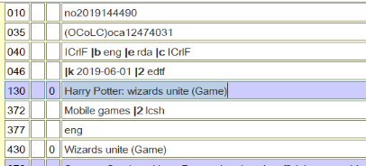
430
Leads from unestablished heading to established heading
Guide to find established headings to use in 130, 630, 730 or 830 field in Bib record
Generates a “See From” reference in the catalog
Notes:
Like the 4XX other Authority Records
It serves the same purpose :
Provides direction a form of a uniform title that is not an established heading (430) to an established personal name heading (130)
Helps catalogers find established headings to use in a 130, 630 or 730 field in a bibliographic record * and
Can generate a see from reference in your public catalog, that will direct users to records with an authorized name heading, which then lead to a list of all materials by or about that person..
This Authority Record shows the established uniform title heading for the game Harry Potter : wizards unite And shows one variant forms of his name in the 430 field ; Wizards unite (Game)

Slide 172
530 See Also from Reference
Leads from established name heading to a related established name heading
Guide to find established headings to use in 130, 630 or 730 field in Bib record
Generate a “See Also From” reference in the catalog
Notes:
Like the 5XX field in other authority records, there can be a “See from Reference” in a Uniform Title Authority Record in a 530
The purposes are the same as in a other name authority records
Provide direction from an established name heading to another established name heading (530)
Help catalogers find alternate established name headings that may be used in a 130, 630 or 730 field in a bibliographic record
They are used to generate a see from reference in the public catalog, that will direct users to records with an authorized uniform title heading, which then lead to a list of all materials with that heading in an author, title or subject field.
In the 530 field the code “r” in the subfield w indicates that there is a relationship between the Heading “Empire strikes back (Motion picture) and the heading in the 130 “Star wars (Motion picutre)
The subfield i in field 530 indicates the relationship - it’s a sequel

Slide 173
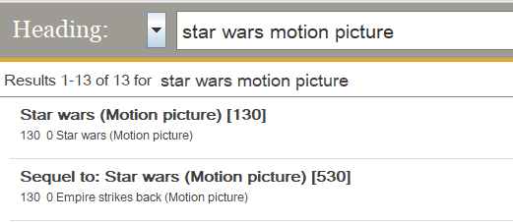
Authority File Search Result Alternate Established Heading
Notes:
This slide shows an Authority File search result with “See Also” refererence
When searching the iniform title “Star Wars Motion Picture” the result shows the other established heading that was found in the 530 field of the authority record. The term and relationship “Sequel to: Star wars (Motion picture) is a related uniform title.
This Uniform Title would be appropriate for a cataloger to use in a 130, 630 or 730 field in a Bibliographic Record

Slide 174
Public Catalog Display of See Also Reference
Notes:
In the public catalog, the 530 field generates a “See Also” reference from the heading Star Wars (Motion picture) in the red box here
It guides the user to another established heading , Empire Strikes back, in our catalog

Slide 175
Genre Headings
Notes:
Shelly

Slide 176
Genre Form Authority Records
What constitutes a genre form term?
What’s the difference between a subject heading and a genre form heading?
These are terms that describe what something is rather than what it is about, as LCSH subject headings do.
Notes:
Notice I referred to this type of authority record as “Genre” “Form” authority records. In general, “Genre” refers to terms that describe themes and “Form” refers to designations that describe structure.
AN EXAMPLE OF GENRE: Fantasy fiction
AN EXAMPLE OF FORM: Encyclopedias
For example, the popular film, The Martian, is a science fiction film as well as an action and adventure film, the subject content is not about a science fiction film or an action adventure film. The same holds true for books that are collections of poetry. These books contain poetry, and they are not for example, about how to write poetry, or an analysis of poetry.

Slide 177
Many libraries that use genre form headings in their bibliographic records, link these to genre form authority records that have been created by the Library of Congress.
Genre form terms created by, and authorized for use by the Library of Congress, are referred to as “lcgft” headings
“Library of Congress Genre Form Terms”

Slide 178
The authority records for genre form terms have a few elements in them that are different than those found in name, series, or subject authority records.
However, the basic core set of elements is the same (there is always a 1xx field and a 670 field - and possibly 4xx and 5xx fields, a 675 field, a 680 field, and a 681 field)

Slide 179
The key difference between a subject authority record and a genre form authority record
LCSH authority record genre form authority record
150 Authorized term 155 Authorized term
450 Used For reference(s) 455 Used For reference(s)
550 Related Term and 555 Related Term and
Broader Term reference(s) Broader Term reference(s)
Notes:
Note

Slide 180
The requirement for literary warrant - (the 670 field)
Thorough research demonstrating that the wording chosen for the proposed term is appropriate is required for all terms
The purpose of doing authority research and listing the sources consulted, as well as providing information found in those sources in the genre/form authority record, is either to demonstrate the form(s) in which the word or phrase has been found in existing literature, or to document the fact that no information about the term can be found in the reference sources (675 field)
Notes:
Before I talk more about genre form terms, I’d like to mention a few things about the 670 field, which is a field included in all authority records no matter what the type.
The 670 field contains the critical information as to the various sources consulted to demonstrate the usage of the term.

Slide 181
The information in the 670 field serves three purposes:
(1) to provide an indication of the relationship of the term to the work being cataloged;
(2) to provide information on the cataloger’s choice of terminology for the authorized term, the UF and BT references, and the scope note (if provided); and
(3) to provide definitions, information on the intended scope and usage of the proposed term, its relationship to, and distinction from, similar existing terms, and any peculiarities or other pertinent information about the term.
Notes:
LC’s rule of thumb pertaining to lcgft terms is usually to provide at least three different 670 sources in the lcgft authority record.

Slide 182
lcgft is a stand‐alone vocabulary that may be used in conjunction with any subject heading system and any descriptive cataloging code.
The terms in included in the lcgft vocabulary may describe the purpose, structure, content, and/or themes of resources.
Examples: “picture books” (purpose)
“dictionaries” (structure)
“poetry” (content)
“romance fiction” (themes)
Notes:
By this I mean it can be used in bibliographic records along with LCSH headings, MESH headings, and in either RDA or AACR2 records.

Slide 183
lcgft terms are divided into several different categories
Artistic and visual works (paintings, sculptures, etc.)
Cartographic materials (maps, atlases)
General terms (dictionaries, encyclopedias, etc.)
Law materials
Literature terms (fiction, drama, poetry, comics)
Moving images (films and television programs)
Music
Non-musical sound recordings (primarily radio programs, audiobooks)
Religious materials
Notes:
The lcgft vocabulary has greatly expanded in the last 8 - 10 years and it includes thousands of terms with more being added on a continual basis. The LC website links to a PDF list of the current terms but this is only published annually. I’ve provided the URL to LC’s lcgft site under our Sources slide which can be found at the end of the presentation.

Slide 184
Structure of a basic lcgft genre authority record
Fixed field Control number
008/11 z 010 gf
Data fields
040 $f lcgft
155 Authorized term
455 Used For reference(s)
555 Related Term and Broader Term reference(s)
670’s Literary warrant
May also contain 675, 680, and 681.
Notes:
008/11 fixed field byte: The data in the position indicates which subject heading thesaurus the authorized term belongs to. In the case of the lcgft terms, they will always be coded z for other subject heading system/thesaurus
Control number 010: The numbers are always preceded by gf for lcgft terms. The gf standing for “genre form”
The name of the vocabulary is always referenced in subfield $f of the 040 field

Slide 185
Authority record for “Picture books”
010__ |a gf2016026096035
035__ |a gf2016026096040
040__ |a WaU |b eng |c DLC |f lcgft
155__ |a Picture books
555__ |w g |a Illustrative works
670__ |a Work cat.: Alexie, Sherman. Thunder Boy Jr., 2016 |b (a picture book for children)
Notes:
This record is continued on the next slide

Slide 186
Continuation of the authority record for
“Picture books”
670__ |a Sherman Alexie website, Oct. 4, 2016: |b bio (Sherman Alexie is a poet, short story writer, novelist, and performer. He has published 25 books including his first picture book, Thunder Boy Jr, and young adult novel, The Absolutely True Diary of a Part-Time Indian, both from Little, Brown Books for Young Readers)
670__ |a School library journal, Feb. 2016: |b p. 58 (review of Thunder Boy Jr.: "An enchanting and humorous picture book about a little boy frustrated with his name. ... Highly recommended for all picture book collections.")
670__ |a The ALA glossary of library and information science, 1983 |b (picture book: A children’s book, consisting of illustrations and little or no text, such as an alphabet or counting book, generally intended for preschool children; picture storybook: A children’s book consisting of a narrative and illustrations that are synchronized with the text, generally requiring a reading ability level of at least third grade and intended to be read by children)
Notes:
I’ve highlighted the term picture book so it’s easier to see. As talked about a few slides ago, the authorized term,must be referenced in the 670’s included in the authority record.

Slide 187
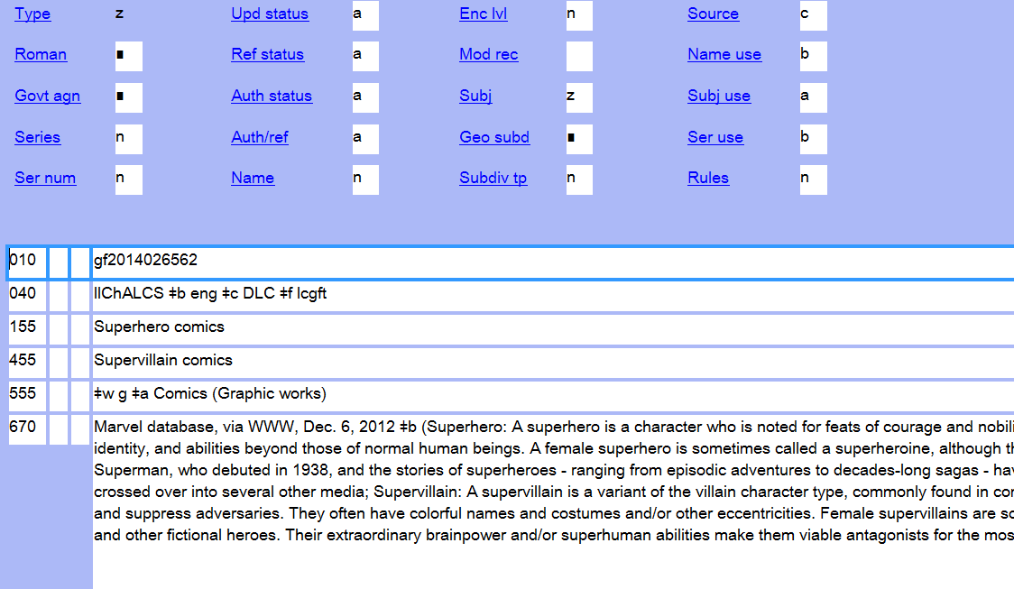
Notes:
Here is a screen shot of the actual authority record for Superhero comics as it looks in OCLC. Although the slide isn’t very large, I wanted to include some screenshots of how the authority records look in OCLC,

Slide 188
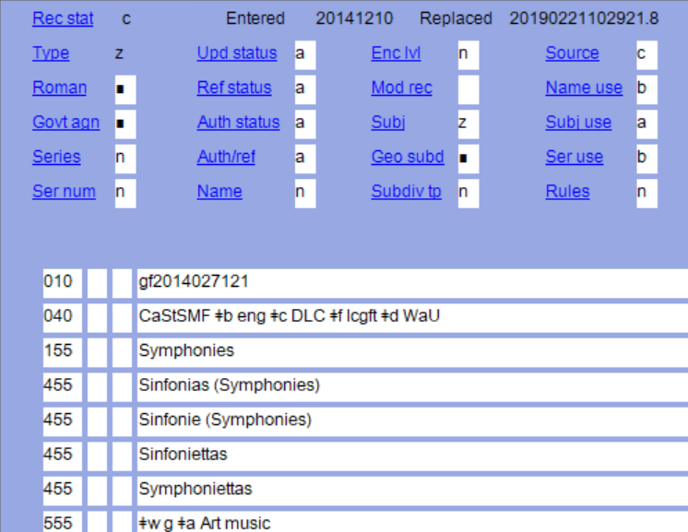
Notes:
I wanted to point out in this music term that the 040 $f lcgft will not necessarily always be the last data entered in the 040. In this case, once the term was authorized and in use, a library edited the authority record. In addition, don’t be surprised if you come across an lcgft authority record where a a number of libraries have made changes to it.

Slide 189
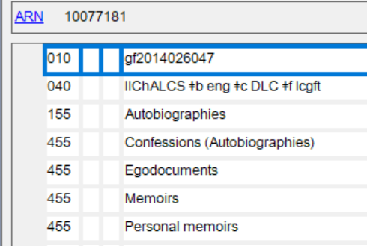
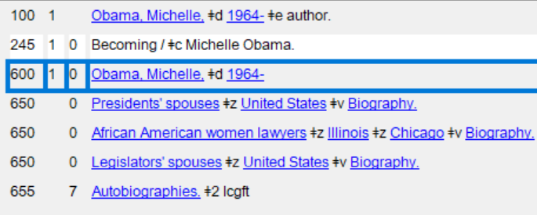
Treatment of lcgft terms in bibliographic records.
lcgft authority record
Bibliographic record
Notes:
This slide illustrates the relationship between the lcgft authority record and its use in a bibliographic record.
Many of the lcgft terms can be applied to audiobook bibliographic records as well. So, in this example, the lcgft term, can be used in the bibliographic record for the audiobook version of Becoming.

Slide 190
Treatment of lcgft terms in bibliographic records
100 1 |a Bridwell, Norman
245 10|a Clifford visits the hospital / |c Norman Bridwell.
650 0|a Clifford (Fictitious character : Bridwell)|v Fiction.
650 0|a Dogs|v Fiction.
655 7|a Picture books. |2 lcgft
655 7|a Animal fiction. |2 lcgft
The 7 in the second indicator position instructs the cataloger to specify the source of the term in subfield $2. In this case, the source is the lcgft vocabulary.
Notes:
Going back to my example of the lcgft term “Picture books” - this is how the term is treated within a bibliographic record.

Slide 191
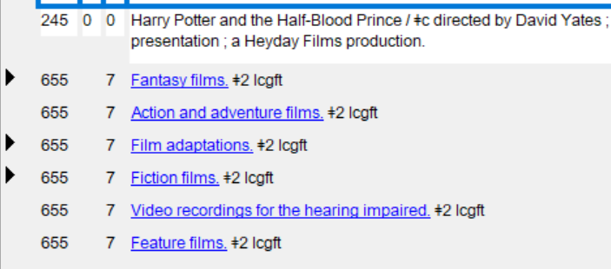
Bibliographic record containing lcgft terms
Notes:
Reminder : the addition of subfield $2 should always accompany the second indicator of 7. It indicates the source of the genre term that is being used.
There’s absolutely no limit as to how many genre terms you can add to a bibliographic record.

Slide 192
Other genre form vocabularies
GSAFD
(Guidelines on Subject Access to Individual Works of Fiction, Drama, Etc.)
Pre-dates the lcgft terms for literature (2000?)
Used heavily by public libraries until the various lcgft literature terms were published by LC
Contains 153 terms
OLACVGGT
(Online Audiovisual Catalogers Video Game Genre Terms)
Published in October 2018 by OLAC
Libraries with video game collections have begun to adopt its use
Contains 66 terms
Notes:
GSAFD and OLACVGGT are two other well used, popular genre form vocabularies that you may come across.
GSAFD - the vast majority of these terms are the same as lcgft terms
For many, many years the MARC authority records for all of the terms in GSAFD vocabulary were available for libraries to import into their library’s catalog so that authority control of the terms could be maintained. They were hosted on a Northwestern University website. However, I discovered while working on this presentation that the links on the Northwestern University are dead. BUT I still felt it was important to include them in my discussion of genre vocabularies here today because the library you work, or may work at in the future, may have uploaded the authority records into their ILS already. Which is the case with my library.
OLACVGGT - I was chair of the ALA working group that worked on the development of this vocabulary. When work first began on creating authority records for video game genre terms it was hoped that the terms would be added as lcgft terms. But due to a lack of staff resources, LC was unable to commit to working on the project to incorporate them as a genre category into the overall lcgft umbrella. Because many AV catalogers have long looked to OLAC to provide resources that support the cataloging of audiovisual materials it made sense to have OLAC take ownership of a video game genre vocabulary and then publish it. The links to the authority records, and the guidelines on how to apply the terms are available on the OLAC website.

Slide 193
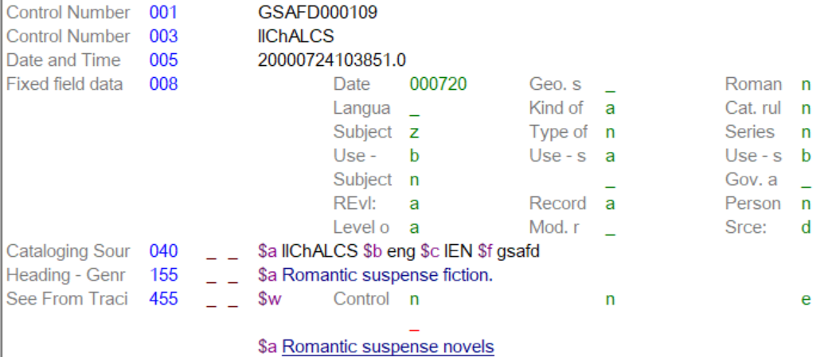
gsafd authority record
Notes:
Like the lcgft authority records, the name of the vocabulary is referenced in both the 001 Control number and the 040 subfield f
This genre term for Romantic suspense fiction is one of the few that doesn’t match an lcgft term. Which is why we continue to use it at my library.
IMPORTANT NOTE: I was surprised to discover as I was preparing my slides on the GSAFD authority records that the link to the file of MARC authority records that could be downloaded from the GSAFD site at Northwestern University was no longer valid.

Slide 194
Treatment of gsafd terms in bibliographic records
Notes:
It is perfectly acceptable to use these vocabulary terms in OCLC and Sky River bibliographic records.
UNFORTUNATELY however, the actual authority records for these are not available to see in OCLC.
It’s also perfectly acceptable to have terms from different genre form vocabularies in the same bibliographic record.

Slide 195
olacvggt genre authority record
Notes:
olacvggt stands for Online Audiovisual Catalogers Video Game Genre Terms
As with other genre authority records, the 001 and 040 subfield identify the name of the vocabulary and the z in the 008 fixed field position for subject indicates that the authority record is for a vocabulary other than LCSH

Slide 196
List of terms in the olacvggt vocabulary
All the resources associated with the OLAC Video Game Genre Terms vocabulary can be found on the OLAC website at:
https://www.olacinc.org/olac-video-game-vocabulary
One of the resources you’ll find there is the list of all of the terms included in the vocabulary can be found there as well:
https://www.olacinc.org/alphabetical-list-genre-terms-olac-video-game-genre-vocabulary
T
Notes:
I just want to quickly pan down the list of the video game genre terms so that those of you not familiar with this vocabulary can get a feeling for the depth and breadth of the terms included.

Slide 197
Treatment of olacvggt terms in bibliographic records
655 _7 Fantasy video games. $2 olacvggt
655 _7 Action video games. $2 olacvggt
655 _7 Platform video games. $2 olacvggt
655 _7 Third person video games. $2 olacvggt
655_7 Video games. $2 olacvggt
Notes:
This vocabulary has been well received by the cataloging community. I don’t have up to date stats but for the first 8 month period from October 2018 through May 2019
OLAC Video Game VOCABULARY GENERAL page – 1,602
ALPHABETICAL LIST OF OLAC VIDEO GAME GENRE TERMS – 1,293

Slide 198
Demonstration of the use of authority records in the MPPL online catalog
https://mtpros.ent.sirsi.net/client/en_US/default/?dt=list

Slide 199
Sources
MARC 21 Format for Authority Data
http://www.loc.gov/marc/authority
SACO Participation Information
https://www.loc.gov/aba/pcc/saco/about.html
OCLC Authorities Formats
https://help.oclc.org/Metadata_Services/Authority_records/Authorities_Format_and_indexes/Get_started/10Authority_record_format
NACO Participation Information
https://www.loc.gov/aba/pcc/naco/
Notes:
Shelly

Slide 200
Sources cont.
Library of Congress Genre Form Terms (lcgft)
https://www.loc.gov/aba/publications/FreeLCGFT/freelcgft.html
MARC Authority records for GSAFD genre terms
http://www.ala.org/alcts/resources/org/cat/marc21authority
OLAC Video Game vocabulary (olacvggt)
https://www.olacinc.org/olac-video-game-vocabulary

Slide 201
Shelly Sandstrom
Cataloging Librarian
Naperville Public Library
msandstrom@naperville-lib.org
Rosemary Groenwald
Head of Technical Services
Mt. Prospect Public Library
Laura Murff
Head of Technical Services
Lisle Library District

