Slide 1
Introduction to Authority Control LACONI Authority Control Session Joliet Public Library November 8, 2019
Paul Frank
Library of Congress
Policy, Training, and Cooperative Programs Division

Slide 2
Thanks!

Slide 3
Authority Control – term with assumptions
Identity Management – changing landscape
Notes:
Authority Control = label, 1XX, closed file
Identity Management = identifier, linked files

Slide 4
NACO Name Authority Cooperative Program Through this program, participants contribute authority records for agents, places, works, and expressions to the LC/NACO Authority File. Membership in NACO is open to individual institutions willing to support their staff through a process of training, review, and direct contributions of records to the LC/NACO Name Authority File.

Slide 5
NACO Members’ Perspective
That is a lot of work!
“Authority Control”
“Control” is a packed word
Is it a valuable and worthwhile goal?
Are there other ways to achieve this?

Slide 6
Authority Control Values
Hard work now makes less work later
Predictability, Consistency, Organization
Serving the user
Exploding resource environment
Impact of WWW and digital
Analog becoming a relic?

Slide 7
Authority Control Drawbacks
Shrinking labor resources
Takes a lot of time
Local vs. International
Exploding resource environment (!)
Impact of WWW and digital (!)

Slide 8
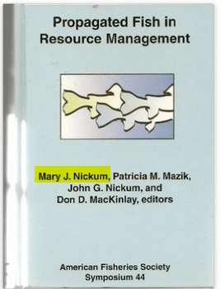
Personal Name Example
Notes:
Example taken from discussion on the PCC listserv, January 2017.
This is the type of disambiguation that catalogers have been doing for years and will continue to do in a Linked Data world.
But in Linked Data inferences will also be at work and that may result in sameAs matching that is not accurate. Is it safe to say that in the Linked Data environment, a cataloger’s job may turn more towards disambiguation of conflated entitles, and not so much original description?

Slide 9
Personal Name Example
Mary J. Nickum
Writes on fish management
Mary Jo Nickum
Writes on Biblical topics and on animals for children
Mary J. Lewis
Writes on fisheries scientists
Notes:
Example taken from discussion on the PCC listserv, January 2017
In the MARC world the authorities cataloger’s task is to create a unique, disambiguated, textual string for this identity.
In a Linked Data environment, the task is Identity Management and Inferences and Assertions come into play. Less about text strings than about linking to “sameAs” entities.
Do you as a cataloger think these three names all represent the same identity?
Does a Linked Data system think these three names all represent the same identity?

Slide 10
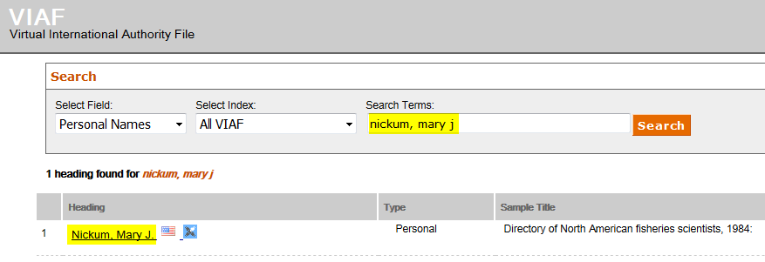
Personal Name Example: VIAF

Slide 11
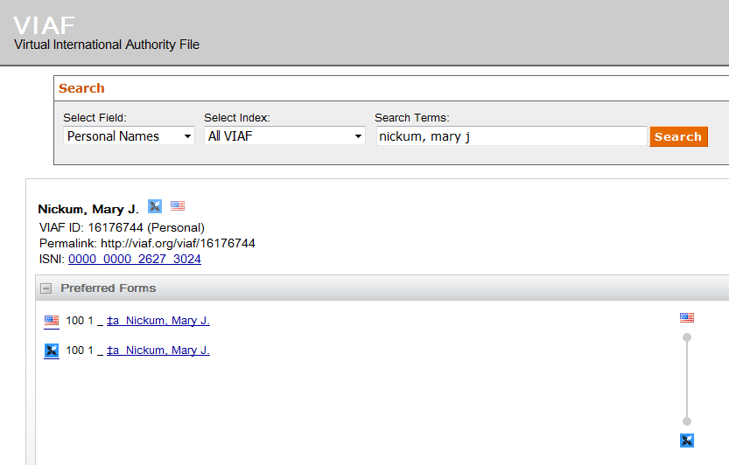
Personal Name Example: VIAF
LC Name Authority File
ISNI
Notes:
The LC/NACO Authority Record and the ISNI record are clustered in VIAF through inferencing. Do you see any differences in he two “strings?”? How did these end up being clustered like this?

Slide 12
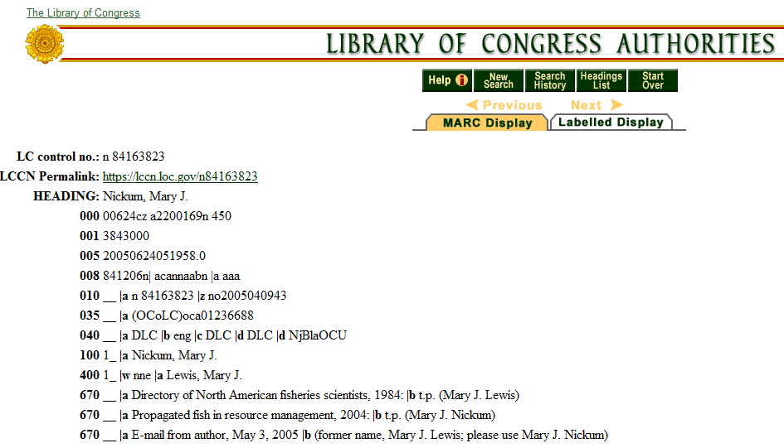
Personal Name Example: NACO
Notes:
The LC/NACO Authority File record stands alone with no reference to the ISNI record.

Slide 13
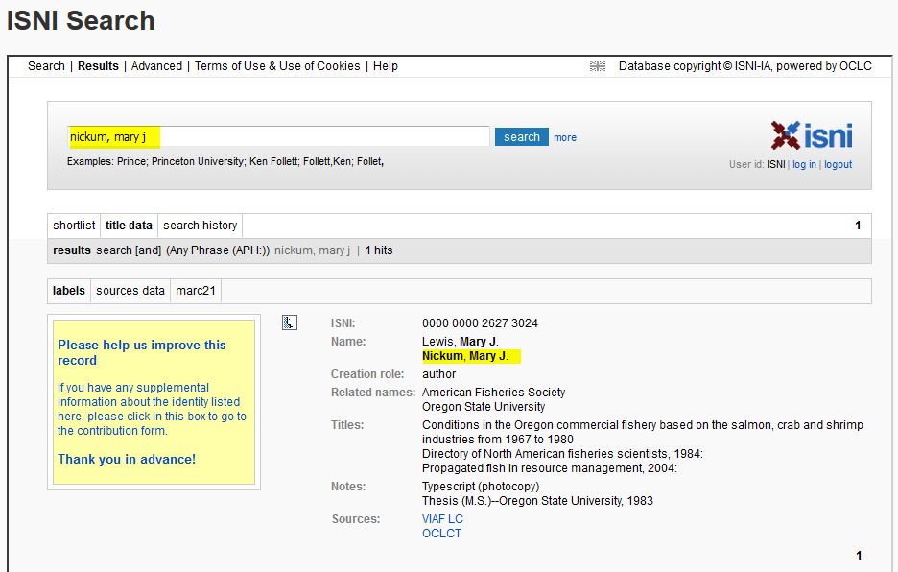
Personal Name Example: ISNI
Notes:
The ISNI record stands alone with no reference to the LC/NACO Authority File record.
Inferencing provided a sameAs match to the LCNAF authority record and the ISNI record, and created a correct cluster in VIAF.

Slide 14
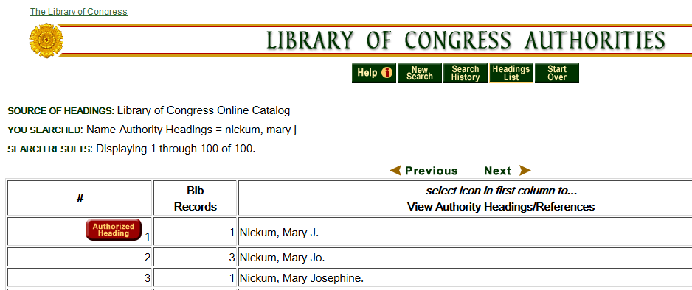
Personal Name Example: Uncontrolled Forms in LC OPAC
Notes:
But what about those other two forms of name – Mary Jo Nickum and Mary J. Lewis? And is Mary Josephine Nickum also the same identity?

Slide 15
Personal Name Example: Back to VIAF
Notes:
Now searching Nickum, Mary Jo in VIAF – no match.

Slide 16
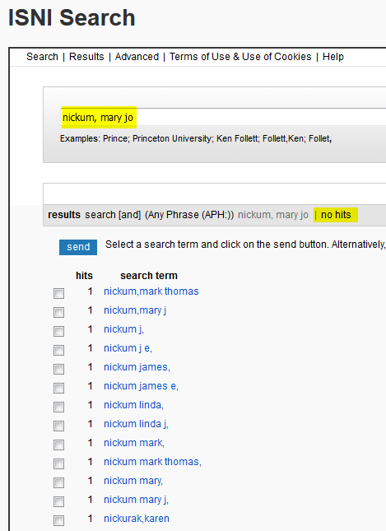
Personal Name Example: Back to ISNI
Notes:
Now searching Nickum, Mary Jo in ISNI – no match.

Slide 17
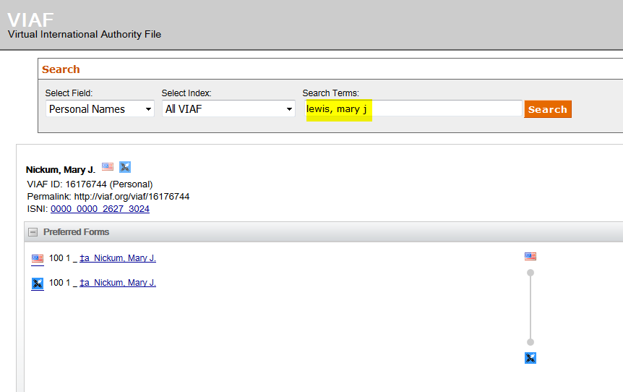
Personal Name Example: Back to VIAF
Notes:
Now let’s try Lewis, Mary J.
VIAF directs us to the same cluster – thanks to the variant name that provides access in both the LCNAF record and the ISNI record.

Slide 18
Personal Name Example: Summary
We determined that these names represent one identity:
Mary J. Nickum
Mary Jo Nickum
Mary J. Lewis

Slide 19
Personal Name Example: Summary
The authority records in the LC/NACO Authority File and in ISNI captured two of the identities:
Mary J. Nickum
Mary J. Lewis

Slide 20
Personal Name Example: Summary
This name was not captured:
Mary Jo Nickum
Why not?
Cataloger error?
Cataloger judgment?

Slide 21
Personal Name Example: Summary
If we were working in a pure Linked Data and Identity Management environment, and provided identifiers over text strings, would sameAs inferences have worked better?

Slide 22
Changing Environment
Authority Control requires differentiation and an identifier for each entity
There are 10M LCNAF records but 30M+ WorldCat Identities (30% coverage)
Notes:
Slides from the Identity Management in NACO TG ALCTS presentation

Slide 23
Changing Environment
Digital library project work—Authorities a luxury?
Numerous researchers & organizational units to track

Slide 24
Does the Differentiating Information All Need to Go in One Field?

Slide 25
A Need to Reconsider Membership Criteria Within NACO
9K OCLC members with cataloging authorizations – 700 NACO members
What are the essential skills needed: heading construction vs. differentiation?
Who will create identifiers for your institution’s researchers, if not you?

Slide 26
Program for Cooperative Cataloging Response
Provide leadership for the shift in authority control from an approach primarily based on creating text strings to one focused on managing identities and entities.

Slide 27
Program for Cooperative Cataloging Response
3.1 Establish a task group to develop best practices for the use of authority data sources beyond the LC Name Authority File.

Slide 28
Program for Cooperative Cataloging Response
3.4 Investigate options and develop a plan to expand community participation in the creation of identifiers and authority data.

Slide 29
”NACO Lite” & Opening Up the PCC
Reconsideration of what truly is essential in authority data contributions
How do we achieve greater numbers & great proportions of entities receiving identifiers?

Slide 30
Possible Venues for Identity Management
LCNAF
PCC ISNI Pilot
PCC URIs in MARC Pilot
PCC Wikidata Pilot – in planning stages

Slide 31
Issues Arising in Identity Management Work
How full-fledged does authority data need to be for an entity, initially?
Is it necessary to designate authority data as preliminary/provisional? (How?)
Does embryonic authority data need to assert RDA compliance?

Slide 32
Issues Arising in Identity Management Work
How best to reflect existence of the same entity in multiple files?
Full incorporation of one file’s data into the other
Merely pointing to it from one file (e.g. MARC 024 fields in LCNAF)
What will support searching across multiple files simultaneously?

Slide 33
How Does All This Impact You?
NACO members
Prospective NACO members?
Not interested in NACO but interested in librarianship
Relevancy of our work
Can we ignore these major environmental changes and (still) stay relevant as professionals?

Slide 34
Thanks!

