Slide 1
Item Data Cleanup A LACONI TSS Presentation
MaryKellie Marquez & Nora Mastny
Downers Grove Public Library
June 11, 2021
Notes:
NORA
Hello
Welcome
Glad to be here
We hope our presentation will help inspire you to start a cleanup project of your own

Slide 2
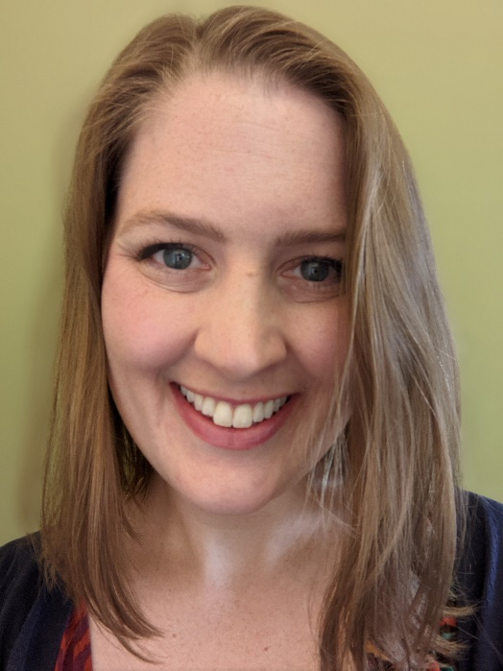
Introductions
MaryKellie Marquez
Access Services Clerk
At DGPL since 2007
mmarquez@dglibrary.org
Nora Mastny
Cataloging Librarian
At DGPL since 2018
nmastny@dglibrary.org
Notes:
MARYKELLIE & NORA
Introduce selves.
Point out contact info.
If you have any questions, or would like to follow up on anything after this presentation, we encourage you to reach out to us. We would love to hear from you.

Slide 3
DGPL Access Services
Downers Grove is part of SWAN Consortium
Use SirsiDynix’s Symphony ILS and BLUEcloud Analytics (BCA) for reporting
6 employees
1 full-time manager
1 full-time cataloging librarian
4 part-time clerks
Notes:
MARYKELLIE
Tell you a little bit about our library and department
Access Services=Tech Services
Because we are in SWAN, we use SDS and BCA
Some of our examples in this presentation may be more applicable to SWAN libraries, or other libraries using Symphony and BCA, but most of the concepts should translate to tech services departments at any library

Slide 4
Why Item Data Cleanup?
DGPL is a member of the SWAN Consortium and the catalog is shared with 100 libraries
Cleanup projects involve entire department, not just catalogers
Item data cleanup is very approachable, and can get the ball rolling on improvements
Notes:
NORA
As you saw/will see, there are a lot of really cool things you can do with bibliographic data cleanup, but that’s just one aspect of data cleanup
A major reason we focus on item data cleanup at DGPL was already mentioned—our membership in SWAN
SWAN has 18 cataloging libraries, while the rest are “precat” libraries. For these libraries, major bibliographic data cleanup may be beyond the scope of their work. But that doesn’t mean there’s no data cleanup for them to address. Every library can perform item data cleanup to improve their catalog
Even for libraries that can perform bibliographic data cleanup,
Though Downers Grove is a cataloging library, only the manager and cataloger have permissions to edit bibliographic data, and it’s important for us to have cleanup projects that involve the entire department
Additionally, people might not have the bandwidth to start a major cleanup project. It’s ok to start small. We all strive for a nice, clean database, and anything that improves any aspect of the catalog is good catalog cleanup

Slide 5
Goals of Item Data Cleanup
Improve data output for reporting
Ease the use of the catalog for staff (and patrons!)
Ease the use of the shelves for patrons (and staff!)
Prevent problems before they arise
Provide meaningful work during “slow” weeks or closures
Notes:
NORA
Point 1: Within BlueCloud Analytics, many reports are defined based on a call number range, so it is very important to have call number consistency. To that point, when running reports for your cleanup projects you must be very careful about defining your call number ranges in BCA so that you get the results you are looking for
Points 2&3: Make things easy for patrons and staff, both on the shelf and in the catalog. We want to make things easy to browse and easy to find, because our whole purpose is to improve patron’s access to materials—hence our name!
Point 4: Of course, when people find inconsistencies, they bring them to our attention and we fix them (and any others that we find), but we strive to keep that as low as possible, and instead anticipate what may cause issues and save staff time in the long run
Point 5: This last point was critical for us over the past year. In addition to closures, we also had extremely inconsistent order fulfillment from Baker & Taylor. We would go a week or more without getting any significant shipments, and then receive 46 boxes on a single day. This made it very difficult for the clerks. There are only so many webinars you can attend without pulling your hair out. By having consistent and meaningful “back-burner” projects,

Slide 6
Item Data Cleanup Process
Get an idea
Run a report
Identify what needs to be changed
Create/edit documentation
Loop in other departments (e.g., Circulation) if necessary
Edit the records and physical items
Re-run report to catch any stragglers
Notes:
MARYKELLIE
Here is a brief overview of the entire item data cleanup process.
Read bullets
We’ll go over each of these steps more in depth in the following slides

Slide 7
How to Find a Project
Library staff
Patron inquiries
Call number browse search in ILS
Walk through stacks
Automated Materials Handler
Inconsistent data fields, e.g., Item Type = BOOK_J Audience = ADULT
Notes:
NORA
So many ways to find a new project
If someone mentions something weird, look into it. Other things may be weirds in the same way
Patron inquiries: a patron notice a very small line, that indicated that we kept a year’s worth of issues of a magazine, even though we did not have any issues of the magazine—we no longer subscribed! This led to our deleting old serial control records project. Who knows how long it would have taken us to realize those records were still there if we didn’t investigate the patron’s comment
Call number browse search: if you search for using a call number browse (for us, this is within WorkFlows, the staff client of our ILS), some weird or funky things may jump out at you. Maybe things aren’t sorting the way you would expect them to. Or maybe half of a section says CD OPERA, while the other says CD OPERAS. Either way, this is a good, if tedious way to find issues
Much like the call number browse search, a physical walk through the stacks can reveal inconsistencies in labeling that may or may not be reflected in the catalog.
Automated Materials Handler: employees from Circ will bring materials to us if they are not sorting correctly. Because the sort matrix is largely based on call number, errors and inconsistencies can create issues. We’ll talk about this in depth a bit more later.
There are certain data fields that should never go together. You can run a report to find these combinations, and look into which field is incorrect

Slide 8
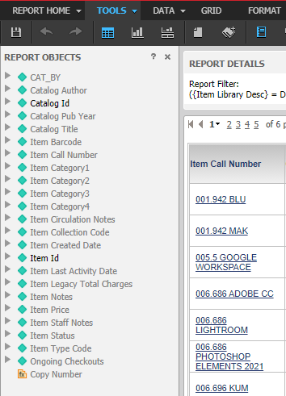
Running Reports
Know your system
Some have precise inputs for precise outputs
Some use more general templates
Choose/design and run your report
Identify what needs to be changed
Notes:
NORA
First type is like WorkFlows report module. You put in exactly what you want, and get very specific results. Real time, can only run one at a time which is not practical in a consortial environment
Second type is like BLUEcloud Analytics. Within SWAN things are more centralized, so we use provided templates and make them work for our needs. You may have extraneous info in your results, but that can always be edited out. Screenshot is an example of a report with many outputs. You can remove those that are not helpful and save a spreadsheet of just the relevant fields to simplify the document everyone will be working off of, which can help prevent mistakes
Using your knowledge of your reporting system, choose a report that will give you the information points you need for the project you have in mind. So if you are planning to change the call numbers and item type of a certain collection, make sure both those facets will be included in your output
Identify and make clear what needs to be change, for example by highlighting the fields that should be edited in the item records

Slide 9
Getting Started
Strike a balance between specialization and cross-training
Remember that clean-up happens in the database and on the shelf
Requirements for item data cleanup
Knowledge of how things ought to be
Attention to detail
Good documentation!
Notes:
MARYKELLIE
For a certain project, it can be helpful to have a point person. This is especially true if there are multiple people working on the same project. For one project we had one clerk print out spreadsheets in manageable chunks. Whenever anyone had time, they would grab a sheet and head into the stacks to work on that project. This way the wok stayed organized and it prevented confusion about what still had to be done
Think about whether anything will need to be changed on the physical object, e.g., relabeling. And if re-labeling, think about all the fields that may need to be changed in the item record.
Keep in mind if you print out label ahead of time to make sure that you are editing the record for each book you relabel
Requirements section – makes sure everyone knows what’s expected, and that this knowledge is backed up with good documentation. And of course, it is essential to have a good eye for detail when working on these sorts of projects

Slide 10
Documentation
Notes:
NORA
This is part of our master list with ALL the information about how each type of item in the library should be entered into the catalog
It is a great resource to prevent errors when initially entering materials, and also a great resource when correcting or changing data points for a specific collection

Slide 11
Documentation
Notes:
NORA
Pulling out specific information for a project ensures that everyone who is working on it has the same information. This way it doesn’t get lost in the big document
Circ has one printed out near the sorter, so they know which returned items still need to be relabeled. They put these on a separate cart for Access Services.
Talk about looking in Circ

Slide 12
It’s Cleanup Time!
Designate a point person for the project
Determine if you need digital and physical copies of the report
Maintain one physical copy if work will occur in the stacks
Maintain one master digital copy
Communication is key
Notes:
MARYKELLIE
If label need to be change
Pull items as changing records, rather than batch edit
Go shelf by shelf for consistency
Section by section
Smaller dept, can let everyone know “I left off on S’s”
Communication with each other
Crossing off on master copy of project list
One person deletes off the digital version
If there is no physical aspect (don’t have to check shelves” ok to have only digital version in Google Drive

Slide 13
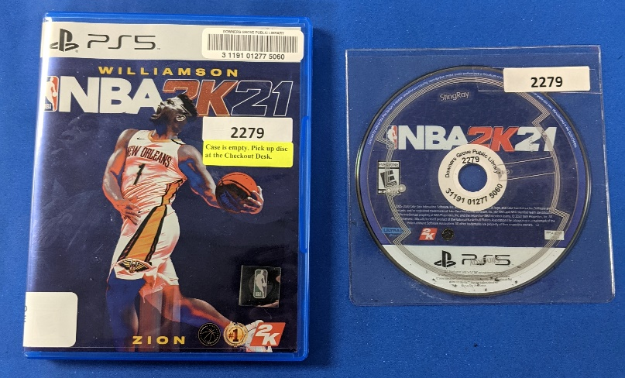
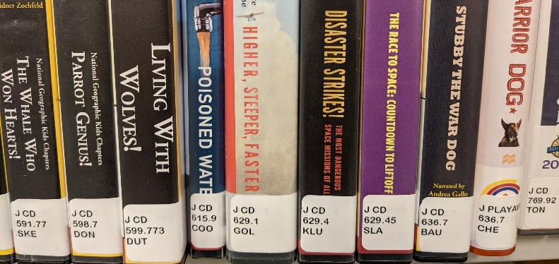
Projects
Video Game Sleeve Numbers
Physical case (patron stacks)
Sleeve (circulation)
Staff note (ILS)
Kids AV Call Numbers
Work shelf by shelf
Fix labels and records at the same time
Work with Circulation to pull items as they are returned
Notes:
MARYKELLIE

Slide 14
Project Completion
Always check for stragglers at least twice!
J FICTION CD → J CD FICTION
Check the catalog
Check the shelf
Make sure to have two sets of eyes
Remember any “special” sections that may have been neglected
Audiobooks on the Homework Shelf, which is physically separate from the audiobook section
Notes:
MARYKELLIE

Slide 15
On-going Projects
Monthly missing reports
Monthly lost in transit reports
Mistakes that accumulate, e.g., incorrect class scheme
Notes:
NORA
You may already be doing data clean up without realizing it! Things like running monthly missing or lost in transit reports help keep your database clean and accurate, so that it reflects what you truly have in your collection
If there are recurrent issues, set up on ongoing clean up project. For us, lots of our on order item records are imported into the database with a class scheme of “AUTO” These should be changed to “DEWEY” when the item arrived, but inevitable, a few slip through the cracks, and over time they accumulate. This causes issues, because an incorrect class scheme causes items to sort separately from similar items in another class scheme. So everything in class scheme “AUTO” will sort alphabetically before everything in class scheme “DEWEY” Setting up a yearly schedule to run reports like these, allows you to fix these sorts of mistakes in manageable chunks. You can also schedule these project for times of the year that are traditionally slower for your department

Slide 16
Questions
What is a project that you could implement in your library?
Remember it’s okay to start small!
Think about goals
Questions for us?
Notes:
MARYKELLIE

Slide 17
Thank you!
mmarquez@dglibrary.org
nmastny@dglibrary.org
Notes:
BOTH

