Slide 1
The New RDA Toolkit: What’s next?
Amanda Sprochi, MA, MLIS, AHIP
The University of Missouri
Columbia, Missouri

Slide 2
Where we started

Slide 3
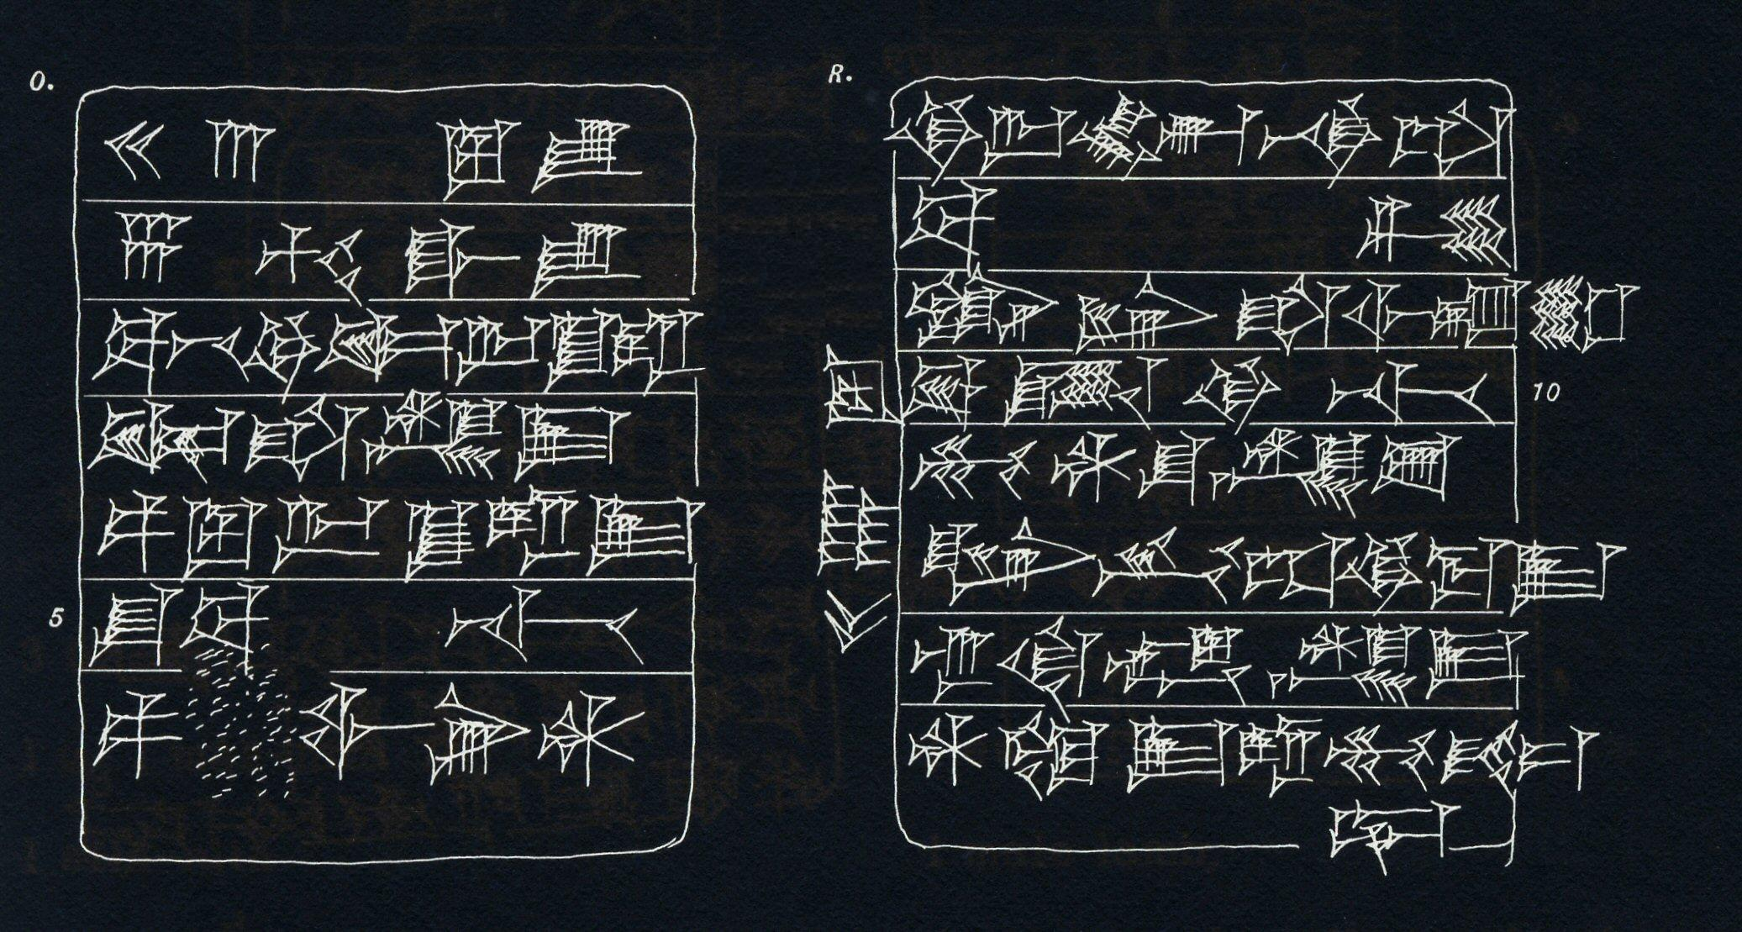
A bit of cataloging history
Cataloging and the storing of texts is an ancient practice
Considering handwritten documents, there are few viable ways to arrange a catalog
Author catalogs—things arranged by author
Classed catalogs—things arranged by subject
Catalogs were alphabetical in type
How to arrange a library so that it is convenient and useful for users?

Slide 4
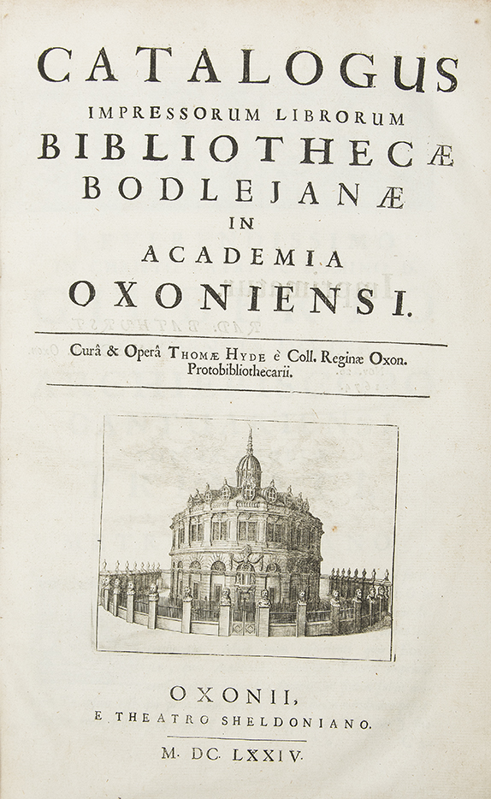
In this work I have given students a tool to enable each of them to construct for himself and with ease out of this forest of materials an index of selected books that will serve to advance in no small measure his private studies.
--Thomas Hyde, Bodleian Library, 1674
Translated by William Denton, in FRBR and the History of Cataloging, 2007. p. 37.
Notes:
Hyde worked nine years on a catalog for the Bodleian at Oxford. In the preface in 1674 he wrote “For though I was exhausted, I did not think I should complain or withdraw my neck from the yoke, but labored stubbornly, neglecting even my health, so that I might draw the matter as rapidly as possible to a successful close.” [quote].

Slide 5
User centered focus
Panizzi and the 91 rules
Cutter’s Rules for a dictionary catalog
Objects
1. To enable a person to find a book of which either
(A) the author
(B) the title
(C) the subject
2. To show what a library has
(D) by a given author
(E) on a given subject
(F) in a given kind of literature
3. To assist in the choice of a book
(G) as to its edition (bibliographically)
(H) as to its character (literary or topical)
is known
Notes:
Panizzi: arrived at the British Museum in 1831 to what Michael Gorman called “a disorganized and random collection of books cataloged by indigent clergymen and other part-time drudges.” In 1836 he suggested a author/subject catalog instead of a classed one. He drew up rules, 91 of them, that defined how to construct a catalog record. They were printed in 1841. The trustees said the catalog would be done in 1844. When they asked Panizzi how it was going he told them it wouldn’t be ready until at least 1854. He told another commission in 1847 that he’d had everything up to 1854 in a catalog by 1895.
He had opponents, who thought that the only catalog that was needed was one that had a list of titles, but P thought “a reader may know the work he requires; but he cannot be expected to know all the peculiarities of different editions, and this information he has a right to expect from the catalogues.” Panizzi saw the book as an edition of a particular work that is intimately related to the other editions and translations of the work that the library may have, and thought that it should therefore be integrated with them
Cutter: Boston Athenaeum: rules for a dictionary catalog: author, title, subject in a list

Slide 6
Ranganathan’s Five laws of library science
Books are for use.
Every person his or her book.
Every book its reader.
Save the time of the reader.
A library is a growing organism.
Lubetzky’s Cataloging rules and principles
“The objectives implicit in our rules for entry are two. The first objective is to enable the user of the catalog to determine readily whether or not the library has the book he wants. The catalog is constantly searched by many readers and members of the staff, and the quicker this information can be found the better the catalog. The second objective is to reveal to the user of the catalog, under one form of the author’s name, what works the library has by a given author and what editions or translations of a given work.”
Lubetzky, Seymour, and Elaine Svenonius. 2000. “Cataloging Rules and Principles.” In Svenonius, Elaine, and Dorothy McGarry, eds. 2001. Seymour Lubetzky: Writings on the Classical Art of Cataloging. Englewood, Colorado : Libraries Unlimited, 83.
Notes:
Ranganathan : 1931 the five laws of library science. Mathematician devoted life to library studies. Logical and organized thinking. Parallels to FRBR’s FISO principles, more on that later
Seymour Lubetzky : simply cataloging rules. LCs rules at the time were simple, ALAs were complicated and legalistic. 1953 Cataloging rules and principles. Is this rule necessary? Chapter 1. His work foundation of the Paris Principles

Slide 7
Paris Principles, 1967
Functions of the catalogue
The catalogue should be an efficient instrument for ascertaining 2.1 whether the library contains a particular book specified by
(a) its author and title, or
(b) if the author is not named in the book, its title alone, or
(c) if author and title are inappropriate or insufficient for identification, a suitable substitute for the title; and
2.2 (a) which works by a particular author and
(b) which editions of a particular work are in the library
Basis of AACR and its subsequent editions
Statement of Principles Adopted by The International Conference on Cataloguing Principles Paris, October 1961. https://www.ifla.org/wp-content/uploads/2019/05/assets/cataloguing/IMEICC/IMEICC1/statement_principles_paris_1961.pdf
Notes:
Statement of Principles passed at the International Conference on Cataloging Principles in 1967
Common principles on which cataloging codes could be based to be international and interoperational

Slide 8
1841
1876
1904
1908
1941
1949
1967
1978
1988
1998
2002
Adapted from Tillett, Barbara (2004) AACR3: Resource Description and Access. https://www.ala.org/alcts/sites/ala.org.alcts/files/content/events/pastala/annual/04/tillettch12.pdf

Slide 9
IFLA and FRBR
Problem: too much stuff, too little time and money, technology is changing
Realization that there hadn’t really been any evidence base for why we recorded what we did in catalog records
Seminar on Bibliographic Records in Stockholm, Sweden, 1990
Resolution to commission a study to “define the functional requirements for bibliographic records in relation to the variety of user needs and the variety of media”
IFLA study group for the Functional Requirements of Bibliographic Records (FRBR)
Chose entity-relationship model common in information/computer science
Decide what the entities were and how they related to each other
Study published in 1997
Notes:
The project to study the functional requirements for bibliographic records was conceived at the 1990 Stockholm Seminar on Cataloguing, sponsored by the IFLA UBCIM Program. During the 1960's, a fundamental examination of cataloguing theory and practice was conducted on an international level. The thirty years since have seen the cataloguing world change. A confluence of developing trends and probl ems in this changing cataloguing world set the stage for the 1990 Stockholm Seminar:
the mounting costs of cataloguing and the concomitant desire for cataloguing simplification;
the proliferation of electronic, multimedia, and computer related materials and the challenges these pose for both description and access;
the increasing drive to economize in cataloguing by reducing duplicate efforts, nationally and internationally, and the associated need to define a core level standard to support the cooperative use of records;
the exploding bibliographic universe and the continual need to effect better universal bibliographic control;
the continuing pressures to adapt cataloguing practices and codes to the machine environment.
Lively discussion at the Stockholm Seminar focused on the quality and functions of bibliographic records. Some speakers proposed that cataloguing could be considerably simplified. One speaker stated that the number of descriptive data elements needed in a bibliographic record could be reduced without seriously affecting access. This statement was based on finding of catalogue use studies at the U niversity of Bath. Further, it was stated that economic advantages could be realized by distributing the work of constructing bibliographic records; in particular it was suggested that non library consumers of bibliographic records, such as book sellers and publishers, might participate in supplying data elements to create generic records. These statements were challenged by another speaker on th e grounds that they did not take into account the variety of functions a bibliographic record was intended to perform. Further, the cost of providing bibliographic control did not lie so much in the provision of descriptive data elements as in the provision of organizing data elements requiring authority control.By the end of the Seminar no consensus had emerged over the functions of bibliographic records, and it was evident to the participants that a fundamental reexamination of the bibliographic record was needed. In particular, what is needed is common agreement on what the bibliographic record aims to provide information about. Also needed is agreement on what the bibliographic record is to achieve i n answering user needs. It was to initiate this reexamination that the study of the functional requirements of bibliographic records was proposed.

Slide 10
AACR3 to RDA
Revision to the 2002 edition of AACR2 needed
AACR2 not useful because of:
Rules spread out over multiple chapters
Catalogers didn’t know how to resolve rule conflicts
Rules were often duplicated
Community wanted to integrate authority control and authority records
Based on old card catalog methods of entry
Emphasized text resources in an increasingly digital world
Had strong Anglo-American bias although it was used around the world in many non-English languages
Content and carriers were often confused
Notes:
AACR2 needed updating
International Conference on the Principles and Future Development of AACR Toronto 1997
Fundamental rethinking of the cataloging code
Work on the new standard began in 2004, and in the same year the Committee of Principals for AACR (CoP) appointed Tom Delsey as the Editor. In December 2004 a draft of part I of AACR3 was made available to the constituencies for review. In 2005 a new approach was agreed on, and the decision made to adopt the title: “RDA: Resource Description and Access”. In December 2005, the draft of RDA part I was made available for review. Further drafts of RDA chapters were issued in 2006 and 2007. At the October 2007 meeting, the JSC agreed on a new organization for RDA, see A New Organization for RDA. A full draft of RDA was issued in November 2008. JSC discussed the responses to the full draft at its meeting in April 2009 and the revised text was delivered to the publishers in June 2009. RDA was published in the RDA Toolkit in June 2010.

Slide 11
RDA
Cataloging standard based on the IFLA FRBR and FRAD entity-relationship models
Structure changed from rules based on type of resource to organization according to FRBR bibliographical entities (WEMI) and relationships between entities
Gives the cataloger more options and leaves more up to cataloger judgement
Notes:
Initially released in 2010

Slide 12
FRBR: What is it?
An entity-relationship model that describes the world in terms of entities and the relationships between them
Defines four user tasks:
Find
Identify
Select
Obtain

Slide 13
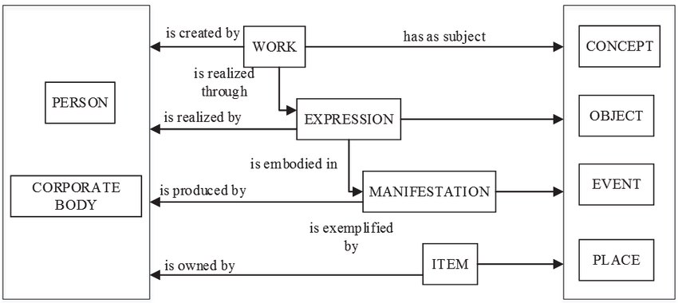
Entities
Relationships
Zou, Xiaozhu & Xiong, Siyi & Li, Zhi & Jiang, Ping. (2018). Constructing Metadata Schema of Scientific and Technical Report Based on FRBR. Computer and Information Science. 11. 34. 10.5539/cis.v11n2p34. CC BY 4.0

Slide 14
FRBR Entities
Group 1 (creations) | Group 2 (creators) | Group 3 (subjects)
Work Expression Manifestation Item | Persons Corporate Bodies | Group 1 or 2 Entities Concept Object Event Place

Slide 15
FRBR Model
Work
is realized through
Expression
is embodied in
Manifestation
is exemplified by
Item
^{[2]} IFLA Study Group on the Functional Requirements for Bibliographic Records, Functional Requirements for Bibliographic Records: Final Report, 1997, <http://www.ifla.org/VII/s13/frbr/frbr.pdf> (20 March 2005) p.13.

Slide 16
w₁ Harry Potter and the Goblet of Fire by J.K.Rowling
e₁ Harry Potter and the Goblet of Fire by J.K.Rowling, original English text
m₁ Scholastic, 2000 hardcover ed.
i₁ copy 1
i₂ copy 2 (missing 2/4/02)
i₃ copy 3

Slide 17
FRAD and FRSAD
Entity-relationships for authority data (FRAD) and subjects (FRSAD)
Functional Requirements for Authority Data (2009) https://www.ifla.org/files/assets/cataloguing/frad/frad_2013.pdf

Slide 18
RDA Original Flavor
Original toolkit we all know and love
Organized by WEMI entities and relationships
Left space open for object, concept, place, and time, which hadn’t been fully developed in FRSAD
https://original.rdatoolkit.org/

Slide 19
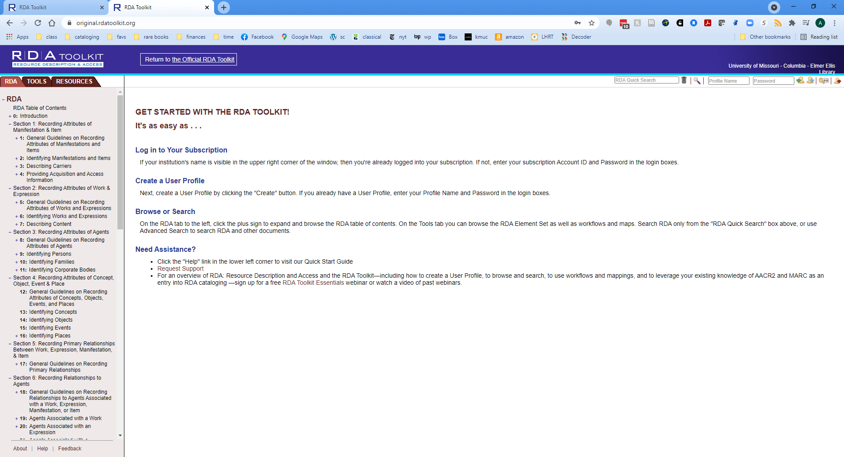

Slide 20
LRM (Library Reference Model)
High-level conceptual entity-relationship model
Basis for elaboration of rules for particular cultural communities
Developed to work with Semantic Web technologies
Expandable for implementation
Previously referred to as the “FRBR LRM”
Reconciliation of the FRBR and FRAD models
FRSAD is implied in the relationship aspect of the model
Platform and encoding standard neutral
Notes:
Remember that the LRM is just a model; it’s not an implementation and it is not rules for cataloging
What the LRM does is model what is existing already, underlying the rules that we follow to catalog
It consolidates the earlier frbr and frad models, with a bit of subject stuff thrown in
It’s meant to be platform and standard neutral, meaning it can be used with MARC, xml, Linked data or any other encoding system and standard
Different cultural communities can adapt it as necessary for their needs
A high-level conceptual reference model developed with an enhanced entity-relationship modelling framework, covering bibliographic data in a broad, general sense.
Aims to make explicit general principles governing the logical structure of bibliographic information, without making presuppositions about how that data might be stored in any particular system or application.
does not make a distinction between data traditionally held separately as bibliographic, authority, or holdings data; includes it all.
Takes its functional scope from the user tasks, defined from the point-of-view of the end-user and the end-user’s needs.

Slide 21
LRM Elements
LRM has four elements
User tasks “FISOE”
Find
Identify
Select
Obtain
Explore
Entities
Attributes
Relationships
Notes:
The User tasks will look familiar, with the addition of “Explore” which covers that serendipitous activity of finding things, much like what researchers used to do in the stacks (and why we classify and shelve things by subject)
The other elements are entities (things), their attributes, and the relationships between them

Slide 22
Entities, Attributes, and Relationships
Entities (11) are the framework of the model
Relationships connect entities to each other
Attributes describe entities
Attributes
Entities
has appellation
Language: Russian
Script: Cyrillic
AF: NAF
Nomen 1
RES
“Thing”
is appellation of
has appellation
Language: English
Script: Roman
AF: VIAF
is appellation of
Nomen 2
Relationships
(Adapted from IFLA LRM, p.17)
Notes:
Entities are “things” that we deal with in bibliographic description
They are subsets of the Model entity Res, literally thing in Latin
Things are called something they are named “Nomen”
The link between a thing and its nomen is a relationship
Attributes are what describe the nomen

Slide 23
Entity Hierarchy
Entity Hierarchy
Top Level | Second Level | Third Level
LRM-E1 RES
-- | LRM-E2 Work
-- | LRM-E3 Expression
-- | LRM-E4 Manifestation
-- | LRM-E5 Item
-- | LRM-E6 Agent
-- | -- | LRM-E7 Person
-- | -- | LRM-E8 Collective Agent
-- | LRM-E9 Nomen
-- | LRM-E10 Place
-- | LRM-E11 Time-span
(IFLA LRM, 18)
Notes:
Entities in the LRM have a hierarchy
Everything on the same level is of equal importance
Be aware that in the LRM an agent has to be a real person, so person cannot be fictitious or non-human

Slide 24
Attributes
Attributes describe (“characterize”) entities
No attribute is required but may be recorded if “applicable and easily ascertainable” and relevant
Attributes listed in the LRM are not exhaustive; applications (such as RDA) may define additional attributes as needed
EXAMPLE:
LRM-E3 Expression
LRM-E3 Expression LRM-E3 Expression LRM-E3 Expression LRM-E3 Expression LRM-E3 Expression | LRM-E3-A2 Extent LRM-E3-A3 Intended Audience LRM-E3-A6 Language LRM-E3-A7 Key LRM-E3-A8 Medium of performance
(IFLA LRM, p. 36)
Notes:
Attributes are what describe entities, and none are required
The list in LRM is not exhaustive, and applications can expand the model to include attributes for entities as they are needed for their communities

Slide 25
Relationships
Connect entities and provide context
Can be expanded in different implementations
All relationships are refinements of the Res ‘is associated with’ Res general relationship
WEMI relationships are at the core of the model, but implementation of further relationships is “encouraged”
Multi-step relationships called “paths” may be declared or may be substituted by allowable shortcuts
NOMEN 1 ‘is appellation of’ RES
RES ‘has appellation’ NOMEN 2 = (shortcut)
NOMEN 1 ‘is equivalent to’ NOMEN 2
Notes:
Relationships connect entities together and provide context
Applications can expand on the basic relationships that are given in the LRM in order to suit the needs of their user groups
The basic relationship in the LRM is Res is associated with Res; all relationships refine on this basic one
THE WEMI (work, expression, manifestation, item) stack is the core of the model (work realized by expression, embodied in manifestation, exemplified by item) but the LRM exprects that these basic relationships will be expanded upon in different applications of the model
Relationships can have shortcuts a:b b:c a:c

Slide 26
LRM in RDA
RDA is/will be an instance of the LRM
RDA adapts and expands on the LRM
The RDA 3R project (Restructure and Redesign of RDA) attempts to “aim for compatibility” between current RDA entities and the LRM
Agents, aggregates, and other undeveloped areas of RDA are being addressed
Notes:
RDA is an application, or an instance of LRM
It’s an expansion of the basic model, which will refine the entities and relationships present in the materials we describe
RDA is currently in the middle of a restructure and redesign (the 3R project) that is going to make RDA and LRM fully compatible
Some of the issues and areas in RDA that are not well developed are being addressed and we’ll discuss those in a bit

Slide 27
Where we are now

Slide 28
RDA Toolkit and the LRM
RDA is an “instance” of the LRM
True to the spirit of the LRM, it starts with that as the basis but expands on the original model quite a bit
RDA elements are “refinements” of the LRM
Retains some elements like WEMI and Person
Adds additional elements Agent, Collective Agent, Nomen, Place, Time-span, and RDA Entity (for LRM Res)

Slide 29
RDA Structure
RDA inherits the LRM emphasis on user tasks
Structure is different
General guidance at the beginning of each section is merged into one big “Guidance” section of RDA
“User tasks” section
Much more cataloger judgement
Focuses on relationship between data and user tasks
Sections and chapters broken up into individual data elements
Realigned to the LRM entities
From Oliver, Chris (2021), Introducing RDA : a guide to the basics after 3r. Chicago: ALA Editions. I HIGHLY recommend this book for anyone thinking of working with the new RDA toolkit.

Slide 30
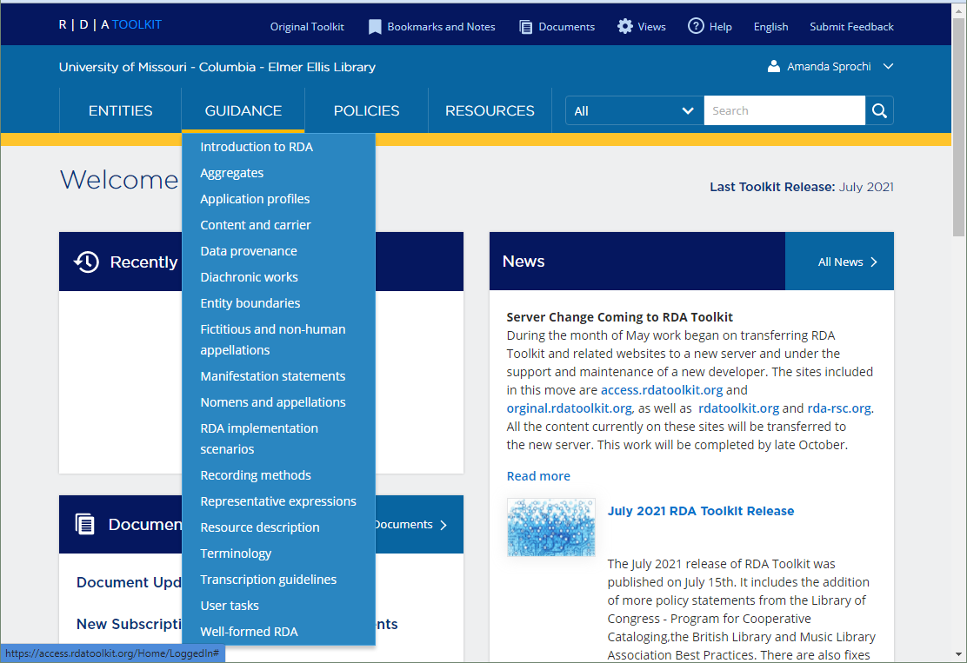

Slide 31
RDA “New Flavor” terminology
Metadata description sets
New term for what we used to refer to as the “record”
“One or more metadata statements that describe and relate individual instances of one or more RDA entities.”
An RDA triple is a metadata statement
Subject (domain) Predicate (element) Object (range)
Person (RDA entity) has date of birth Timespan (RDA entity)
Terry Pratchett has date of birth April 28, 1948
A set of triples combined to describe an entity is a metadata description set
Work
has author agent Terry Pratchett
has author agent Neil Gaiman
has title of work Good omens
has category of work Fantasy fiction
has date of work 1990
From Maxwell, Robert L. (2019). Representative expressions and manifestation statements. RDA New Concepts Series. https://www.slideshare.net/ALAeLearningSolutions/new-concepts-representative-expressions-and-manifestation-statements

Slide 32
RDA Entities
RDA entities
RDA’s top level entity is RDA entity instead of Res
RDA entity is limited to the set of entities in RDA
Collective agent is divided into corporate body and family
Hierarchical
Superclasses and subclasses
All subclasses take on the attributes and relationships of the superclass (but not vice-versa)
RDA specifically defines all of these
author agent
but also author collective agent
author corporate body
author family
author person

Slide 33
RDA Entities
Entity in RDA is “an abstract class of a physical or conceptual thing in the universe of human discourse
13 entities in RDA; most come from LRM but some are specific to RDA
Most are also carried over from the Original RDA toolkit, so
WEMI entities
Agent
Agent has subclasses Person and Collective Agent
Collective Agent has subclasses Corporate Body and Family
New entities include RDA entity, Nomen, Place, and Timespan

Slide 34
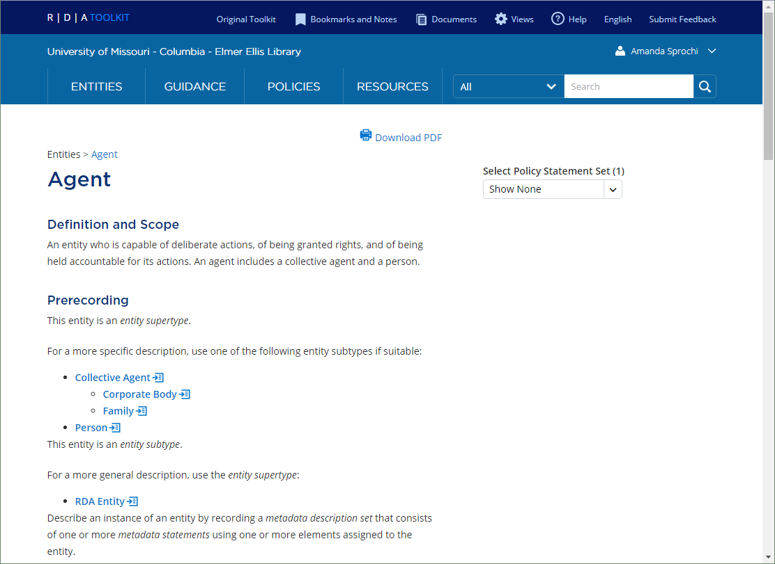

Slide 35
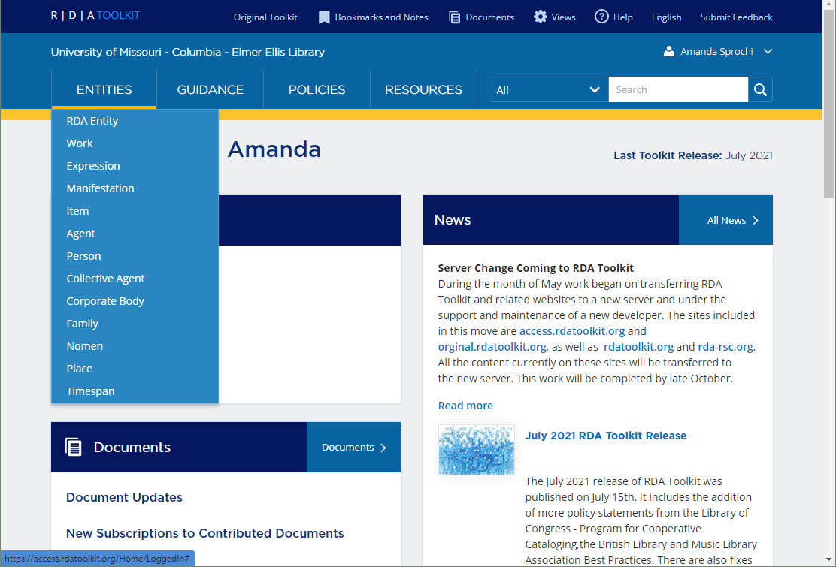

Slide 36
RDA Entity
Top level entity in RDA, replaces “Res” in the LRM
“An abstract class of key conceptual objects in the universe of human discourse that are a focus of interest to users of RDA metadata in a system for resource discovery. An RDA entity includes an agent, collective agent, corporate body, expression, family, item, manifestation, nomen, person, place, timespan, and work.”
RDA Entity only includes things that are RDA entities
Some things like non-human personages and animals, gods, angels, and others are treated as either:
Pseudonyms, or
An entity external to RDA
External entities can be related to an RDA Entity by using the element “related entity of [RDA Entity]”
Subjects are out of scope for RDA
Subject element can be used to relate a topic to an RDA entity
All other twelve RDA entities are subtypes (subclasses) of RDA Entity

Slide 37
RDA Entity Hierarchy
Top Level | Second Level | Third Level | Fourth Level
RDA Entity
-- | RDA Entity Work
-- | RDA Entity Expression
-- | RDA Entity Manifestation
-- | RDA Entity Item
-- | RDA Entity Agent
-- | -- | RDA Entity Person
-- | -- | RDA Entity Collective Agent
-- | -- | -- | RDA Entity Corporate Body
-- | -- | -- | RDA Entity Family
-- | RDA Entity Nomen
-- | RDA Entity Place
-- | RDA Entity Timespan

Slide 38
Nomen
New RDA entity
Useful for authority control and managing identities
Nomen means “name” but goes further; a nomen can be a name, a title, an access point, a URI, an identifier, or anything else used to identify an entity
Nomen is also an entity in itself, so nomen can have relationships with other nomen and other RDA entities
The “nomen string” is the attribute that describes a nomen
It can be any combination of letters, symbols, numbers, characters, signs, etc.
The same nomen string can refer to different nomens
nomen string “Paul Simon”= former Illinois senator
nomen string “Paul Simon”= singer/songwriter
Appellation elements relate a nomen to an RDA entity

Slide 39
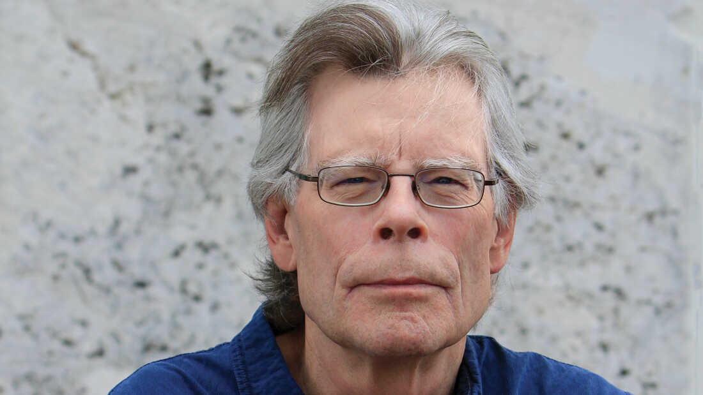
Nomen string
Nomen A
Stephen King
is appellation of
Nomen B
Stephen Edwin King
is appellation of
Nomen C
King, Stephen, 1947-
is appellation of
is appellation of
Nomen D
Кинг, С., 1947-
is appellation of
Nomen E
ינג, סטיפן, 1947- (nomen string)
[Guy who is the author of Carrie, The Stand, Rita Hayworth and the Shawshank Redemption, Stand by Me, etc.]
Nomens can have their own attributes
Hebrew (script of nomen)
Hebrew (language of nomen)
Horror fiction (nomen context of use)

Slide 40
Nomen appellations
Relationship elements that link nomen to nomen strings are called appellation elements
Top level relationship is appellation of [RDA entity]
Sub-elements include
Access point for [entity]
Authorized access point for [entity]
Identifier for [entity]
Name of [entity]
Preferred name of [entity]
Preferred title of [entity]
Title of [entity]
Variant access point for [entity]
Variant name of [entity]
Variant title of [entity]

Slide 41
Place and timespan entities
Place is defined by RDA as “a given extent of space”
Timespan is “a finite period of time”
Hypen was removed to make searching in the toolkit easier
Timespan can have a preferred name that is a specific date, a name, like the Renaissance, or a year
In the old toolkit, timespan was an attribute of an entity; now it’s an entity so timespan is related to another entity by a relationship
Person: Helen Stocker
Has date of birth 1869
Relationship element
Timespan

Slide 42
RDA elements
RDA is a metadata element set (more than 3000!)
Each element is unique
Each element can describe only one entity
Each element has one or more alternate labels
An “element” in RDA carries information about the entity
Can be a characteristic, attribute, or relationship
Organized by entity
Each element in RDA has its own page
Element Domain: the RDA entity described by an element
Element Range: the RDA entity that is the value of the relationship element
If the element is an attribute, it only has a domain
Notes:
Recording data in defined, unambiguous elements has been a key feature of RDA since it was first introduced. These elements are precisely defined, they do not overlap, each element contains only a single type of data, and the instructions for many of these elements recommend the use of a controlled vocabulary, now called a vocabulary encoding scheme. Each element is defined at a fairly granular or fine-grained level, so that it is clear what kind of data is recorded in that element. The granularity of the elements and their precise scope and definition reduces ambiguity and increases reliability when navigating through large collections of bibliographic data.

Slide 43
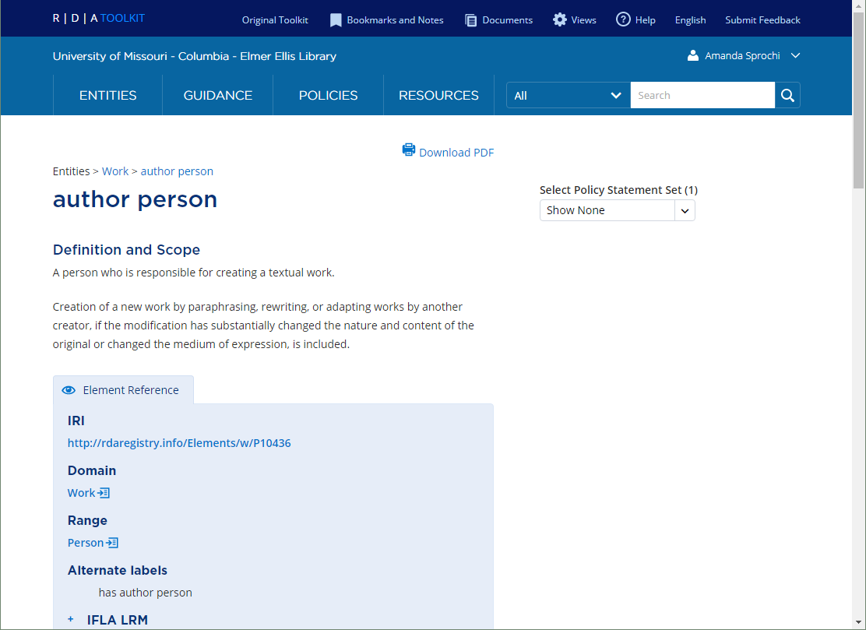

Slide 44
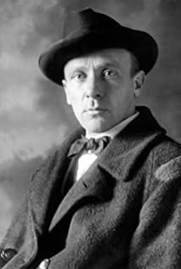
Domain: Work
Relationship element
Range: Person
Author person
The Master and Margarita
Bulgakov, Mikhail, ǂd 1891-1940

Slide 45
Domain: Person
Attribute element
Profession
Writer
Bulgakov, Mikhail, ǂd 1891-1940
“Writer” is a description not a relationship, so there is no range

Slide 46
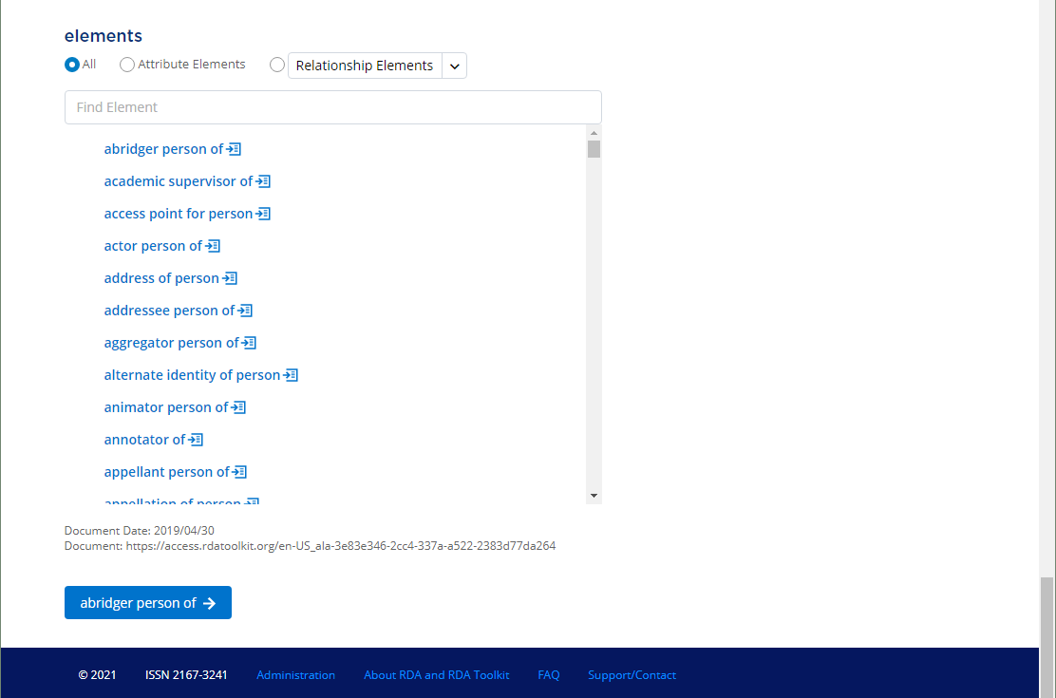
All possible elements for an entity are listed at the bottom of the entity page

Slide 47
Some new important elements
Manifestation statement
“A statement appearing in a manifestation and deemed to be significant for users to understand how the manifestation represents itself.”
Transcribed from the manifestation using basic (new) or normalized transcription (current RDA)
Why?
For machine transcription from digital or born digital materials
“Good enough” descriptions for stuff that needs to be discoverable quickly
For early printed resources
From Glennan, Kathy (2018). Recording methods, transcription, and manifestation statements. http://www.rda-rsc.org/sites/all/files/Recording%20methods%20etc-EN.pdf

Slide 48
Example:
Manifestation title and responsibility statement:
Terry Pratchett WYRd SiStErS A Novel of Discworld®
Manifestation publication statement:
HARPER An Imprint of HarperCollinsPublishers
Full manifestation statement for the title page:
Terry Pratchett WYRd SiStErS A Novel of Discworld®\\HARPER An Imprint of HarperCollinsPublishers
The Toolkit gives guidance on transcription in the “Transcription guidelines” section under “Guidance”
Problem: basic transcription in MARC is limited to subelements; there’s no place to put a manifestation statement for the whole title page
245 10 WYRd SiStErS : $b A Novel of Discworld® / $c Terry Pratchett
NOT
245 10 Terry Pratchett WYRd SiStErS A Novel of Discworld®
From Maxwell, Robert L. (2019). Representative expressions and manifestation statements. RDA New Concepts Series. https://www.slideshare.net/ALAeLearningSolutions/new-concepts-representative-expressions-and-manifestation-statements

Slide 49
Representative Expression
In current RDA, language or content type are expression elements
In new flavor RDA, intended audience is an expression element

Slide 50
Representative expression
Introduced in LRM
Attribute of work “representative expression attribute”
“A representative expression provides the values of specific elements used to identify a work and distinguish it from other works.
The IFLA library reference model treats as equal all expressions that realize a work. However, certain characteristics of an expression are considered to best represent the intention of the creators of the work. A representative expression that has these characteristics may be assumed to be an original or canonical realization of the work.”
Think of it as the “original expression” of a work
Musical piece in original key with original orchestration
Novel in its original language
Map in its original projection
Can be more than one Representative expression

Slide 51
Expressed as a relationship
Subject (domain) Predicate (relationship) Object (Range)
Work has representative expression Expression
Alice in Wonderland has representative expression 1865 language text
Hypothetical authorized access point for the 1865 English expression
From Maxwell, Robert L. (2019). Representative expressions and manifestation statements. RDA New Concepts Series. https://www.slideshare.net/ALAeLearningSolutions/new-concepts-representative-expressions-and-manifestation-statements

Slide 52
From Maxwell, Robert L. (2019). Representative expressions and manifestation statements. RDA New Concepts Series. https://www.slideshare.net/ALAeLearningSolutions/new-concepts-representative-expressions-and-manifestation-statements

Slide 53
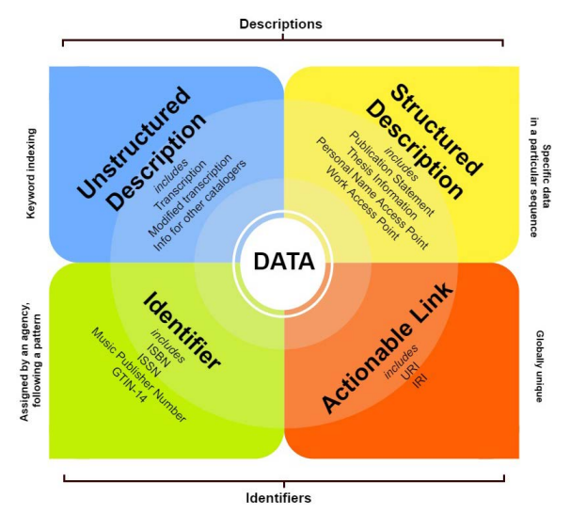
Recording entities and elements: the Four-Fold Path
Basically, RDA says there are four ways you can record data
Every element explains how to apply and record it
Permissible to use more than one method if “applicable and desired”
From Glennan, Kathy (2017). RDA Toolkit 3R project: incorporating the 4-fold path. http://www.rda-rsc.org/sites/all/files/Glennan%203R-4fold%20path.pdf

Slide 54
Why?
To support different databases and implementations
Flat files, including card catalogs
Linked authorized access points, for example between authority and bib records
Relational or object databases
Linked data (fully linked at a global level)

Slide 55
Unstructured description
Transcribed statements from a manifestation (includes title page!), notes, quotes, etc.
If it identifies an RDA entity it’s also a nomen for that entity
Only path that includes transcription
Can be mechanically captured
Can be transcribed using rules or conventions
Capitalization rules
Punctuation
Text for symbols
Typographic conventions
Examples:
Includes bibliographical references and index.
Harry Potter and the goblet of fire
Staff notation.

Slide 56
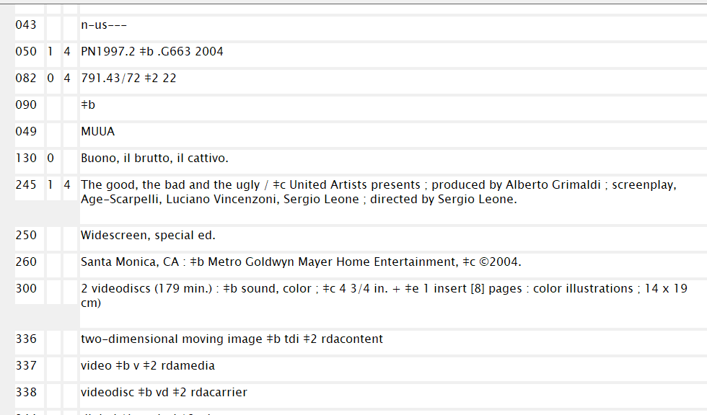
Modified transcription: capitalization and punctuation changes

Slide 57
Structured description
Structured descriptions include access points, structured notes, names taken from an authority control system, a term from a controlled vocabulary, or a value from a structured data type, including numbers, dates, and times
A structured description of an RDA entity is a kind of nomen
A structured description can be associated with a string encoding stream (SES) or a vocabulary encoding scheme (VES)
Examples:
Lawson, Jenny, 1973- (VES source LCNAF)
two-dimensional moving image (VES rdacontent)
2021-09-14 (VED edtf)

Slide 58
Identifiers
Label assigned by an agency to help with identification
Agency can be local or external
Associated with a VES
If it identifies an RDA entity it’s also a nomen for that entity
Examples:
9780231096768 (VES ISBN)
n 2011086820 (VES source LCNAF)
0000 0004 3416 760X (VES source ISNI)
B0001682-02 (VES source Decca Records)

Slide 59
IRIs
A globally unique identifier designed for the semantic web and machine applications
Meant for machine parsing, not really for people
IRIs are not considered a nomen, because the nomen string is an RDF literal
Examples:
http://id.loc.gov/authorities/names/n2011086820
(LCNAF authority file entry for Jenny Lawson)
http://id.loc.gov/authorities/performanceMediums/mp2013015507
(LCMPT IRI for oboe)
http://id.loc.gov/vocabulary/languages/eng
(MARC List of languages for English)

Slide 60
How this works:
Linked data
http://rdaregistry.info/Elements/a/P50541
http://id.loc.gov/authorities/names/n2011086820
https://openlibrary.org/works/OL20840532W/Broken
RDA registry [author person of]
Lawson, Jenny, 1973-
Broken [title] OpenLibrary

Slide 61
Aggregates, i.e. serials (oy vey!)
Very very messy in RDA
What is an aggregate?
“An aggregate is a manifestation that embodies an aggregating expression and one or more expressions that are aggregated. The expressions that are aggregated may realize one or more works.
An aggregate embodies one and only one aggregating expression.
An aggregate may be issued in one or more units.”
Totally clear, right?

Slide 62
Aggregates
Three kinds:
collection aggregate
augmentation aggregate
parallel aggregate
Collection aggregate
A collection aggregate is a manifestation that embodies two or more independent expressions of two or more independent works
Examples:
compilation of short stories
an album of folk songs
an anthology of poems
a periodical with multiple issues, AND an issue of a periodical with multiple articles

Slide 63
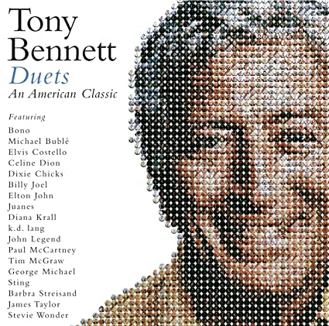
Collection Aggregates

Slide 64
Augmentation aggregate
An augmentation aggregate is a manifestation that embodies two or more expressions of two or more works, where one work is supplemented by one or more other works.
Each expression of an augmenting work supplements the expression of the augmented work without affecting its integrity or changing its content.
Examples:
Novel with a foreward, illustrations, and index
CD with a software program and an accompanying book
DVD with a film and bonus material
Urtext of a musical symphony with preface and commentary

Slide 65
Parallel aggregate
“A parallel aggregate is a manifestation that embodies two or more expressions of a single work.”
Examples:
Bilingual government documents
CD product manual with multiple languages
Website in multiple languages
Books in original language with translation

Slide 66
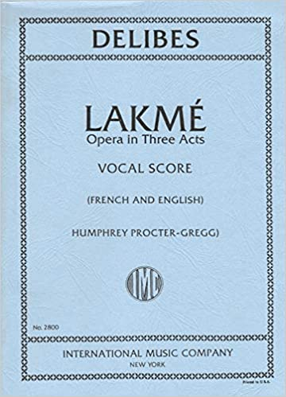
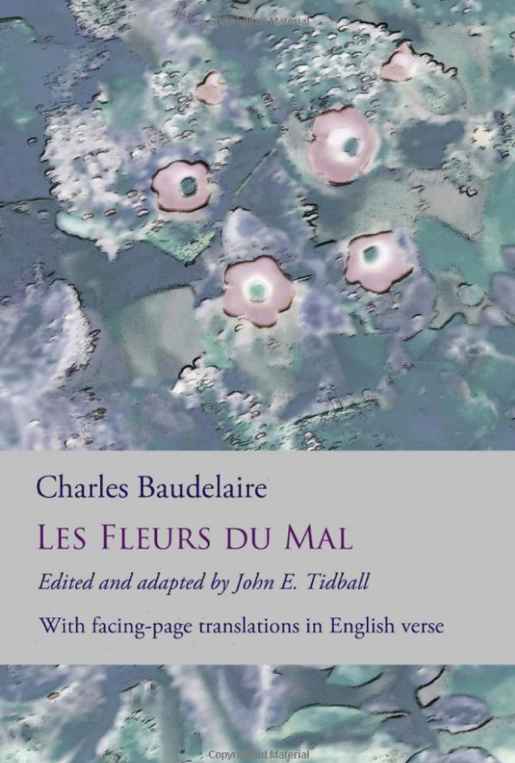
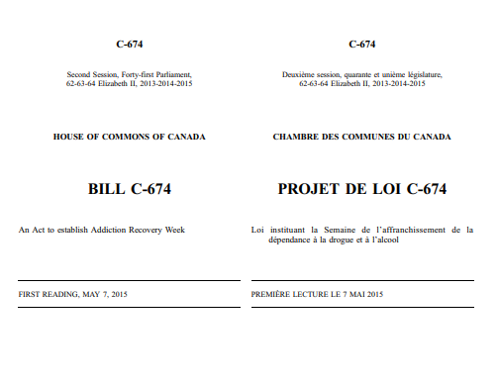
Parallel Aggregates

Slide 67
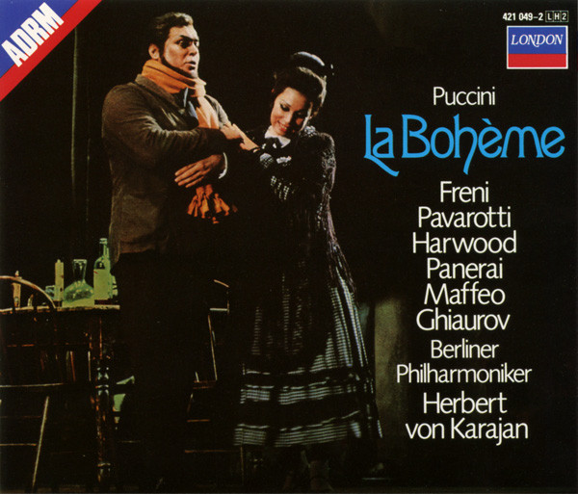
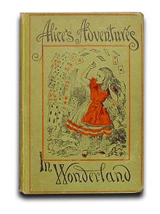
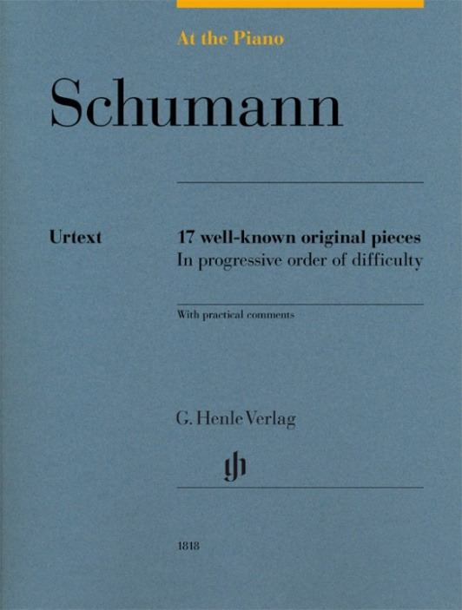
Augmentation Aggregates

Slide 68
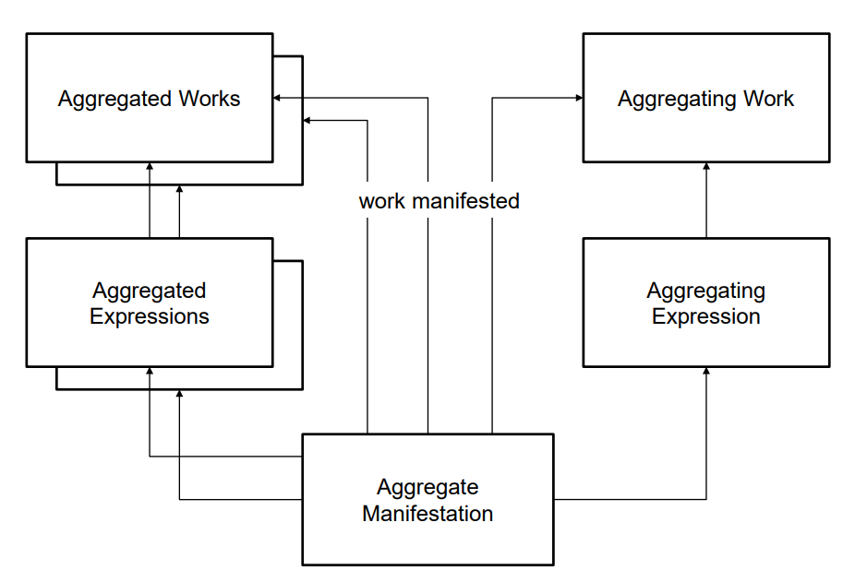
From Iseminger, Damien (2019). Aggregates in the IFLA Library Reference Model and RDA. http://www.rda-rsc.org/sites/all/files/Aggregates%20Iseminger%20PCC%20OpCo.pdf

Slide 69
Some things to remember!
Aggregates the LRM/RDA model are NOT whole/part relationships
Do not describe it using part/part of or contains/contained in relationships
Use a generic high level relationship
Related work of work
Related expression of expression
In reality, in a MARC environment there probably won’t be much change in current cataloging practices
Most policies will remain the same for
assignment of access points, for single works, for single works with augmenting content, and compilations Added entries for agents
Analytical added entries
Notes for describing content
Changes mostly affect which RDA elements to use
From Iseminger, Damien (2019). Aggregates in the IFLA Library Reference Model and RDA. http://www.rda-rsc.org/sites/all/files/Aggregates%20Iseminger%20PCC%20OpCo.pdf

Slide 70
Example
130 Out of bounds (Harvard University Department of Music)
245 00 Out of bounds : $b ethnography, history, music / $c edited by Ingrid T. Monson, Carol J. Oja, Richard K. Wolf.
…
505 0 Interrogating the dead : an ethnography of eighteenth-century London / Ellen T. Harris -- Performing ethnography out of bounds : an essay on transmission failure / Tomie Hahn …
700 1 Monson, Ingrid T. $q (Ingrid Tolia), $e editor
700 12 $i Container of (work): $a Harris, Ellen T. Interrogating the dead.
Current Treatment
Potential new treatment under RDA
130 Out of bounds (Harvard University Department of Music)
…
505 0 Interrogating the dead : an ethnography of eighteenth-century London / Ellen T. Harris -- Performing ethnography out of bounds : an essay on transmission failure / Tomie Hahn …
700 1 Monson, Ingrid T. $q (Ingrid Tolia), $e aggregator person, $e contributor person of text
700 12 $i Work manifested: $a Harris, Ellen T. Interrogating the dead. [RDA]
or
700 12 $i Related work of work: $a Harris, Ellen T. Interrogating the dead. [LC/PCC]
From Iseminger, Damien (2019). Aggregates in the IFLA Library Reference Model and RDA. http://www.rda-rsc.org/sites/all/files/Aggregates%20Iseminger%20PCC%20OpCo.pdf

Slide 71
Fictitious, pseudonymous, and non-human personages
In LRM, all agents (entities involved in the creation of bibliographic things of interest) have to be real people “who have lived or who are assumed to have lived”
Problem: what to do with books purported to be written by animals or non-human personages?
What do we do with animal actors and performers?
How do we treat works by spirits, angels, gods, or other non-human entities?
As catalogers we still want to record these things as access points for our users

Slide 72
LRM and non humans
Res has association with Res
Res is subject of Work
Res has appellation Nomen
Koko the Gorilla (res) has association with film Koko: the gorilla that talks (res)
Koko the Gorilla (res) has appellation Koko (Gorilla) 1971- (nomen)
Since RDA did not implement Res, LRM approach does not work for RDA
RDA Entity is all other entities defined in RDA
Nomen is a designation that refers to an RDA Entity
Non-human personages are NOT included in RDA Entity
Non-human personages do not have relationships to Nomen in RDA
RDA calls these “Fictitious and non-human appellations”

Slide 73
Non-human personages as “agents”
Two main types of non-human personages in agent-type roles
Clear use of a non-human/fictitious personage as a pseudonym for a “real” person
Non-humans performing in an agent-like capacity
Animals performing in film, television, stage shows, etc.
Animal communication (blue whale and bird song, Koko the gorilla’s ASL)
Spirits, angels, gods etc. acting as creators of works

Slide 74
Non-human personages as pseudonyms
Non-humans clearly acting as pseudonyms, treat as pseudonyms
No qualitative difference between a person using a “person-like” pseudonym vs. a “non-human” pseudonym
Geronimo Stilton is a pseudonym for (probably) Elisabetta Dami
Richard Bachman is a pseudonym for Stephen King
Millie is a pseudonym for Barbara Bush

Slide 75
Pseudonym: real agent known
Geronimo Stilton pseudonym of ? (perhaps Elisabetta Dami)
record the author (person/agent) as Elisabetta Dami, and relate the pseudonym Geronimo Stilton to her in her authority record, or
record Geronimo Stilton as the author (person/agent) with his own authority record and relate the appellations of Geronimo Stilton and Elisabetta Dami to each other using the appropriate relationships, in this case “real identity of person” and “real identity of person of”

Slide 76
Pseudonym: real agent unknown
Kermit the Frog pseudonym for ?
(unknown human creator(s))
record the fictitious entity using an unstructured or structured (access point) description
relate the entity to the resource using an appropriate relationship (creator agent of work, author person, etc.)

Slide 77
Animal and non-human creators/performers
Non-human/animal creators/performers present a special case
They CANNOT be agents under LRM/RDA, BUT
They are also clearly not pseudonyms of a “real” person in an agent capacity
They DO perform tasks and roles that we would normally attribute to an agent
RDA treats these as “non-RDA entities” in the same way subjects are non-RDA entities; that is, they are outside the scope of RDA but can be related to resources using the “related entity” relationship

Slide 78
700 0 ǂi Related entity of work: ǂa Koko ǂc (Gorilla), ǂd 1971-

Slide 79
Other slippery non-human type things
Figures like gods, angels, spirits, legendary characters and the like may not clearly fall into one of these two categories
Whether or not a non-human personage is seen as a pseudonym for a “real” person or not will eventually have to be determined by the cataloging agenc(ies) maintaining authority files
Different culture groups may have differing opinions on what constitutes “real” and/or “living or may have lived”
RDA is deliberately non-directive to accommodate these views

Slide 80
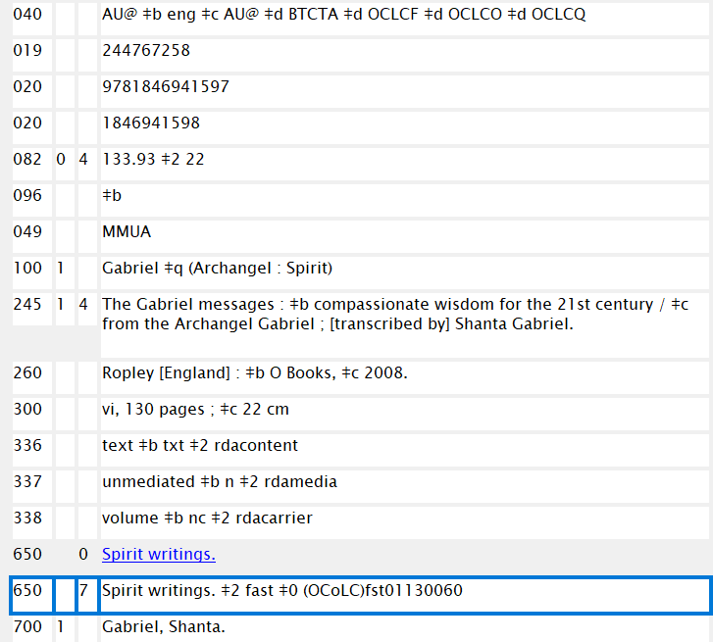
700 0 ǂi Related entity of work: ǂa Gabriel ǂc (Archangel : Spirit)

Slide 81
Implications for the LC/NAF
Name authority records for non-human personages cannot be coded “rda”
Non-human personages cannot have Agent relationships to Works, Expressions, etc.
Instructions for identification of non-human personages cannot come from RDA or LC-PCC PSs
LC has some ideas BUT has made no firm decisions or policies on it
Keep existing NARs in LC/NAF and allow new NARS for individual non-human personages as needed
Keep fictitious groups and places in LCSH
New LC manual of instructions for constructing heading for non-human personages
New MARC description convention source code for 040 $e and 075 $2

Slide 82
Other news
Appendices have been moved to Community Resources
This is an area for particular language communities to add information that is pertinent to them but not appropriate for RDA in general
If you use workflows in the Original Toolkit, editing and adding new ones will be ending around September 1
LC is working on an application profile for RDA, but it is not expected that LC will change to using the new toolkit for record creation until at least October ’22
All policy statements in the new toolkit should be considered drafts

Slide 83
So now what?

Slide 84
DON’T PANIC!

Slide 85
The new RDA toolkit is not currently being used for cataloging in any official capacity
LC isn’t switching over until at least October of 2022, and maybe later
Until application profiles are written for cataloging communities the toolkit isn’t really useable as is
You have time to explore and investigate the toolkit now before the switchover next year (or later!)
Tools, reference, and guidance is already being written to help people make the transition
NARDAC (North American RDA Committee) is already working on more user-friendly wording and labelling for elements, etc.

Slide 86
What you can do now
Get to know the RDA entities. Make them your friends. Love them and cherish them
Get to know the RDA elements that describe the entities
List of applicable elements for each entity are at the bottom of each entity page
Also searchable by element
Understand the distinction between attribute and relationship elements (hint: relationships have a domain and range, attributes only have a domain)
Check out the element reference and look at the mapping to MARC21, Dublin Core and the LRM
Get to know Guidance
Often referenced from instructions
Get to know Policies
Draft LC-PCC and British Library policies can be found on some instructions
Music Library Association and other best practices will go here as well eventually
Links from policies to element pages helps with navigation
Get to know Resources
Glennan, Kathy (20). The new RDA toolkit: how did we get here, and what do we do next? http://www.rda-rsc.org/sites/all/files/Glennan%20RDA%20Past-Future%20-%20MLA%202021.pdf

Slide 88
Many, many thanks to my colleagues on the RSC+ Plus project, from whom I have shamelessly borrowed slides and materials: Kathy Glennan, Gordon Dunsire, Kate James, Damien Iseminger, and Dominque Bourassa.

Slide 89
References
Denton, William. “FRBR and the History of Cataloging,” in Understanding FRBR: What It Is and How It Will Affect Our Retrieval Tools, edited by Arlene G. Taylor, 35-57. Westport: Greenwood Publishing Group, 2007.
Panizzi, Antonio. “Rules for the Compilation of the Catalogue.” In The Catalogue of Printed Books in the British Museum. London: Printed by order of the Trustees, 1841.
Gorman, Michael. “Let Us Now Praise-- a Reflective Look at Six Persons Who Greatly Influenced the Art of Cataloging.” American Libraries, April (1980): 201-203
Ranganathan, S. R. (Shiyali Ramamrita). The Five Laws of Library Science. Madras: The Madras Library Association. 1931. https://catalog.hathitrust.org/Record/001661182
Zou, Xiaozhu & Xiong, Siyi & Li, Zhi & Jiang, Ping. “Constructing Metadata Schema of Scientific and Technical Report Based on FRBR.” Computer and Information Science. 11,2 (2018) 34-39. http://dx.doi.org/10.5539/cis.v11n2p34
Statement of principles: adopted by the International Congress on Cataloguing Principles, Paris, 1961. Kent, England: I.F.L.A. Secretariat. https://www.ifla.org/wp-content/uploads/2019/05/assets/cataloguing/IMEICC/IMEICC1/statement_principles_paris_1961.pdf
Lubetzky, Seymour “Cataloging Rules and Principles.” In Seymour Lubetzky: Writings on the Classical Art of Cataloging, edited by Elaine Svenonius and Dorothy McGarry. 78-139. Englewood, Colorado: Libraries Unlimited, 2001.

Slide 90
Maxwell, Robert L. “Representative Expressions and Manifestation Statements.” Webinar from ALA, RDA New Concepts Series, Chicago, IL, July 24, 2019. https://www.slideshare.net/ALAeLearningSolutions/new-concepts-representative-expressions-and-manifestation-statements
Maxwell, Robert L. “Nomens and appellations.” RDA New Concepts Series. Webinar from ALA, RDA New Concepts Series, July 17, 2019. https://www.slideshare.net/ALAeLearningSolutions/new-concepts-nomens-and-appellations
Tillett, Barbara B. “AACR3: Resource Description and Access.” Paper presented at the ALA Annual Conference, Orlando, FL, June 2004. https://www.ala.org/alcts/sites/ala.org.alcts/files/content/events/pastala/annual/04/tillettch12.pdf
Glennan, Kathy. “RDA Toolkit 3R Project: Incorporating the 4-Fold Path.” Paper presented at ALCTS Exchange (Online), May 9, 2017. http://www.rda-rsc.org/sites/all/files/Glennan%203R-4fold%20path.pdf
Iseminger, Damien. Aggregates in the IFLA Library Reference Model and RDA. Paper presented at the PCC Operations Committee Meeting, May 14, 2019. http://www.rda-rsc.org/sites/all/files/Aggregates%20Iseminger%20PCC%20OpCo.pdf
Jones, Ed. “Aggregates and Diachronic Works.” Webinar from ALA, RDA Special Topics Series, July 30, 2019. https://www.slideshare.net/ALAeLearningSolutions/special-topics-aggregates-and-diachronic-works

Slide 91
James, Kate. “Non-Human Personages and the New RDA: Considerations for the LC/NACO Authority File.” Paper presented at the ALA Annual Meeting, Washington, D.C., June 24, 2019. http://alcts.ala.org/ccdablog/wp-content/uploads/2019/09/LOC-James-2019.pdf
RDA Toolkit YouTube Channel. https://www.youtube.com/channel/UCd5pa3AoQIr17wESE9YHcnw
James, Kate. RDA Concepts Video Series. https://www.youtube.com/results?search_query=rda+concepts+rda+toolkit
Glennan, Kathy. “The New RDA toolkit: How Did We Get Here, and What Do We Do Next?” Paper presented at the Joint Meeting of the Music Library Association and the Theatre Library Association, Cataloging and Metadata Town Hall (Online), March 2, 2021. http://www.rda-rsc.org/sites/all/files/Glennan%20RDA%20Past-Future%20-%20MLA%202021.pdf
Bourassa, Dominique. “A Quickstart Guide to RDA Terminology: Elements, SES, and VES.” Paper presented at the ALA Midwinter Meeting, Philadelphia, Pennsylvania, January 24, 2020. https://www.rdatoolkit.org/sites/default/files/2020-01/ALA-Midwinter-Preconference-Bourassa.pdf
James, Kate. “RDA Beta Toolkit Basics.” Paper presented at the ALA Midwinter Meeting, Philadelphia, Pennsylvania, January 24, 2020. https://www.rdatoolkit.org/sites/default/files/2020-01/RDA%20Beta%20Toolkit%20Basics%20Midwinter%202020_final.pdf
Moody, Honor. “New Concepts in the Beta Toolkit.” Paper presented at the ALA Midwinter Meeting, Philadelphia, Pennsylvania, January 24, 2020. https://www.rdatoolkit.org/sites/default/files/2020-01/ALAMW2020%20New%20Concepts.pdf

Slide 92
Glennan, Kathy. “RDA Toolkit Workshop: a Crash Course.” Preconference workshop presented at the ALA Midwinter Meeting, Philadelphia, Pennsylvania, January 24, 2020. https://www.rdatoolkit.org/RDAWorkshop_1.20
PCC Standing Committee on Training. Preparing for the new RDA: RDA Toolkit Restructure and Redesign Project (3R Project). https://www.loc.gov/catworkshop/RDA2020/index.html
RSC website. http://www.rda-rsc.org/
IFLA Study Group on the Functional Requirements for Bibliographic Records. Functional Requirements for Bibliographic Records: Final Report. München: K.G. Saur, 1998.
Tillett, Barbara B. “IFLA Study on the Functional Requirements of Bibliographic Records: Theoretical and Practical Foundations.” In 60th IFLA General Conference Proceedings, August 21-27, 1994. http://archive.ifla.org/IV/ifla60/60-tilb.htm
Seminar on Bibliographic Records: Proceedings of the Seminar Held in Stockholm, 15-16 August 1990. Edited by Ross Bourne. München: Saur, 1992.
IFLA Working Group on Functional Requirements and Numbering of Authority Records (FRANAR). Functional Requirements for Authority Data. The Hague: International Federation of Library Associations and Institutions, 2013. https://www.ifla.org/files/assets/cataloguing/frad/frad_2013.pdf

Slide 93
Riva, Pat, Patrick Le Bœuf, and Maja Žumer. IFLA Library Reference Model: A Conceptual Model for Bibliographic Information. The Hague: International Federation of Library Associations and Institutions, 2013. https://repository.ifla.org/bitstream/123456789/40/1/ifla-lrm-august-2017_rev201712.pdf
Oliver, Chris. Introducing RDA : a Guide to the Basics After 3R. Chicago: ALA Editions, 2021.
Sprochi, Amanda K. “RDA and Non-Human Personages.” RDA New Concepts Series. RDA New Concepts Series. Webinar from ALA, RDA New Concepts Series, July 31, 2019. https://www.slideshare.net/ALAeLearningSolutions/new-concepts-fictitious-and-nonhuman-personages

Slide 94
Questions?
Contact me:
Amanda Sprochi
University of Missouri
sprochia@missouri.edu

