Slide 1
Metadata Application
Profiles (MAP):
Your RoadMAP for Digital Collection Metadata Creation

Slide 2
What is a Metadata Application Profile…
A document that specifies and describes the metadata used in a particular application
Provide specific definitions of metadata elements according to the needs of the creating organization

Slide 3
…And Why Should You Have One?
Ensures all relevant data is included
Ensures consistency in the creation and application of metadata
Creates a logical roadmap behind the creation of metadata
Helps in mapping and crosswalking between metadata schemes

Slide 4
What’s in a MAP?
In a nutshell: a list of the data elements you need to describe your collection
Goal: provide a guidelines for your data, covering:
How it maps to your metadata scheme
If it’s required and/or repeatable
Free text vs. controlled vocabulary
Source of information
Guidelines for input
Rationale for inclusion

Slide 5
Where
To
Start?

Slide 6
Before You Get Too Far
What are the capabilities of your system, both for the front end and the back end?
What metadata scheme(s) are you using?
How is your metadata being created?

Slide 7
Examples!
Metadata Application Profile for Wheaton College (Ill.)
See the resulting metadata live in our digital collections!

Slide 8
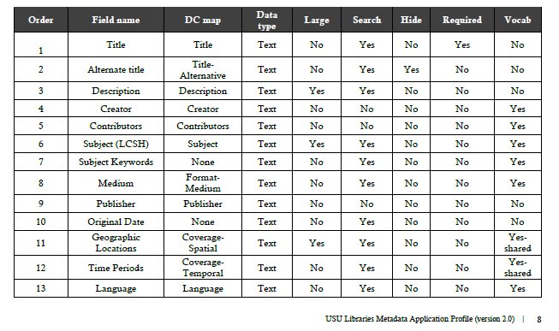
Examples!
https://digitalcommons.usu.edu/lib_pubs/308/

Slide 9
Navigating with
MAPs
A Closer Look at what to include in your MAP

Slide 10
Step 1: Natural Language Data
Start with your list of data elements in Natural Language
What would you name these elements so that your end users know what the data point is?
What elements do your end users need?
What elements do your staff need?
Deciding on your data elements

Slide 11
Step 2: MAP to your Scheme
Decide what element in your metadata scheme best fits with this data point
Consult the definitions and scope notes provided by the schema
Look at examples from other libraries
Crosswalking
Include mapping to all schemes that will be used

Slide 12
Step 3: Field Requirements
Is this field required, required if applicable, or optional?
If a field is truly optional, do you need to include it?
Is this field repeatable?
Does the data in this field need to be in a certain form?
Is this field public or private?
Is this field searchable or faceted?

Slide 13
Step 3a: Data Form
Free text or use a controlled vocabulary?
Will it help patrons search your collections if the field has a controlled value?
Is there a vocabulary that fits your need for this data?
What does your metadata scheme recommend/require?
Identify which vocabulary you used within the metadata?

Slide 14
Step 3a: Data Form
Subject strings
Full strings vs. individual terms
Naming conventions
Filenames
Identifiers
Standard phrasing or options decided at the local level

Slide 15
Step 4: Guidelines
Include information on how and why to include the data you’ve chosen
Is there a rationale for including this data point (consider future users!)
Content input
Use this information to help new metadata creators understand the field
Source of information
Should the metadata creator expect to find this data point somewhere, and if not, how do they create the data?

Slide 16
Tips for Success

Slide 17
Tip: Consider the End Users
Who is using your collection, and what are they using it for?
Is there metadata you can include to facilitate these needs and searching behaviors?
How can you help patrons explore your collection? Can you construct your data to help them discover related and/or similar resources?

Slide 18
Tip: Consider the MAP Users
How can you help ensure your MAP provides helpful guidelines for future metadata creators?
For experienced metadata professionals?
For volunteers?
For new librarians?
For librarians unfamiliar with your collections?
For librarians unfamiliar with digital metadata?

Slide 19
Tip: Be Practical
Practical over theoretical metadata
Make your elements justify their existence
Don’t overwhelm your users with data, especially on the front end
Avoid data repetition between fields
Include notes so that when it comes time to tweak and revise your MAP, you can follow the logic

Slide 20
Tip: Context is Important
Courtesy of the Library of Congress Prints & Photographs Division
Accessed via Wikimedia Commons: https://lccn.loc.gov/2013651303
Avoid the “On a Horse” approach to metadata creation
Remember that metadata is often shared/harvested
Preserve the context of your objects independent of their collections

Slide 21
Tip: Remember the 1 to 1 Principle
What is your data describing, the original resource or the digital version?
How does your metadata make this distinction clear?
Are there fields that need to be repeated to be inclusive of both versions?

Slide 22
Take-
Aways
What to remember to create
a successful MAP

Slide 23
Keys to Success
Know your system. What can it handle? What can’t it handle? Consider the future, but don’t create metadata based on features you wish your system had, but instead work with what you do have.
Know your patrons. How will they expect to search and encounter your assets, and how can the metadata you create help them do it?
Know your assets. What is the value of your collection(s) to your patrons and to the research community? How can you create data that will market and highlight this value?
Know your scheme. If you can, choose a metadata scheme that will best show the data you think is essential in a way that will be easy for your patrons to understand. If you can’t choose, make sure that you have a good understanding of the elements in your scheme so you can MAP your data to its best advantage.

Slide 24
Questions?
I’m happy to do my best and answer any questions you might have about:
digital metadata or
metadata application profiles!
Feel free to drop me an e-mail at jill.walker@wheaton.edu

